Slide 1
Leaf Botany and Plant Cell Biology
By C. Kohn, Waterford, WI
Materials based on “Botany Basics” by Ann Marie VanDerZanden, OSU

Slide 2
Leaf Function
The main function of leaves is to absorb sunlight and use this energy to produce sugars
  This is the process of photosynthesis
  Photosynthesis is the creation of sugar from carbon dioxide and water using the energy of the sun
Leaves are usually flat so that they can absorb the maximum amount of light as efficiently as possible.

Slide 3
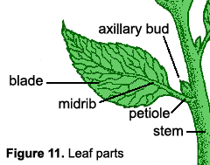
Leaf Anatomy
A leaf is connected to
the stem by a structure
called the petiole.
  The base of the stem where the petiole connects is called the node
  Where the petiole connects to the leaf is called the axil
  The axil is where we happen to find buds, clusters, and emerging leaves.

Slide 4
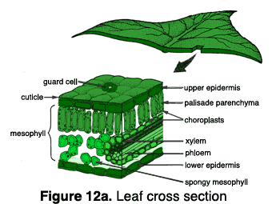
Cross section of a leaf
A leaf blade consists of several layers
The outer layer (top and bottom) is the epidermis
  Its main function is protection of the leaf

Slide 5
Epidermis
The epidermis layer can
be specialized
For example, some leaves have hairs for protection.
The cuticle is a part of the epidermis that produces cutin
  Cutin is a waxy layer that protects the plant from dehydration and disease.
  Increasing light intensity will increase the thickness of the cutin layer
  Hence the need for hardening off before moving plants

Slide 6
Cutin
Cutin also repels water
This can make some pesticides less effective unless they have additives to help them penetrate the cutin layer
  Without these additives, the insecticide would completely flow off of the plant

Slide 7
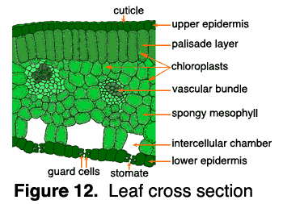
Guard Cells
Specialized epidermal
cells called guard cells are like valves to a leaf
  They can open and close in response to weather, light, and moisture
  They regulate the passage of water, oxygen, and carbon dioxide
The openings in guard cells are called stomata.
  Most stomata are found on the underside of leaves
Conditions that would cause a plant to lose water (high temp, low humidity) cause the guard cells to close, sealing off the stomata.
  Guard cells also close in absence of light

Slide 8
Mesophyll
The mesophyll layer is
found in the middle of the leaf
The mesophyll has two layers
  The dense upper layer is called the palisade layer
  The air-filled soft lower layer is called the spongy mesophyll
The mesophyll is important because this is where photosynthesis takes place

Slide 9
Review
Outer Layer –
Epidermis consisting of…
  Cuticle
  Guard Cells
  Stomata
Inner Layer – Mesophyll, consisting of…
  Palisade Layer
  Spongy Mesophyll
Epidermis = Protection
Mesophyll = Production

Slide 10
Types of modified leaves
Scale leaves (cataphylls) are found on rhizomes and buds, which they enclose and protect.
Seed leaves (cotyledons) are found on embryonic plants. They store food for the developing seedling.
Spines and tendrils, such as those found on barberry and pea plants, protect a plant or help support its stems.
Storage leaves, such as those on bulbous plants and succulents, store food.
Bracts often are brightly colored. For example, the showy structures on dogwoods and poinsettias are bracts, not petals.

Slide 11
Structure and Anatomy of Flowers
By C. Kohn, Waterford, WI
Materials based on “Botany Basics” by Ann Marie VanDerZanden, OSU

Slide 12
Overview of Flowers
The primary purpose of a flower is sexual reproduction
The color and fragrance of a flower is the result of adaptive strategies
  They are only pleasing to humans as a coincidence of evolution

Slide 13
Classification
Flowers, like leaves, are key to classification.
  This classification system, or Linnaean system, was developed by Linnaeus and is characterized by each species having a Latin genus and species name.
In flowers, the name is based on the flowers or other reproductive part of the plant
  This turned out to be a fortunate turn of events, as flowers are the part of the plant least affected by environmental factors
A knowledge of flowers is essential for anyone who will use plant ID as a part of their career.

Slide 14
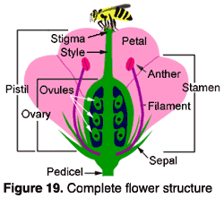
Flower Structure
The flower has both male and female organs.
The male organ is the stamen
The female organ is the pistil, but may also include the sepals, petals, and nectar glands.

Slide 15
The Stamen
The stamen is the male reproductive organ
The stamen consists of the anther (pollen sac) and a long, supporting filament
The filament holds the anther in position, making it more available for birds, bees, or the wind to carry pollen away

Slide 16
The Pistil
The pistil is the female part of the plant
  It is generally shaped like a bowling pin and is usually located in the center of the flower
The pistil consists of a stigma, style, and ovary
  The stigma is located at the top and receives pollen
  The style serves as a ‘neck’ connecting the stigma to the pistil
  The ovary contains the eggs which reside in ovules
    If the egg is fertilized, the ovule becomes a seed.

Slide 18
Petals
Petals are typically the
colorful portion of the flower
  Collectively, the petals form the corolla
Below the petals are the protective leaf-like structures called the sepals
  Collectively, the sepals are called a calyx.

Slide 19
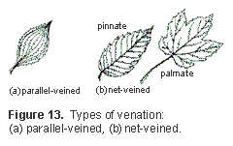
Petals & Leaves
Petals and leaves are useful in determining whether a plant is a monocot or a dicot
  Monocots have parallel veins and flower petals that come in three or mutliples of three
  Dicots have net-veined leaves and flower petals in fours or fives

Slide 20
Terminology
If a flower has a stamen, pistil, petals, and sepals, it is called a complete flower.
If one or more of these parts are missing, it is called an incomplete flower.
The male stamen and the female pistil are the most essential parts of the flower because they are involved in seed production
  If a flower has both functional stamens and pistils, it is called a perfect flower
  If either are lacking, it is imperfect

Slide 21
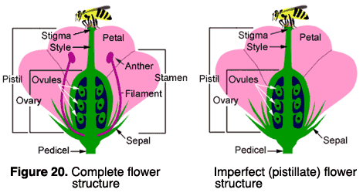

Slide 22
How Plants Reproduce
By C. Kohn, Waterford, WI
Materials based on “Botany Basics” by Ann Marie VanDerZanden, OSU

Slide 23
How Seeds Form
Pollination is the transfer of pollen from an anther to a stigma
A plant’s method of pollination can usually be determined by it’s color and odor
  Colorful, fragrant flowers are typically pollinated by animals or insects
  Wind-pollinated flowers tend to lack these traits

Slide 24
Fertilization
When pollen reaches the stigma of the pistil, the stigma will release a chemical signal
This chemical signal will cause the pollen to grow a long tube
This long tube will travel down the style to the ovules inside the ovary
When the pollen tube reaches the ovary, it releases sperm cells, at which point fertilization should occur.

Slide 25
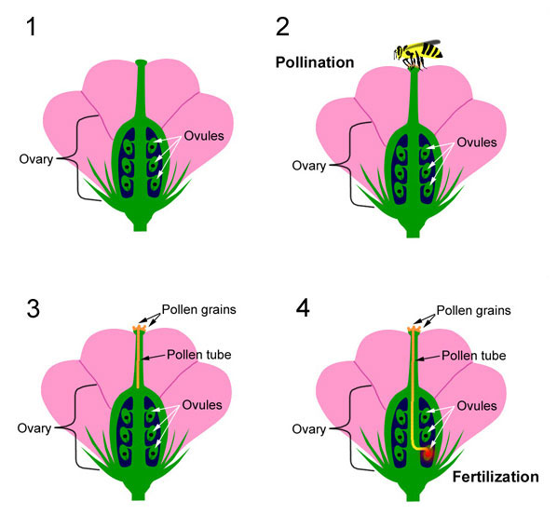
http://extension.oregonstate.edu/mg/botany/images/fertilization2.html

Slide 26
Fruits
Fruits consist of the fertilized, mature seeds (ovules) as well as the ovary wall.
The seeds contain genes from both the male and female parts of flowers
The flesh of the fruit is genetically identical to the female plant

Slide 27
Types of Fruit
Simple fruits arise from a single ovary
  Examples: apples, pears, tomatoes
  NOTE: a tomato is a fruit because it developed from a flower; vegetables are classified as coming from the roots, stems, or leaves of a plant
Aggregate fruits develop from a single flower with many ovaries
  Examples: strawberries, raspberries
Multiple fruits come from separate flowers with their own calyx and corolla on a single axil.

