Slide 1
Whole Body Growth

Slide 2
Objectives
Draw growth curves
Explain different changes in body measurements
Explain different changes is body components
Explain different changes in carcass components
Explain different changes in chemical composition

Slide 3
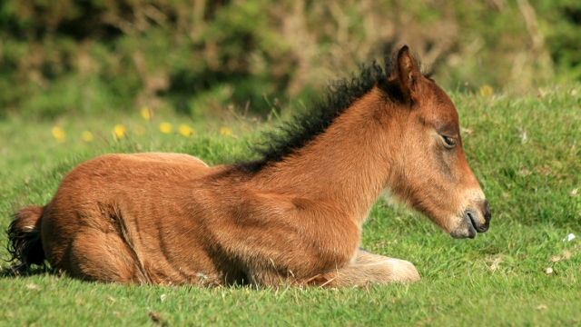
Video
Foal growth video

Slide 4
Growth Curves
Represents an increase in size relative to a period of time
Often impacted on compositional levels of varying tissues
Muscle, fat, bone
Dependent on plane of nutrition and stage of development
Four phases of growth (figure 9.5)

Slide 5
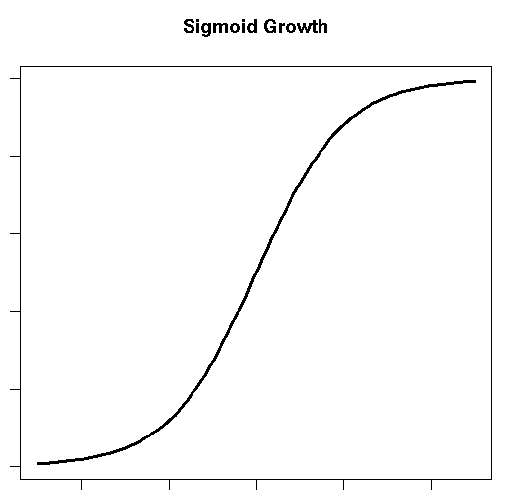
Sigmoidal growth curve
What do you notice?

Slide 6
Age vs Maturity
Chronological age
Age in absolute time e.g. days weeks months
Physiological age
Stages of development that may be discerned by specific physical or chemical stages of development or function
Maturity is the point in time when an animal reaches its highest level of complexity or development
Absolute growth rate: utilizes units
ADG, WDA, Birth, Weaning, etc. (Figure 9.9)
Growth rates of various tissues (figure 9.11)

Slide 7
Changes in Body Measurements
Quantifiable
There are measurements specific to the livestock industry
Carcass length
Longissimus muscle area
Subcutaneous fat thickness
Carcass length in pork – value
Standard reference points of measurement

Slide 8
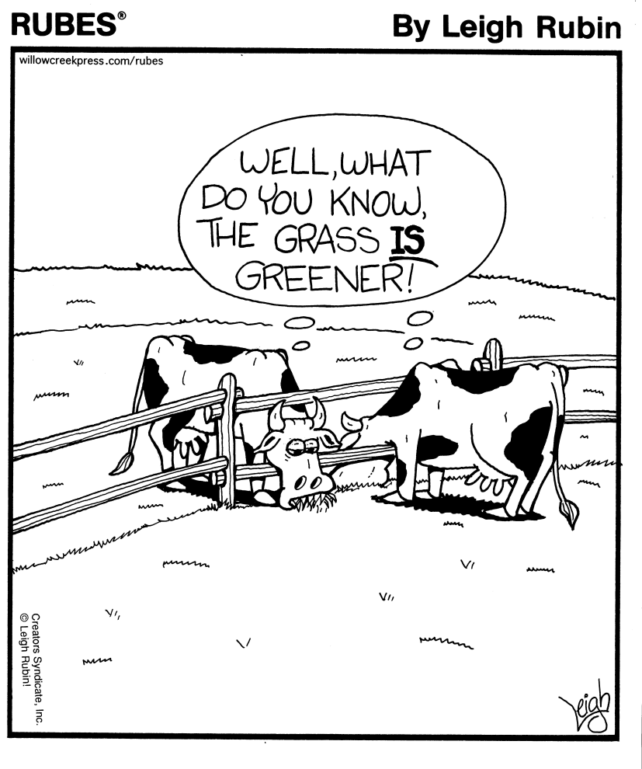
Changes in Body Components
Body Weight
Empty Body weight
Dressing Percentage
Carcass Weight

Slide 9
Body Weight
First method used to evaluate an animals ability to produce edible products
Although not always accurate
Rumen has a large amount of fill
Must withhold feed and water for 24 hours prior to slaughter
Secures shrunken weights

Slide 10
Empty Body Weight
Accounts for the digestive system content
Accomplished by flushing digestive tract and weighing empty tissues

Slide 11
Dressing Percentage
Dressing the animal
During slaughter portions of the animal are removed
Internal organs, hide, feet and head
Most important pieces remaining
Muscle, bone, and fat
Dressing percentage is calculated by dividing the carcass weight by the shrunken live weight of the animal

Slide 12
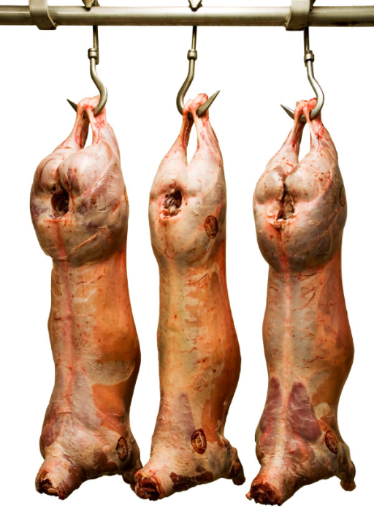
Carcass Weight
Carcass weight as growth end point is highly desirable
Carcass weight is routinely used as a primary end point
Muscle, bone, fat

Slide 13
Changes in carcass components
The composition of the carcass has a major effect on economic value of the animal
Growth of individual carcass components (muscle, bone, and fat) may be plotted against time to better characterize these differences.

Slide 14
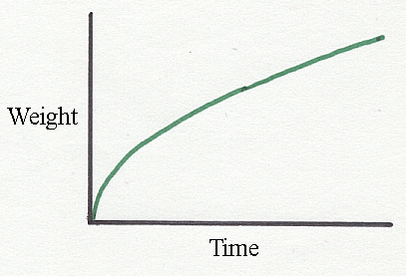
Changes in carcass components

Slide 15
Changes in carcass components
Bone- increases at a decreasing rate
Muscle is the fastest growing during early life and post weaning, yet decreases with time
Fat is the fastest growing at physiological maturity
A decrease in bone and muscle is due to the extreme increase in fat percentage

Slide 16
Changes in the Chemical Composition
Chemical Composition changes with time and weight
Because bone, muscle, and fat are deposited at different rates
Muscle ranges from 68-85% water
Moisture to protein ratio = 4:1
CT increases with age
Muscle fibers increase in size, yet CT decreases in percent thus increases in size
Fat
More variable yet accumulates in various depots with age including the depots associated with muscle

Slide 17
Factors affecting Carcass composition
Genetics
Species
Selection and domestication
Muscle distribution
Fat distribution
Breed
Frame size
Sex

Slide 18
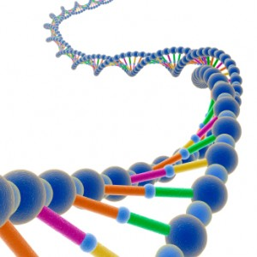
Genetics
Mutation or intensive selection
Influence of environment
Phenotype versus genotype
Heritability estimates

Slide 19
Species
Variation between species
Deposition of tissues, especially fat
Order of fat deposition between species
Proportion of composition compared anatomically
Value differences among composition parts of each species

Slide 20
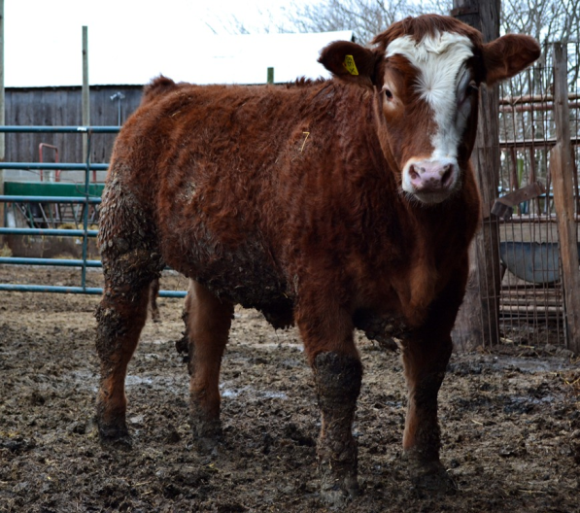
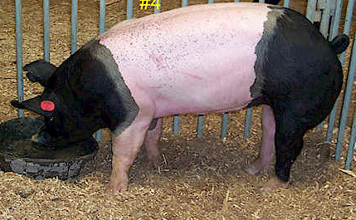
Muscle distribution
Comparison of muscle
distribution between species
Ruminant versus non-ruminant
Domestic versus non-domesticated species
Meat versus milk type selection

Slide 21
Fat distribution
Species is a major determinant in fat deposition
At the beginning, carcass fat is fairly even in distribution
However, a growth increases and maturity develops fat begins to accumulate varying percentages at different anatomical locations

Slide 22
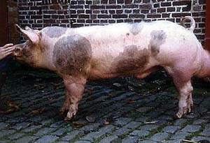
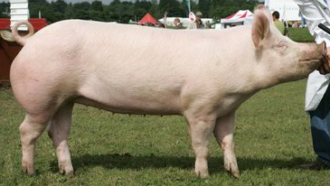
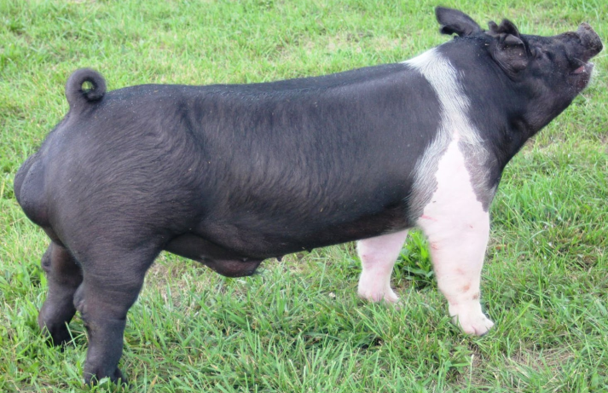
Breed Variations
Various breeds have:
Different maturity patterns
Frame sizes
Meat versus dairy type
Selection pressure for muscling

Slide 23
Frame Size
Growth patterns
Feedlot gain and efficiency
Chronological vs Physiological maturity
Quality Grade vs fat deposition
Compositional Endpoints
Dairy vs Meat type
Dressing Percentage variations
Forage availability and utilization

Slide 24
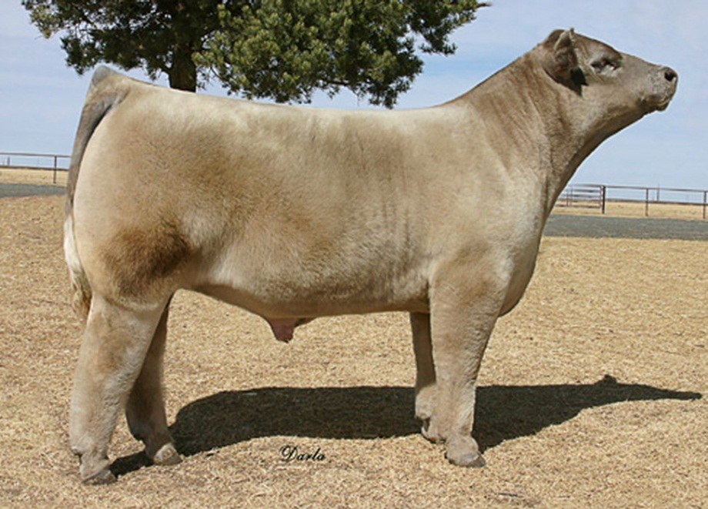
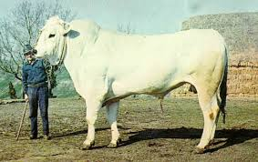
Frame size

Slide 25
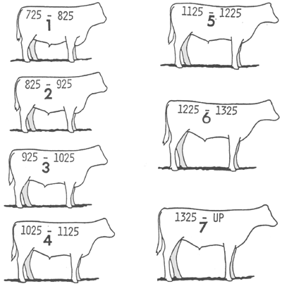
Frame Size

Slide 26
Sex
Except for pigs, females mature earliest
Intact males have a greater proportion of muscles in the forequarter while heifers in the proximal pelvic limb
Castrated males are intermediate
Heifers at the same physiological slaughter age and maturity will be fatter lower yielding

Slide 27
Objectives
Draw growth curves
Explain different changes in body measurements
Explain different changes is body components
Explain different changes in carcass components
Explain different changes in chemical composition

