Slide 1
Selection and Evaluation of Swine

Slide 2
Objectives
List selection priorities of market and breeding swine in order of importance
Evaluate selection priorities of market and breeding swine
Understand the purpose of market and breeding swine selection

Slide 3
Swine
Market Hogs
Breeding
Gilts/ Sows
Boars

Slide 4
Market Hogs
Priorities
Muscle Content
Lean Growth
Skeletal Width and Dimension
Structural Correctness
Balance and Eye Appeal

Slide 5
Market Hogs
Muscle Content
Forearm
Blades
Loin
Ham-Loin Junction
Hip
Stifle
Ham

Slide 6
Market Hogs

Slide 7
Market Hogs

Slide 8
Market Hogs
Leanness- absence of fat deposition
Jowl
Over blades
Elbow pocket
Loin Edge
Seam of Ham
Lower one-third of body

Slide 9
Market Hogs

Slide 10
Market Hogs
Skeletal Width and Dimension
Width of Chest
Square Rib Design
Depth of Flank
Natural Base Width at the Ground
Ability to convert feed to gain

Slide 11
Market Hogs

Slide 12
Market Hogs

Slide 13
Market Hogs
Structural Correctness
Proper angle to scapula
Backward set and relaxed knee design
Correct angle to pastern
Looseness of hip and hock
Heaviness of Structure
Even and Wide Foot Design

Slide 14
Market Hogs

Slide 15
Market Hogs

Slide 16
Market Hogs
Balance and Eye Appeal
Proportional Skeleton
Attractive & High Quality Look
Levelness of Topline and Hip
Strength Behind Blades and to Loin
Quality to Hair and Skin Coat

Slide 17
Market Hogs

Slide 18
Practice Class

Slide 19
Practice Class

Slide 20
Practice Class - Officials
Place:
Cuts:

Slide 21
Breeding Hogs
Priorities
Functionality
Structural Soundness
Internal Dimension and Condition
Growth Performance
Muscle
Maternal Characteristics

Slide 22
Breeding Hogs
Structural Correctness
Looseness of skeleton and mobility
Same visual indicators as market hogs
Of utmost importance to ensure sow longevity

Slide 23
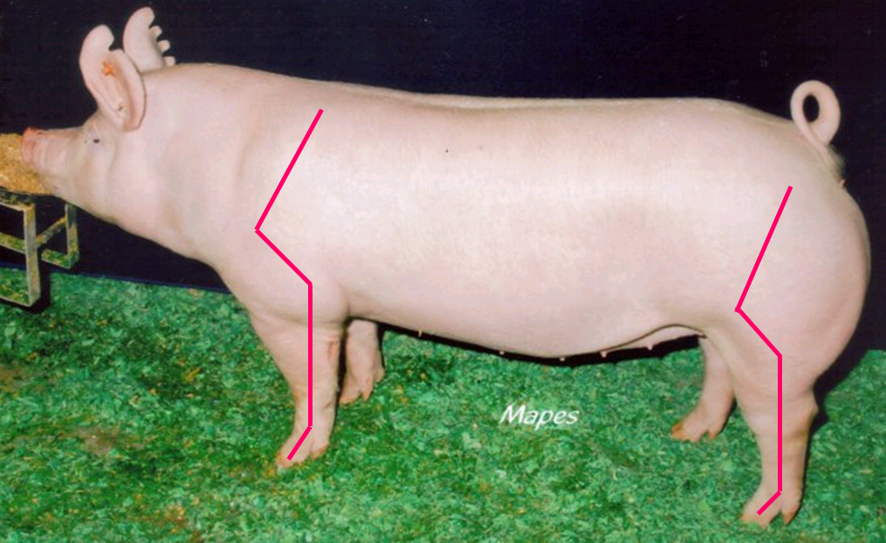
Breeding Hogs

Slide 24
Breeding Hogs
Internal Dimension and Volume
Width of Skeleton
Depth and Shape of Rib
Natural Base Width at the ground
Condition
Important for females to not be too heavy, conditioned, however, an adequate degree is needed for sound reproductive intervals

Slide 25
Breeding Hogs

Slide 26
Breeding Hogs
Growth Performance
Females must possess the growth potential and genetics to farrow litters that are fastgrowing and efficient
Gilts should be extended and not be too early maturing

Slide 27
Breeding Hogs

Slide 28
Breeding Hogs
Muscle
Indicators will be similar to market hog evaluation
Excessive muscle should be avoided

Slide 29
Breeding Hogs

Slide 30
Breeding Hogs
Maternal Characteristics
Vulva
Estrus Detection
Upturned/Tipped
Infantile
Underline
Pin/Blunt Teats
Size and spacing issues
Count

Slide 33
Practice Class- Officials
Place:
Cuts:

Slide 34
Objectives
List selection priorities of market and breeding swine in order of importance
Evaluate selection priorities of market and breeding swine
Understand the purpose of market and breeding swine selection

