Slide 1
Selection and Evaluation of Sheep

Slide 2
Objectives
List selection priorities of market and breeding sheep in order of importance
Evaluate selection priorities of market and breeding sheep
Understand the purpose of market and breeding sheep selection

Slide 3
Sheep
Market
Breeding
  Rams
  Ewes

Slide 4
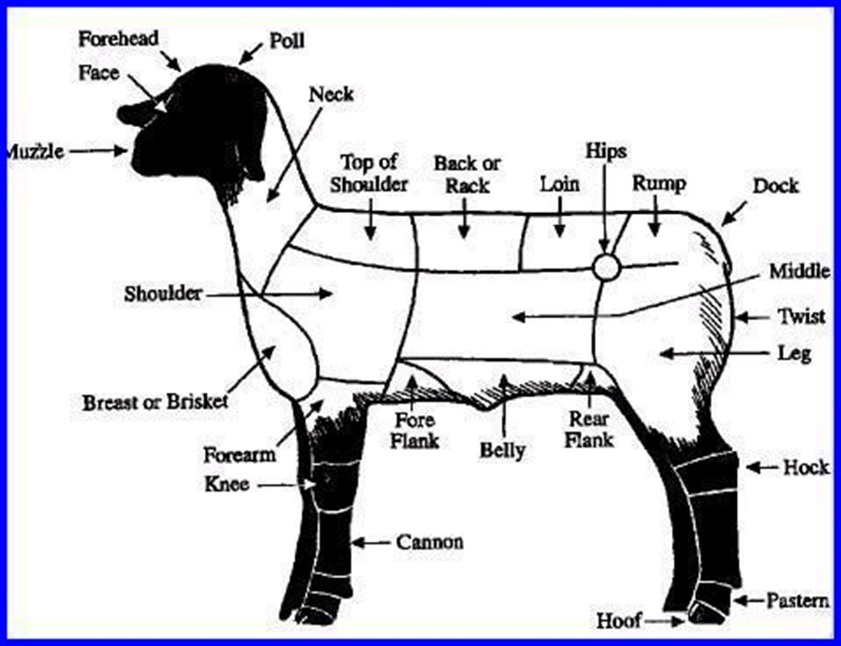

Slide 5
Market Lambs
Priorities
  Muscle
  Correctness of finish
  Growth/Weight
  Skeletal Correctness
  Balance and Eye Appeal

Slide 6
Market Lambs
Muscle Indicators
  Forearm
  Rack
  Loin
  Hip
  Leg
  Base Width

Slide 7
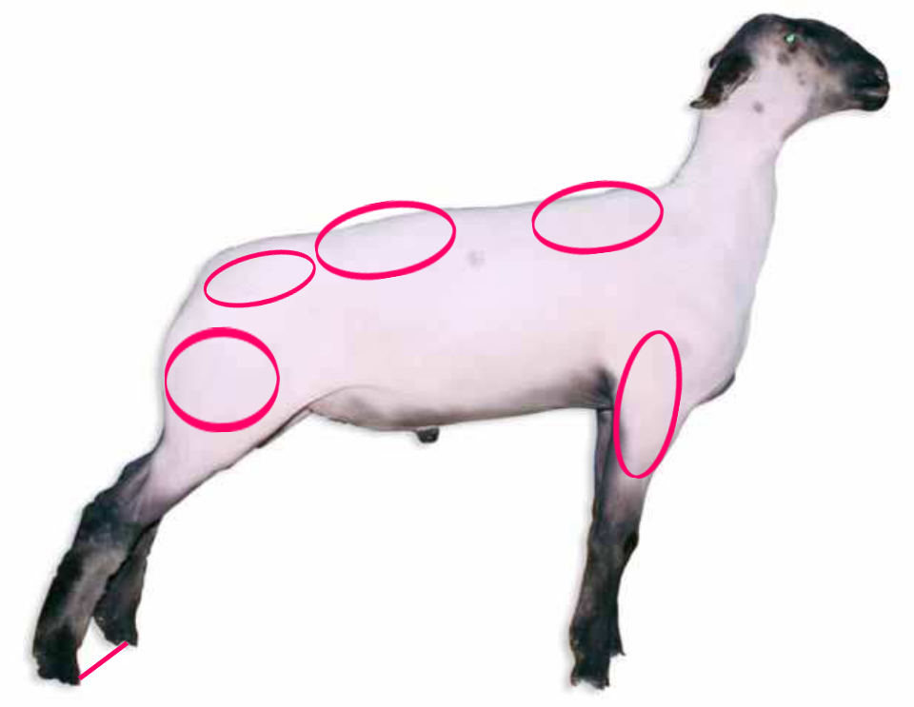
Market Lambs

Slide 8
Market Lambs
Finish Indicators
  Breast/Chest Plate
  Forerib
  Over Ribs
  Flank
  Twist

Slide 9
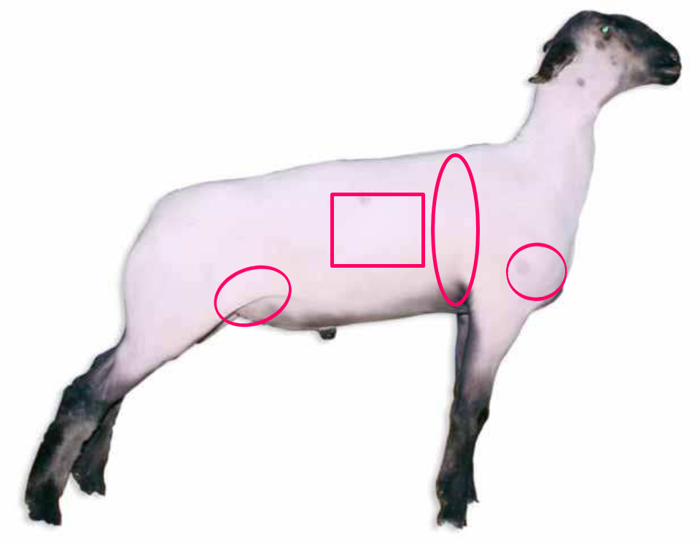
Market Lambs

Slide 10
Market Lambs
Growth Indicators
  Length of cannon bone
  Height at top of shoulders
  Length of body
  Weight

Slide 11
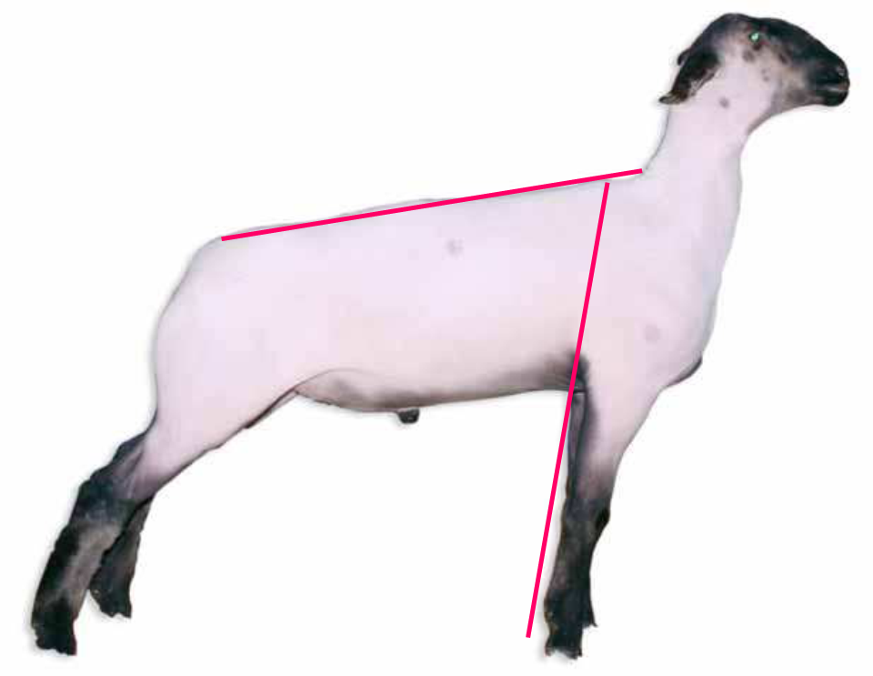
Market Lambs

Slide 12
Market Lambs
Skeletal Correctness
  Proper angle to shoulder and knee
  Appropriate set to pastern
  Levelness of top and dock set
  Square set from hock to ground from behind
  Heaviness of structure

Slide 13
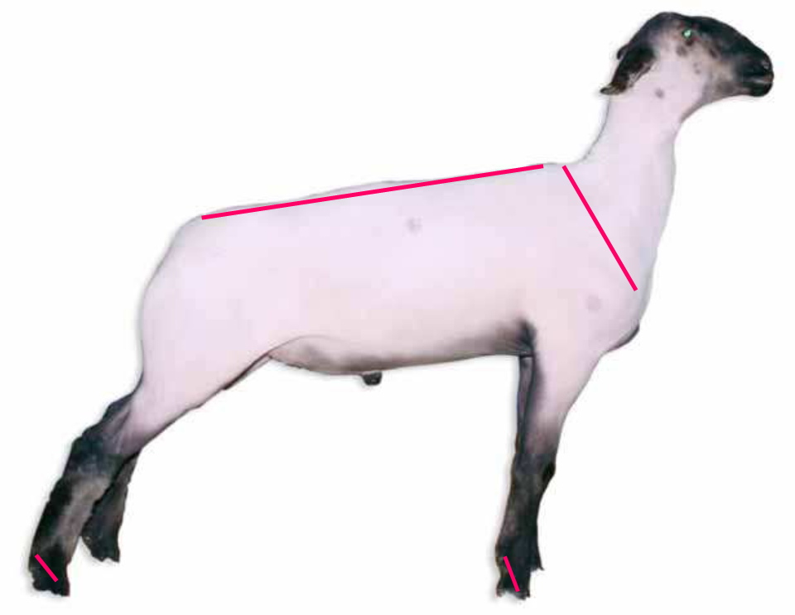
Market Lambs

Slide 14
Market Lambs
Balance and Eye Appeal
  Similar to other species
  Proportional
  Trim chested
  Length and smoothness of front end
  Level topline and square hip
  Attractive rib design

Slide 15

Market Lambs

Slide 16
Breeding Sheep
Priorities
  Growth and Performance
  Functionality
  Balance and Eye Appeal
  Muscle

Slide 17
Breeding Sheep
Growth and Performance
  An extremely important factor
  Ability to offer future growth
  Length of cannon bone and face
  Length of body

Slide 18
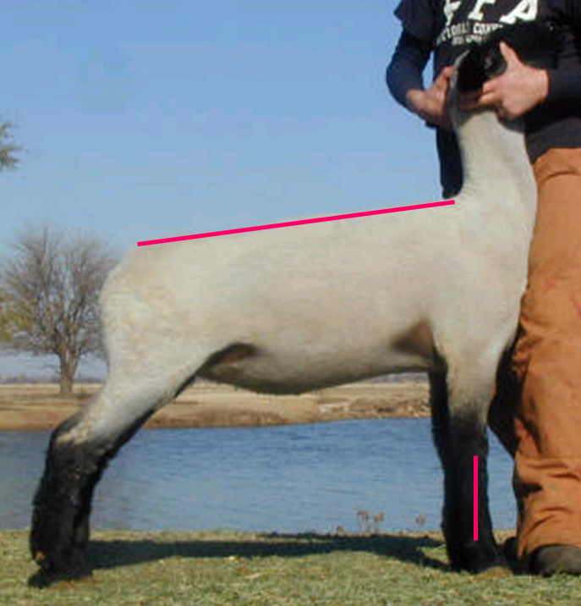
Breeding Sheep

Slide 19
Breeding Sheep
Functionality
  Similar to breeding cattle
  Rib
  Structural correctness
    Pasterns
    Length of stride

Slide 20
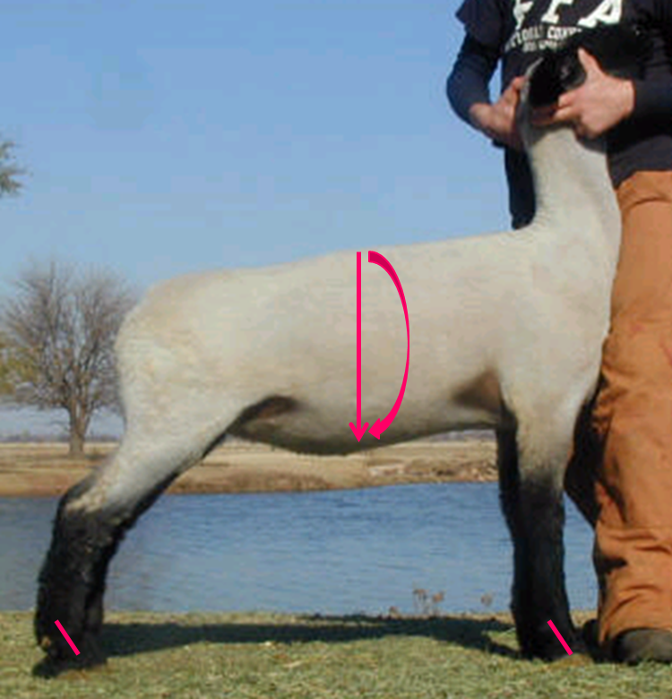
Breeding Sheep

Slide 21
Breeding Sheep
Balance and Eye Appeal
  Proportional
  Length and smoothness of front end
  Cleanliness thru shoulder and chest
  Levelness of topline and hip

Slide 22

Breeding Sheep

Slide 23
Breeding Sheep
Muscle
  Indicators will be similar to market lamb evaluation
  Excessive muscle should be avoided

Slide 24
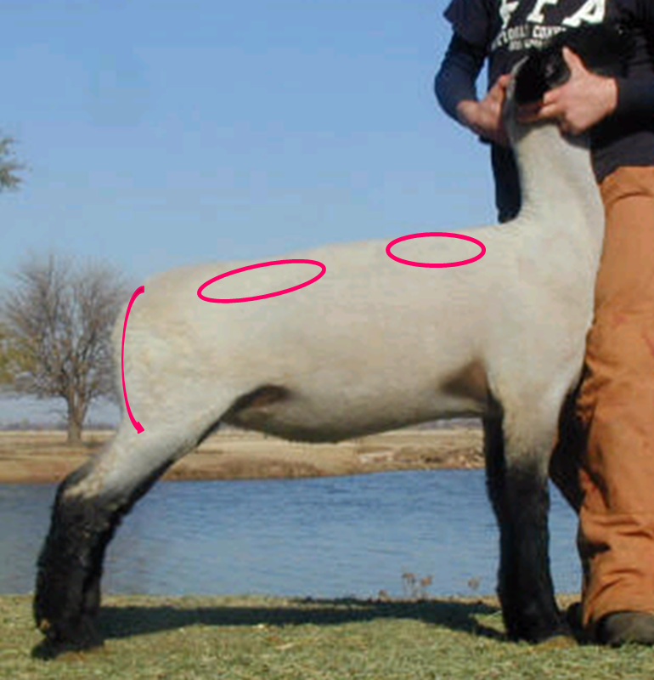
Breeding Sheep

Slide 25
Objectives
List selection priorities of market and breeding sheep in order of importance
Evaluate selection priorities of market and breeding sheep
Understand the purpose of market and breeding sheep selection

