Slide 1
Selection and Evaluation of Market Cattle

Slide 2
Objectives
List selection priorities in order of importance
Evaluate selection priorities of market steers
Understand the purpose of market steer selection

Slide 3
Cattle
Market
Breeding
  Heifers/Cows
  Bulls

Slide 4
Market Cattle
Priorities
  Muscle
  Correctness of Finish
  Structure and Movement
  Rib and Feeding Ability
  Balance and Eye Appeal

Slide 5
Market Cattle
Muscle Indicators
  Forearm
  Rib
  Loin
  Hip
  Stifle
  Quarter
  Base Width

Slide 6
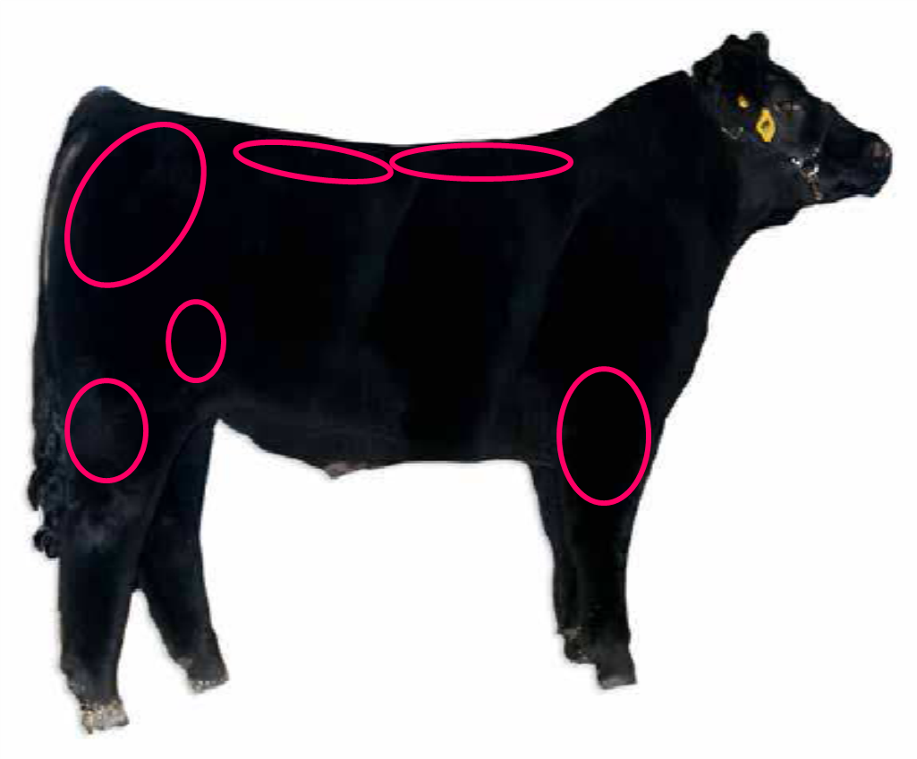
Market Cattle – Muscle Indicators

Slide 7
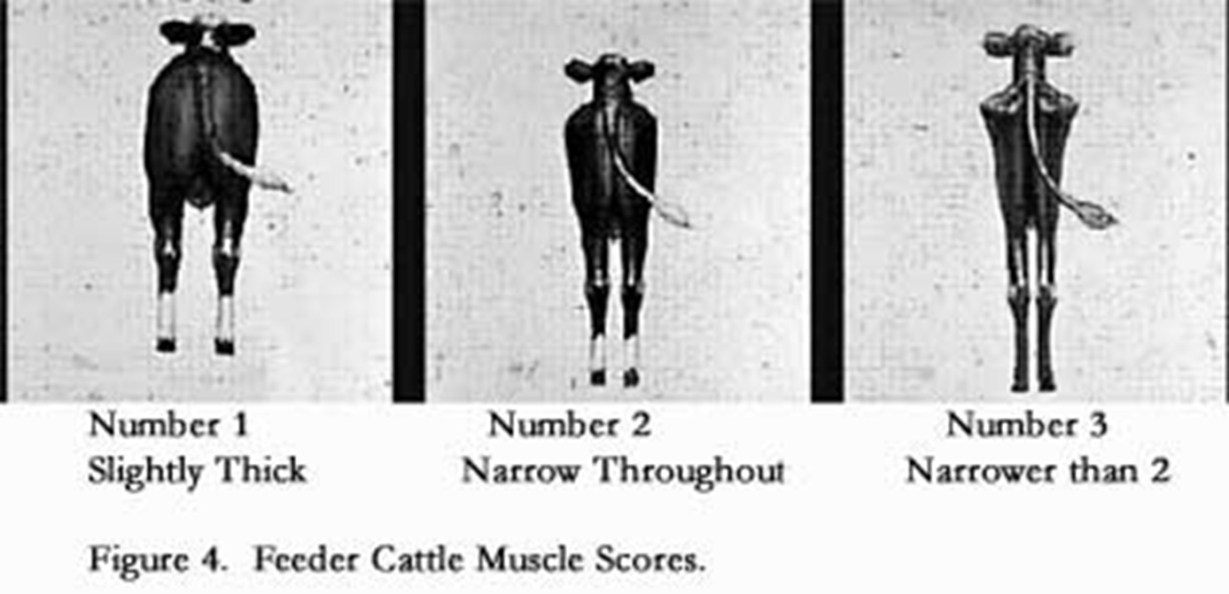
Market Cattle – Muscle Indicators

Slide 8
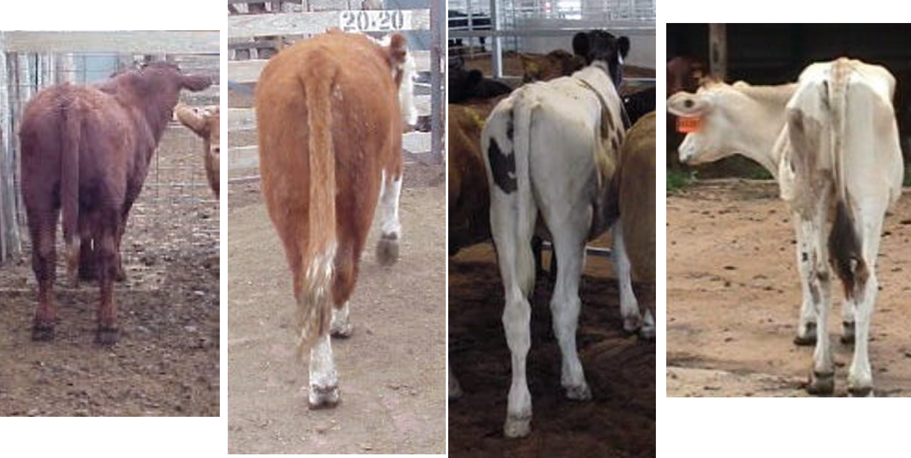
Market Cattle – Muscle Indicators

Slide 9
Market Cattle
Finish Indicators
  Brisket
  Down Top
  Over Ribs
  Around tail head
  Drop to flank
  Cod fat

Slide 10
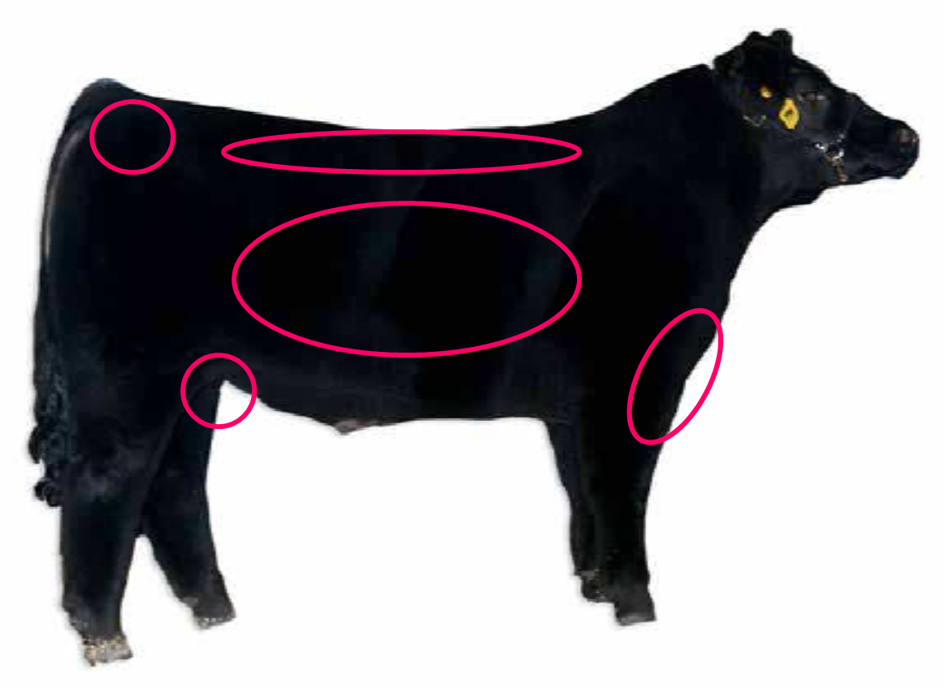
Market Cattle

Slide 11
Market Cattle
Evaluating Structure
  Front foot alignment
  Shoulder angle
  Strength of top line
  Levelness and length of hip
  Set to hock
  Set to pastern
  Heaviness of structure

Slide 12
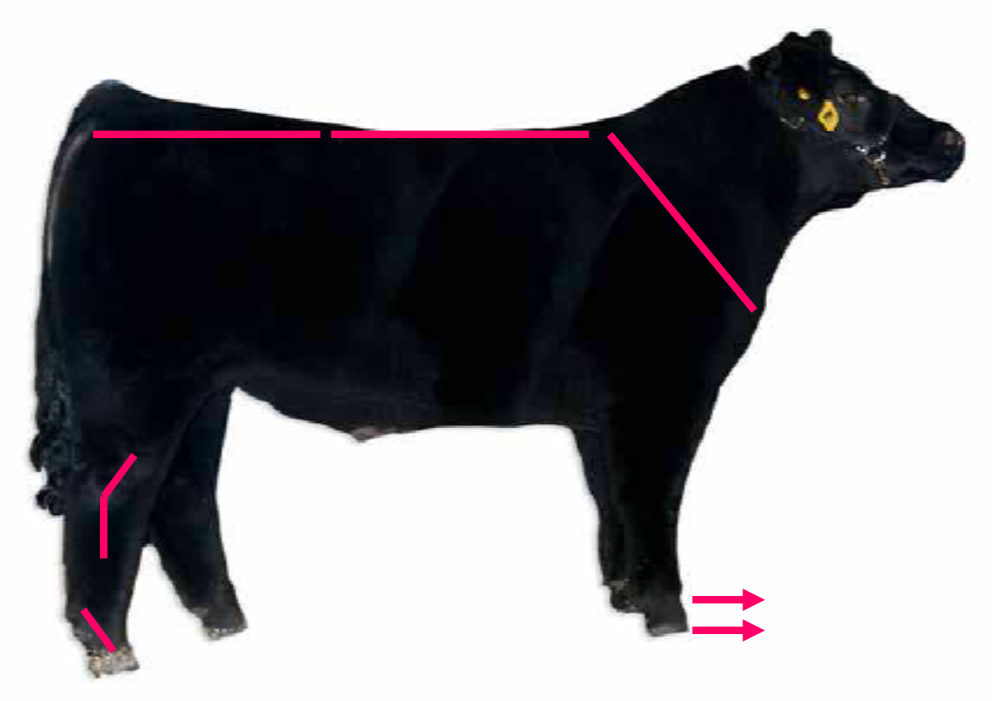
Market Cattle

Slide 13
Market Cattle
Evaluating Rib/Feeding Ability
  Steers should possess dimension to their
  skeleton in terms of chest width and center
  body shape to ensure efficiency in a feedlot
  setting and the ability to deposit finish
    Width of chest
    Depth of body
    Rib Shape
    Uniformity of body depth

Slide 14
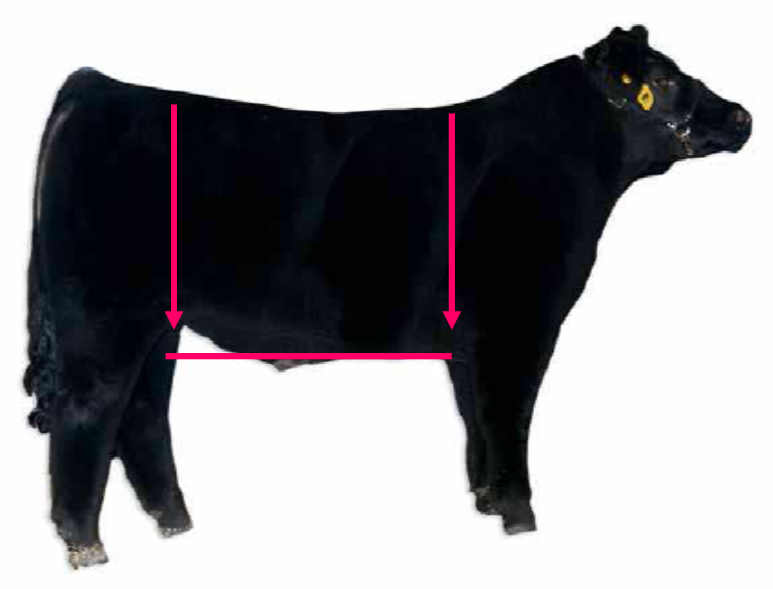
Market Cattle

Slide 15
Market Cattle
Evaluating Balance and Eye Appeal
  The proportionalism of the animal
  How well the animal’s parts fit together
    Length of neck
    Levelness of top line and hip
    Smooth pattern
    General attractiveness

Slide 16
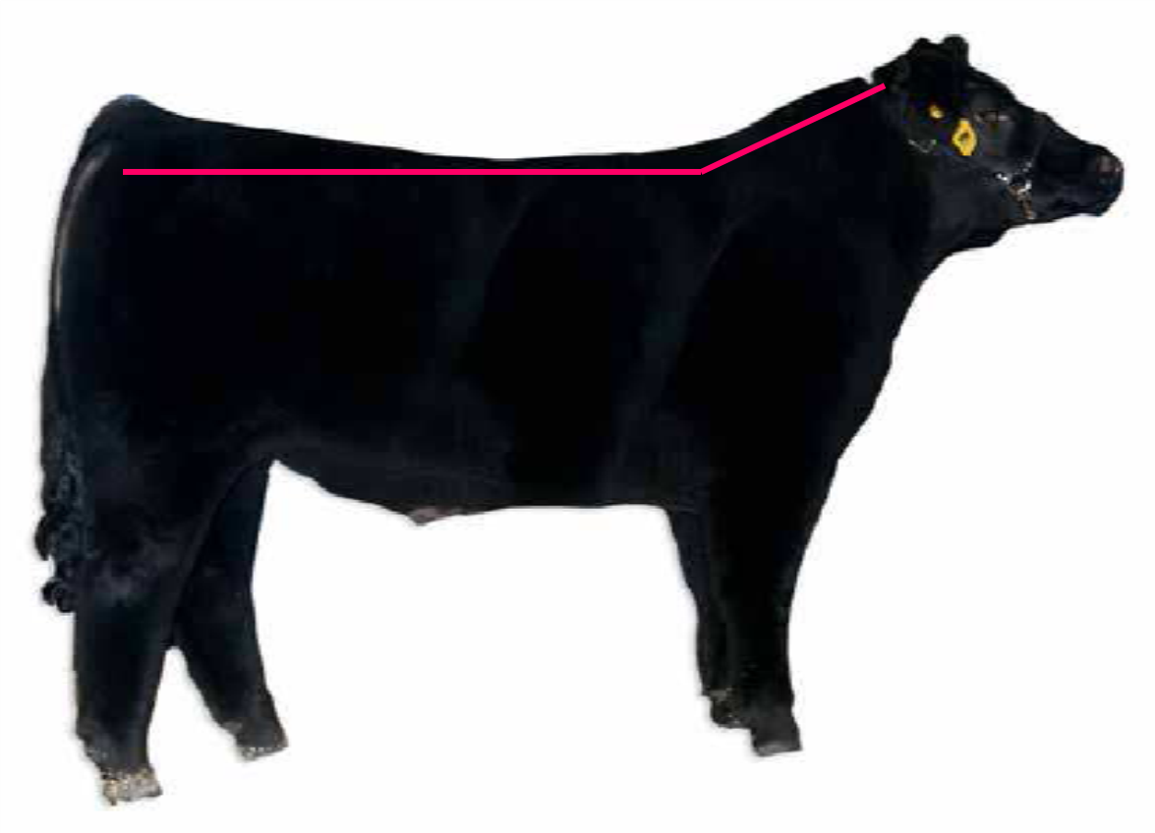
Market Cattle

Slide 17
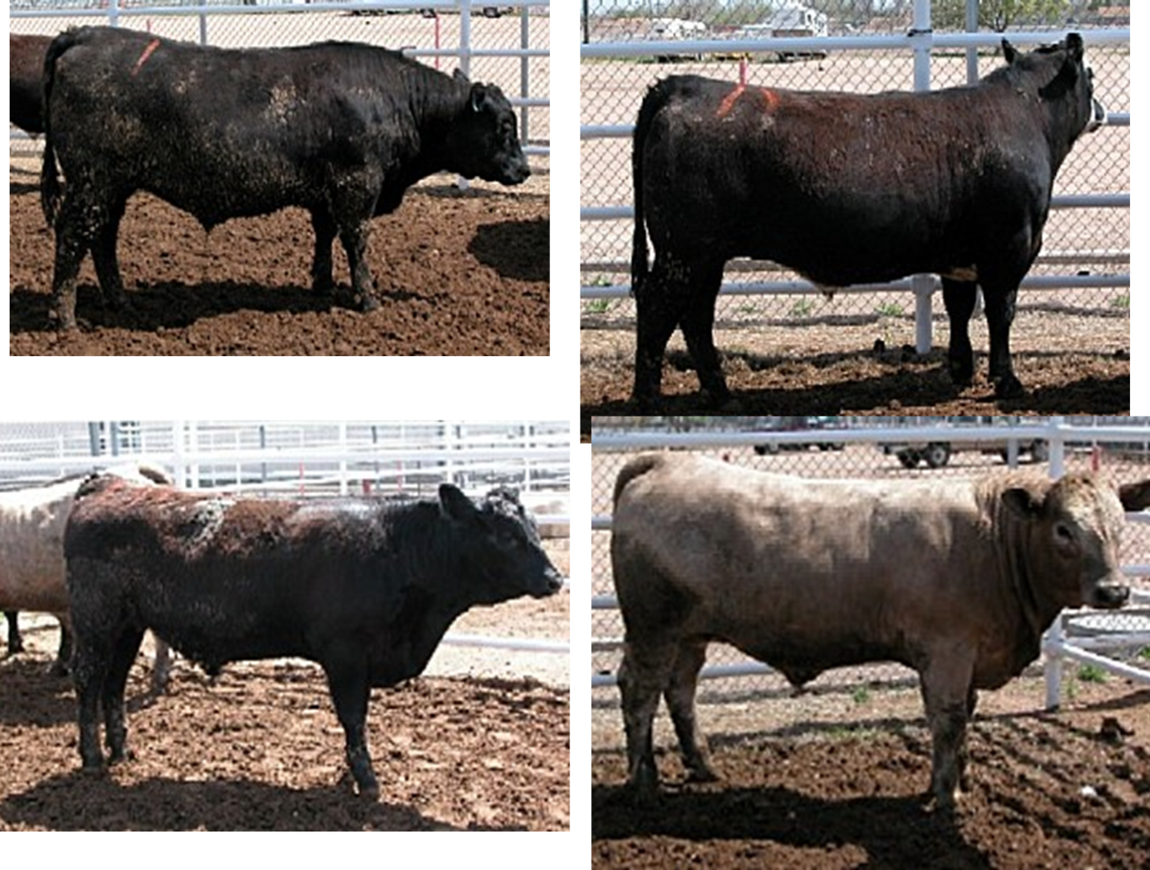
Practice Class

Slide 18
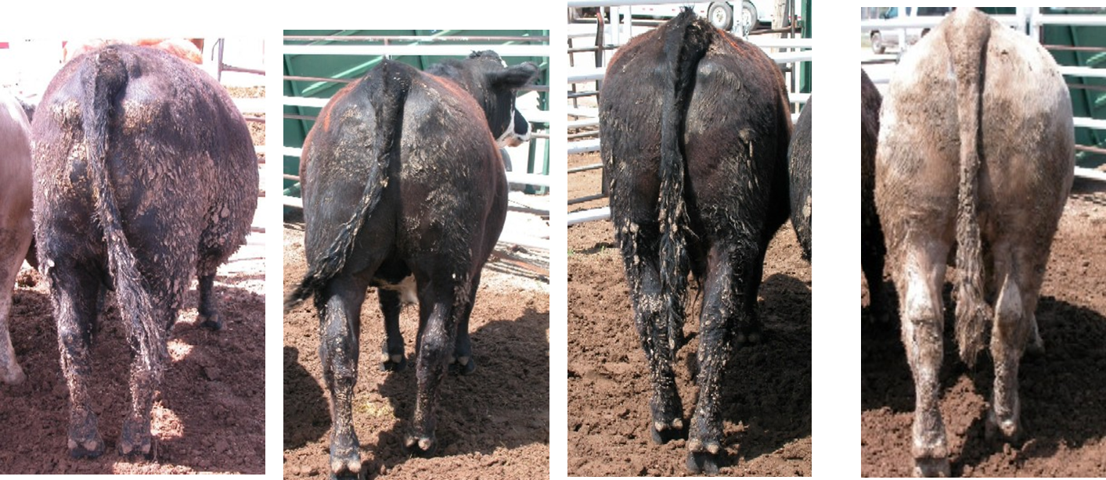
Practice Class

Slide 19
Practice Class - Officials
Place: 4-2-3-1
Cuts 3-5-3

Slide 20
Objectives
List selection priorities in order of importance
Evaluate selection priorities of market steers
Understand the purpose of market steer selection

