Slide 1
Selection and Evaluation of Goats

Slide 2
Objectives
List selection priorities of market and breeding goats in order of importance
Evaluate selection priorities of market and breeding goats
Understand the purpose of market and breeding goats selection

Slide 3
Goats
Market
Breeding
Bucks
Does

Slide 4
Market Goats
Priorities
Muscle
Correctness of finish
Growth/Weight
Skeletal Correctness
Balance and Eye Appeal

Slide 5
Market Goats
Muscle Indicators
Forearm
Rack
Loin
Hip
Leg
Base Width

Slide 6
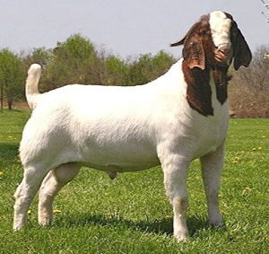
Market Goats

Slide 7
Market Goats
Finish Indicators
Breast/Chest Plate
Forerib
Over Ribs
Flank

Slide 8
Market Goats

Slide 9
Market Goats
Growth Indicators
Length of cannon bone
Height at top of shoulders
Length of body
Weight

Slide 10
Market Goats

Slide 11
Market Goats
Skeletal Correctness
Proper angle to shoulder and knee
Appropriate set to pastern
Levelness of top and dock set
Square set from hock to ground from behind
Heaviness of structure

Slide 12
Market Goats

Slide 13
Market Goats
Balance and Eye Appeal
Similar to other species
Proportional
Trim chested
Length and smoothness of front end
Level topline and square hip
Attractive rib design

Slide 14
Market Goats

Slide 15
Breeding Goats
Priorities
Growth and Performance
Functionality
Balance and Eye Appeal
Muscle

Slide 16
Breeding Goats
Growth and Performance
An extremely important factor
Ability to offer future growth
Length of cannon bone and face
Length of body

Slide 17
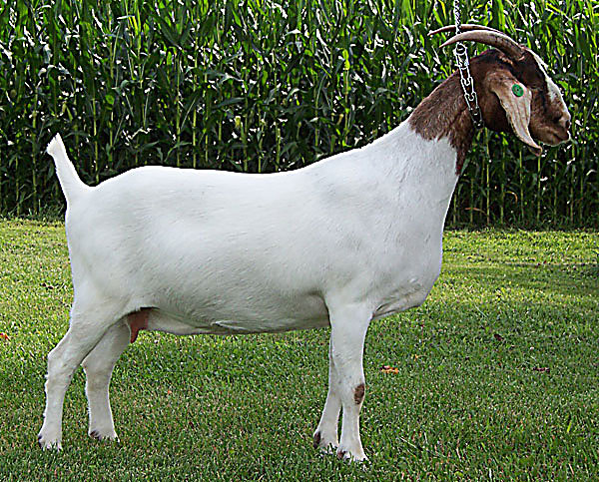
Breeding Goats

Slide 18
Breeding Goats
Functionality
Similar to breeding cattle
Rib
Structural correctness
Pasterns
Length of stride

Slide 19
Breeding Goats

Slide 20
Breeding Goats
Balance and Eye Appeal
Proportional
Length and smoothness of front end
Cleanliness thru shoulder and chest
Levelness of topline and hip

Slide 21
Breeding Goats

Slide 22
Breeding Goats
Muscle
Indicators will be similar to market lamb evaluation
Excessive muscle should be avoided

Slide 23
Breeding Goats

Slide 24
Objectives
List selection priorities of market and breeding goats in order of importance
Evaluate selection priorities of market and breeding goats
Understand the purpose of market and breeding goat selection

