Slide 1
Protein Synthesis
Jessica Hawley

Slide 2
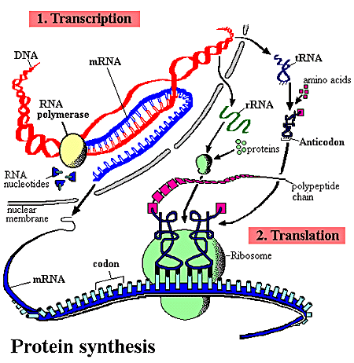
Protein Synthesis
Protein Synthesis

Slide 3
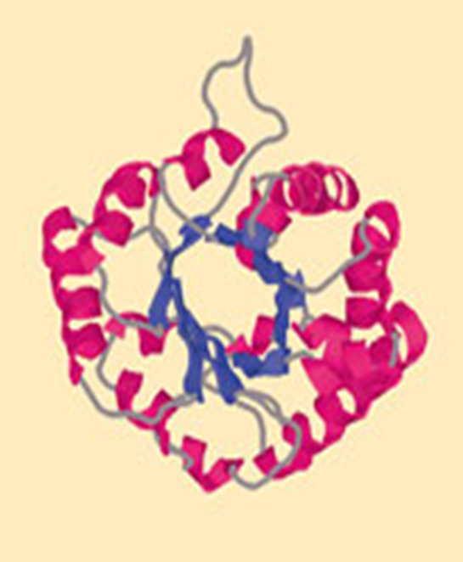
dna
DNA contains genes
sequences of nucleotide bases
These Genes code for polypeptides (proteins)
Proteins are
used to build cells and do much of the work inside cells
made of amino acids linked together by peptide bonds
20 different amino acids exist

Slide 4
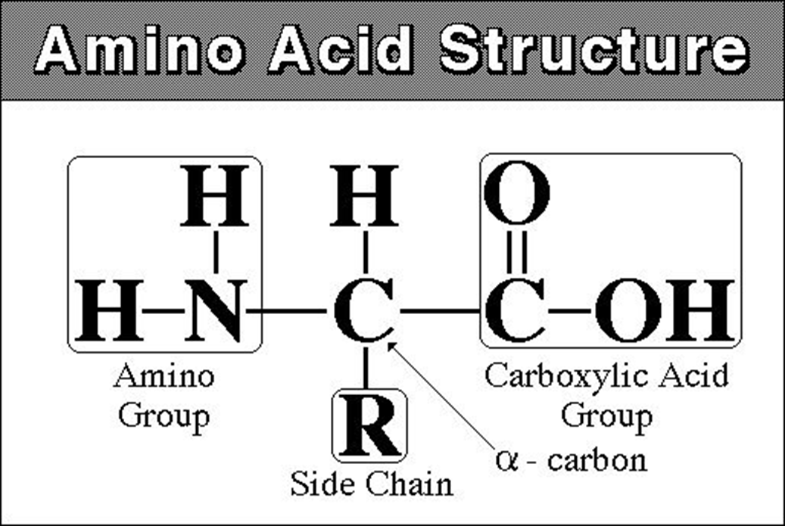
Amino Acid Structure

Slide 5
DNA
DNA
found inside the nucleus
Proteins
are made in the cytoplasm of cells by organelles called ribosomes
Ribosomes
free in the cytosol or
attached to the surface of rough ER
DNA‘s code must be copied and taken to the cytosol
DNA code must be read in the cytoplasm so amino acids can be assembled to make polypeptides (proteins)
This process is called PROTEIN SYNTHESIS

Slide 6
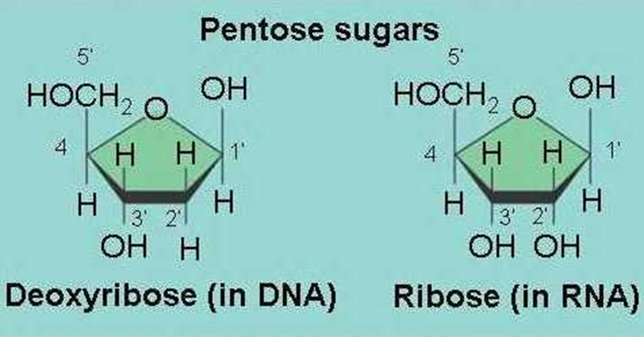
Differences between DNA and RNA
DNA is the MASTER PLAN
DNA has a sugar deoxyribose
DNA has thymine (T)
DNA is double-stranded
RNA is the BLUEPRINT of the Master Plan
RNA has a sugar ribose
RNA contains the base uracil (U)
RNA molecule is single-stranded

Slide 7
Three Types of RNA
Messenger RNA (mRNA)
copies DNA’s code & carries the genetic information to the ribosomes
Ribosomal RNA (rRNA)
along with protein, makes up the ribosomes
Transfer RNA (tRNA)
transfers amino acids to the ribosomes where proteins are synthesized

Slide 8
Messanger RNA
Long Straight chain of Nucleotides
Made in the Nucleus
Copies DNA & leaves through nuclear pores
Contains the Nitrogen Bases A, G, C, U ( no T )
Carries the information for a specific protein
Made up of 500 to 1000 nucleotides long
Sequence of 3 bases called codon
AUG – methionine or start codon
UAA, UAG, or UGA – stop codons

Slide 9
Ribosomal RNA
rRNA is a single strand 100 to 3000 nucleotides long
Globular in shape
Made inside the nucleus of a cell
Associates with proteins to form ribosomes
Site of Protein Synthesis

Slide 10
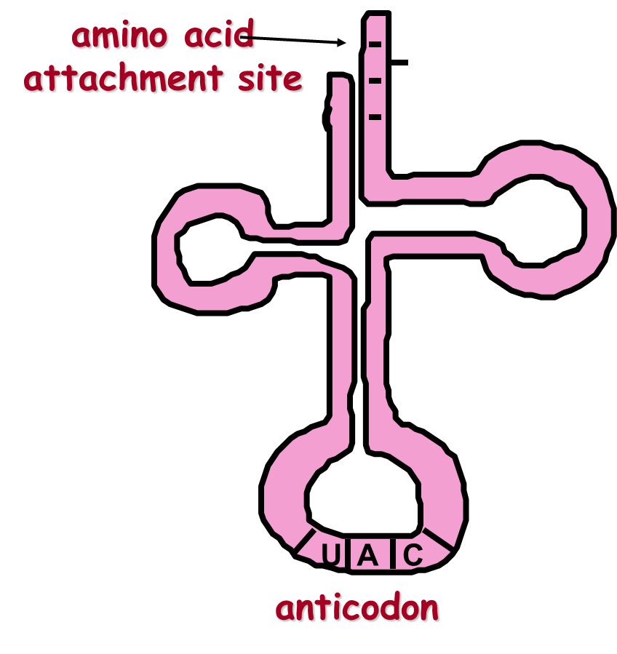
Transfer RNA
Clover-leaf shape
Single stranded molecule with attachment site at one end for an amino acid
Opposite end has three nucleotide bases called the anticodon

Slide 11
The genetic Code
A codon designates an amino acid
An amino acid may have more than one codon
There are 20 amino acids, but 64 possible codons
Some codons tell the ribosome to stop translating

Slide 12
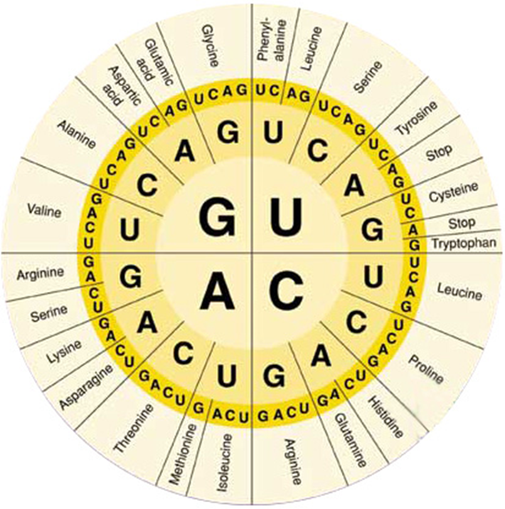
The genetic code
Use the code by reading from the center to the outside
Example: AUG codes for Methionine

Slide 13
The genetic code
GGG?
UCA?
CAU?
GCA?
AAA?

Slide 14
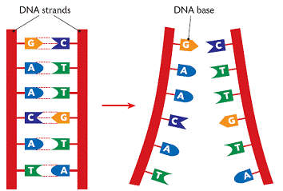
Complementary bases
On DNA
A-T
C-G
On RNA:
A-U
C-G

Slide 15
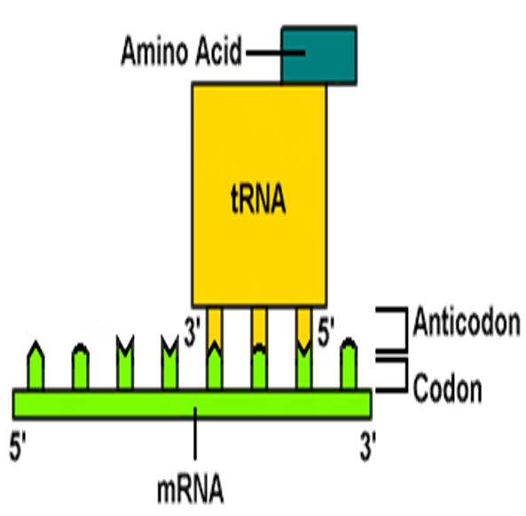
Condon/Anticodon
The 3 bases of an anticodon are complementary to the 3 bases of a codon
Example: Codon ACU
Anticodon UGA

Slide 16
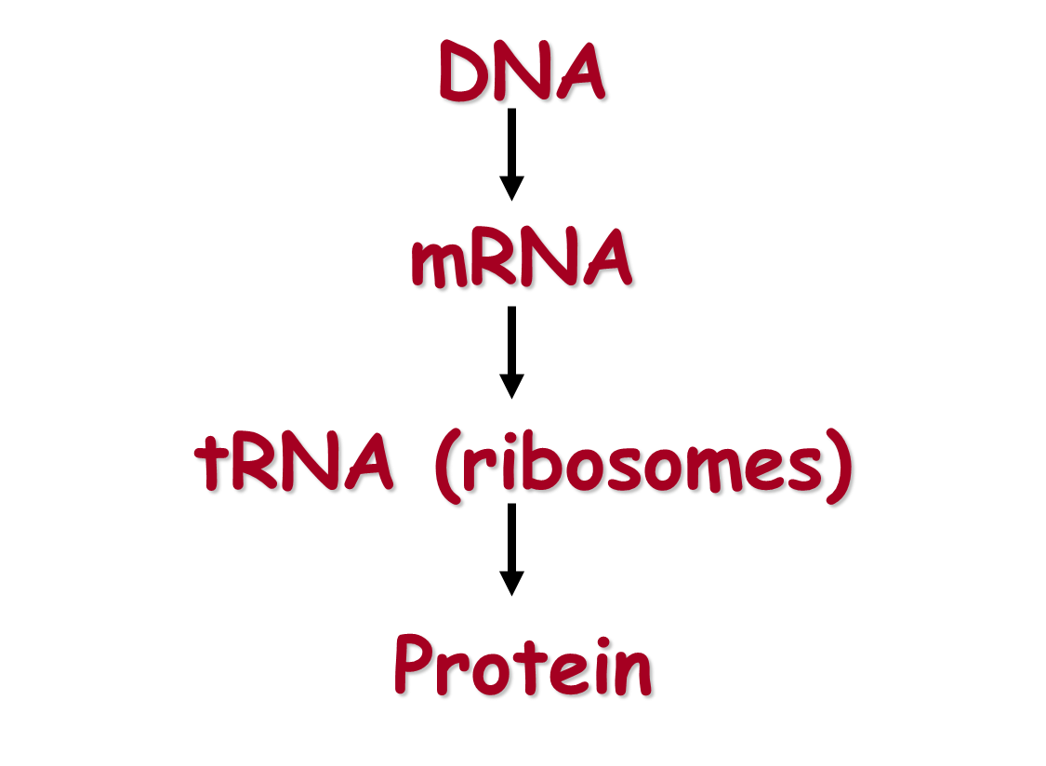
Order of protein synthesis

Slide 17
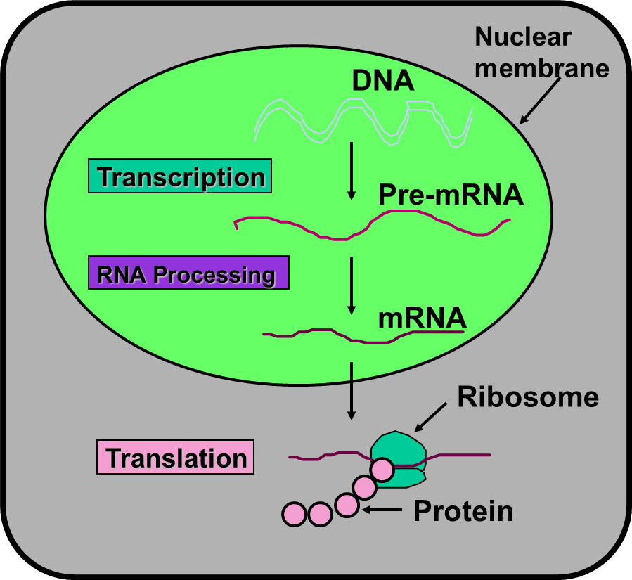
Eukaryotic cell
The production or synthesis of polypeptide chains (proteins)
Two phases: Transcription & Translation
mRNA must be processed before it leaves the nucleus of eukaryotic cells

Slide 18
Transcription
The process of copying the sequence of one strand of DNA, the template strand
mRNA copies the template strand
Requires the enzyme RNA Polymerase

Slide 19
Question
What would be the complementary RNA strand for the following DNA sequence?
DNA 5’-GCGTATG-3’

Slide 20
Answer
DNA 5’-GCGTATG-3’
RNA 3’-CGCAUAC-5’

Slide 21
Transcription
During transcription, RNA polymerase binds to DNA and separates the DNA strands
RNA Polymerase then uses one strand of DNA as a template to assemble nucleotides into RNA
Promoters are regions on DNA that show where RNA Polymerase must bind to begin the Transcription of RNA
Called the TATA box
Specific base sequences act as signals to stop
Called the termination signal

Slide 22
RNA Polymerase

Slide 23
mRNA
Processing
After the DNA is transcribed into RNA, editing must be done to the nucleotide chain to make the RNA functional
Introns, non-functional segments of DNA are snipped out of the chain
Editing
Exons, segments of DNA that code for proteins, are then rejoined by the enzyme ligase
A guanine triphosphate cap is added to the 5” end of the newly copied mRNA
A poly A tail is added to the 3’ end of the RNA
The newly processed mRNA can then leave the nucleus

Slide 24
mRNA transcript

Slide 25
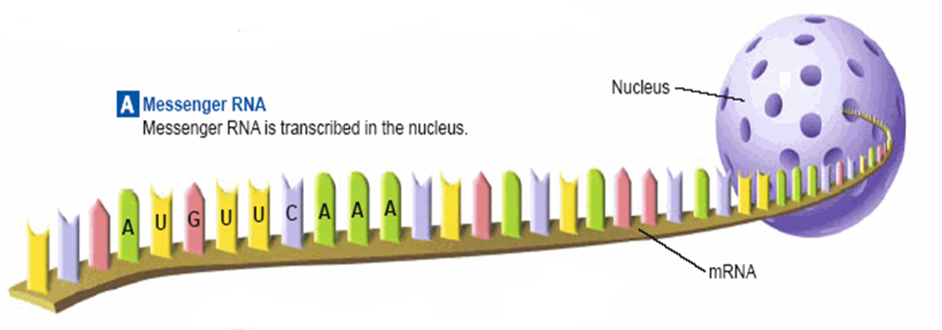
Mrna transcript
mRNA leaves the nucleus through its pores and goes to the ribosomes

Slide 26
Translation
Translation is the process of decoding the mRNA into a polypeptide chain
Ribosomes read mRNA three bases or 1 codon at a time and construct the proteins

Slide 28
A protein
The end products of protein synthesis is a primary structure of a protein
A sequence of amino acid bonded together by peptide bonds

Slide 29
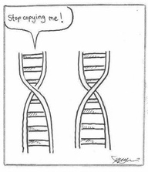
The end

