Slide 1
Nutrient Regulation of Growth

Slide 2
Objectives
Explain nutrient partitioning
Explain Compensatory growth
Explain the purpose of antibacterial feed additives

Slide 3
Nutrient Partitioning
Plane of nutrition – nutritional status of animals
Definition – amount of nutrients consumed by an animal relative to the amount required for optimal growth and or performance
Dietary energy is a major determinant of plane of nutrition
Dependent of the amount of carbohydrate, fat, and protein present in the diet

Slide 4
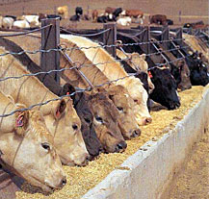
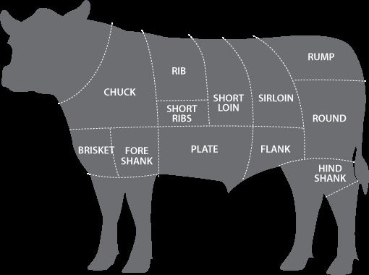
Nutrient partitioning
Utilization of ingested nutrient is partitioned among various tissue and organs according to their metabolic rate and physiological importance.

Slide 5
Nutrient Partitioning
The order of priority from highest to lowest
Systems
Nervous System
Circulatory System
Respiratory System
Digestive System
Reproductive System
Tissues
Skeletal
Muscle
Adipose

Slide 6
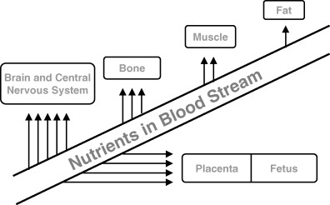
Nutrient partitioning

Slide 7
Energy Balance
Positive energy balance – when food is plentiful enough for body maintenance, growth, and fattening
Negative energy balance – food intake is not sufficient to meet needs.
Ex. Dairy cows during peak lactation
Daily milk production is at its highest and dairy cows cannot consume enough feed to maintain body tissue mass.
Energy must be mobilized from body tissues to support production of milk

Slide 8
Under nutrition
Prenatal
Should under nutrition occurs, it is likely to have effect on postnatal growth of animals.
Low birth weights are often a result of prenatal under nutrition

Slide 9
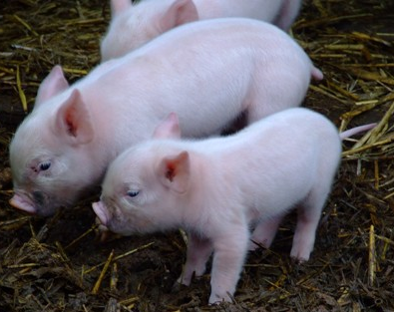
Runt Pigs
Vital organs are smaller and DNA content in various tissues is less
Less DNA in skeletal muscle results in fewer fiber muscles
This results in lean growth being met sooner which negatively impacts the carcass
Slower growth and fatter carcasses

Slide 10
Under Nutrition
Postnatal
Increased metabolic activity at birth necessary for maintaining body temperature
Some species use adipose tissue as a source of energy
Large amounts of brown fat may be mobilized for heat production, but livestock species contain little brown fat after birth.
White adipose tissues may be used as energy sources, but in pigs there are only small amounts of fat present.

Slide 11
Compensatory growth
Compenstatory growth – growth exhibited by an animal after a period of nutritional stress
Rate of compensatory growth is higher than that exhibited by a genetically identical animal during normal growth

Slide 12
Compensatory growth
Two types of compensatory growth
Recovering Weight for Age
Animal is catching up to the normal without requiring additional time
Extended Growth Period
Feed restriction is so severe that the entire growth curve is extended

Slide 13
Compensatory growth
Permanent Stunting of Growth- severe nutrient deprivation in postnatal stages of growth commonly results in smaller mature body size and is associated with excessive fat deposition

Slide 14
Antibacterial feed additives
Ionophores
Commonly fed to cattle because of increased growth efficiency
Alter the cell membrane properties and play a major role in altering microbial populations in the digestive system
Change the population of metabolism of rumen microbes
Can be used as a coccidio stat (anticoccidial drug)
Improves feed conversion

Slide 15
Antibacterial feed additives
Antibiotics are used in poultry, swine, and cattle feed additives
Theraputic level – Treats sick animals
Prophylactic levels – prevents disease
Subtheraputic levels – in healthy animals it improves feed efficiency and growth rates
Mode of action – changes populations of GI microorganisms, which alters nutrient utilization and metabolism

Slide 16
Objectives
Explain nutrient partitioning
Explain Compensatory growth
Explain the purpose of antibacterial feed additives

