Slide 1
Muscle

Slide 2
Objectives
Define myogenesis
Explain different ways myogenesis occurs
Define muscle growth
Explain different ways muscle growth occurs
Compare and contrast myogenesis and muscle growth

Slide 3
Mitosis
Requisite for developing any organism is an increase in cell number via mitosis (cell division)

Slide 4
IPMAT
Interphase- Normal cell functions
Prophase- Identify the chromosomes
Metaphase- No nucleus; chromosomes align
Anaphase- Chromosomes split apart
Telophase- cytoplasm splits; nucleus returns; 2 daughter cells formed

Slide 5
Definitions
Determination- process in which a previously undifferentiated cell is already programmed to become a specific cell type
Differentiation- process by which a less specialized cell develops or matures to possess a more distinct form and function

Slide 6
Determination
Cells will be destined to become a certain cell type
  Mesodermal cells →Myoblasts
Triggered by muscle regulatory factors (MRFs).

Slide 7
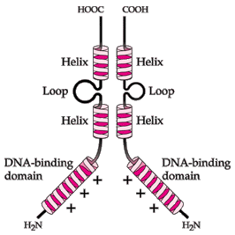
Muscle Regulatory Factors
Responsible for “turning on” transcription of other genes
Has a basic helix loop helix(bHLH) structure

Slide 8
Differentiation
Myoblast fuse into myotubes
Myoblasts come into close proximity
Small attachments form between myoblasts
Two lipid bilayers merge into a single cell membrane

Slide 9
Fusion

Slide 10
Maturation
Once cells fuse
  they do not continue to express the same set of genes
  They do not function in the same way before the fusion
Cells mature and express a new set of genes
  This happens to accommodate the morphological changes that will occur

Slide 11
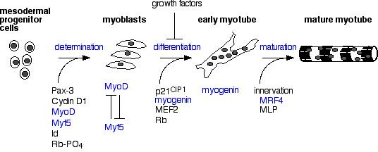
Changes during myogenesis

Slide 12
Myotube maturation
Maturation of primary myotubes is autonomous
  Little input from outside sources
  They mature by themselves
Development of secondary myotubes is predicated on the contraction of the primary myotube
  They cannot mature until primary myotubes mature

Slide 13
Myofibrillogenesis
Myofibrils begin to organize at the sarcolemma
Development of myofibrils
Need myofibrils for contracting muscles

Slide 14
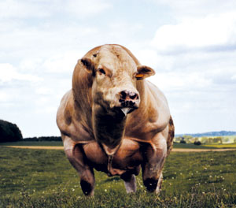
Muscle Growth
Now we know how muscle fibers are built… lets see how they grow

Slide 15
Muscle Growth
Muscle fiber number
  The absolute number of muscle fibers in a given area.
  Difficult to measure due to fiber direction and intrafasicularly terminating fibers.
    Some muscle fibers do not extend the entire length of the muscle

Slide 16
Increasing muscle fiber number
Almost all muscle fibers are developed prenatally
Previously thought increases in muscle fiber number were due to intrafasicularly terminating fibers.

Slide 17
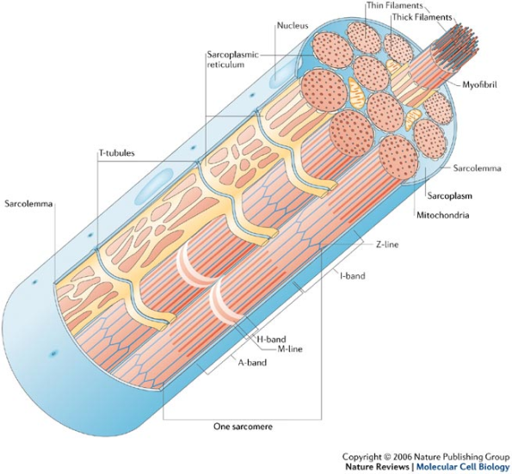
Increasing muscle fiber number
New postnatal muscle fibers are only generated during repair of muscle injury in mammals and most avian species
This is a result of muscle satellite cells proliferating and fusing across the damaged area.

Slide 18
Factors affecting muscle fiber number
Animal variation
Muscle
Species
Nutrition
Age
Breed and Genetic Selection
Sex
Genetic Conditions

Slide 19
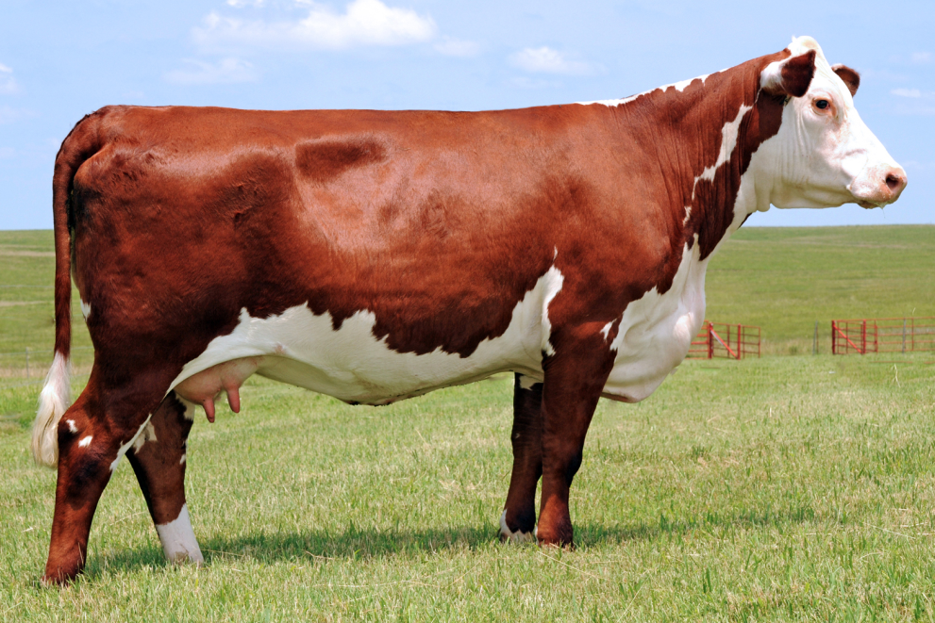
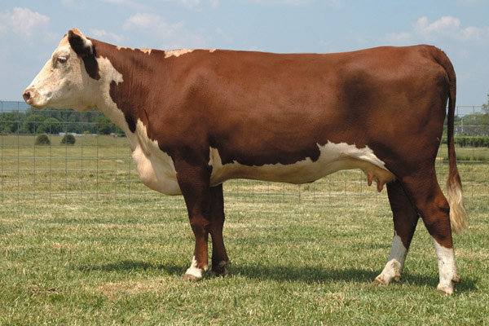
Animal Variation
Variation between two animals of the same species
This is the variation that is used during genetic selection/breeding

Slide 20
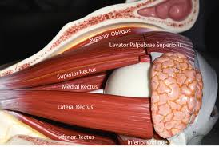
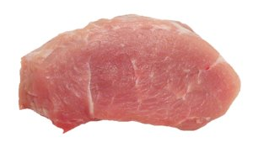
Muscle
The difference in size of a muscle is primarily based on the number of muscle fibers
Small muscle that control eye movement
  Thousands of muscle fibers
Ham muscle in pigs (semimembranosus)
  Billions of muscle fibers

Slide 21
Species
Primarily based on body size
Porcine semitendinosus contains approximately one-third the number of muscle fibers as the same muscle in bovine species
Excessive growth in fiber diameter is metabolically unfavorable
Diffusion of nutrients and metabolites in and out of the muscle fiber restricts radial growth

Slide 22
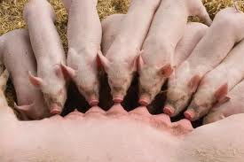
Nutrition
Nutrition is more important to muscle fiber number prenatally than postnatally
During development the conceptus (embryo/fetus) has a priority over other tissues in the dam for nutrients partitioned to tissues and organs.

Slide 23
Litter Bearing Nutrition
There is a priority that exists amongst developing embryo’s
  Can result in severe growth retardation, i.e. runts
  Many runts die shortly after birth because they can not compete with larger littermates for adequate nutrient intake during nursing
  If a runt survives it will become fatter than its counterparts because of less muscle fibers
    Think nutrient partitioning

Slide 24
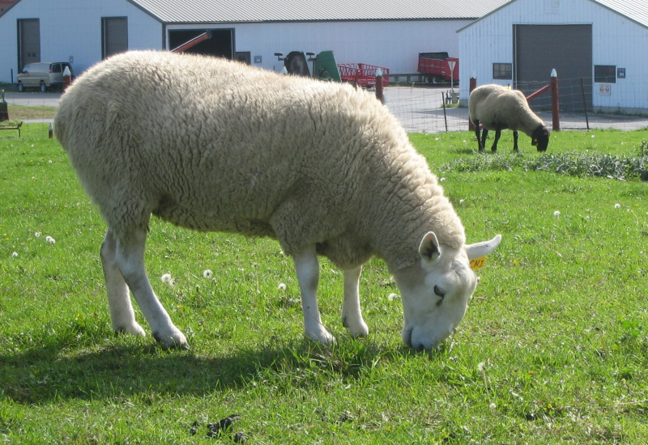
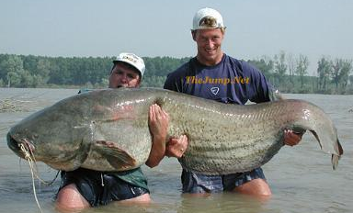
Age
Determinate grower
  Mammals and avian
  Grow until they reach a mature size
Indeterminate grower
  Fish
  No predetermined mature weight
  Grow to a size that reflects their environment and food availability

Slide 25
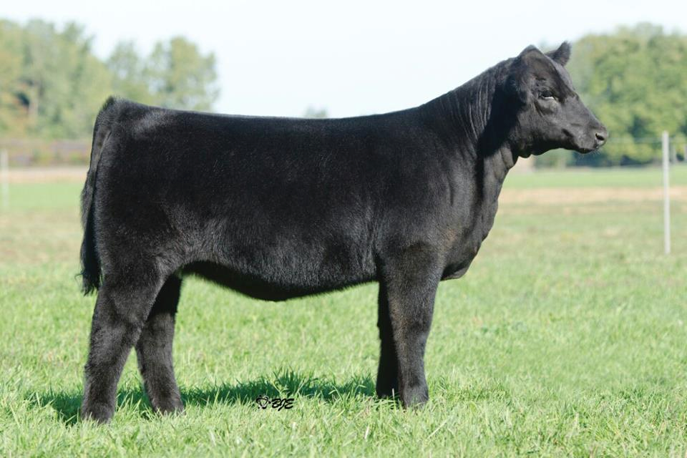
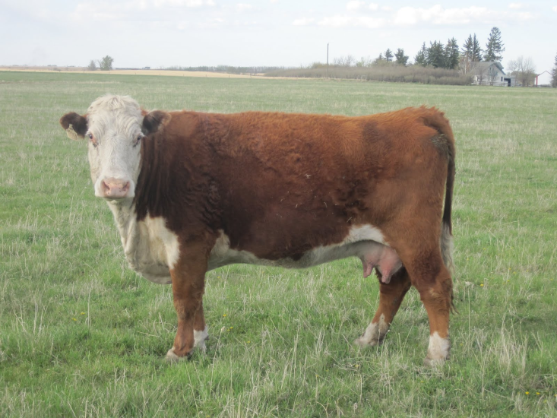
Age
Senescence
  When tissue mass in no longer maintained in its mature state and muscle fibers are lost
  Not a problem for most meat animals, but can be seen in males and females maintained for breeding

Slide 26
Sex
Males tend to have a greater number of muscle fibers than females
Likely due to exposure to higher concentrations of androgens in utero
Results in a greater potential for postnatal muscle hypertrophy

Slide 27
Genetic “Conditions”
Each protein is encoded by a specific gene in the genome
Mistakes can happen during DNA replication that can then be passed on.
  Errors or mutations can range from lethal to desirable

Slide 28
Genetic “Conditions
Mutations can range from
  Point mutations – a wrong code
  Deletions of larger region of a gene
Both point mutations and deletions can be found in myostatin (double muscled mutations).

Slide 29
Factors affecting muscle fiber size
Sex
Nutrition
Age
Growth Promotants
Genetic selection/Anomalies
Species

Slide 30
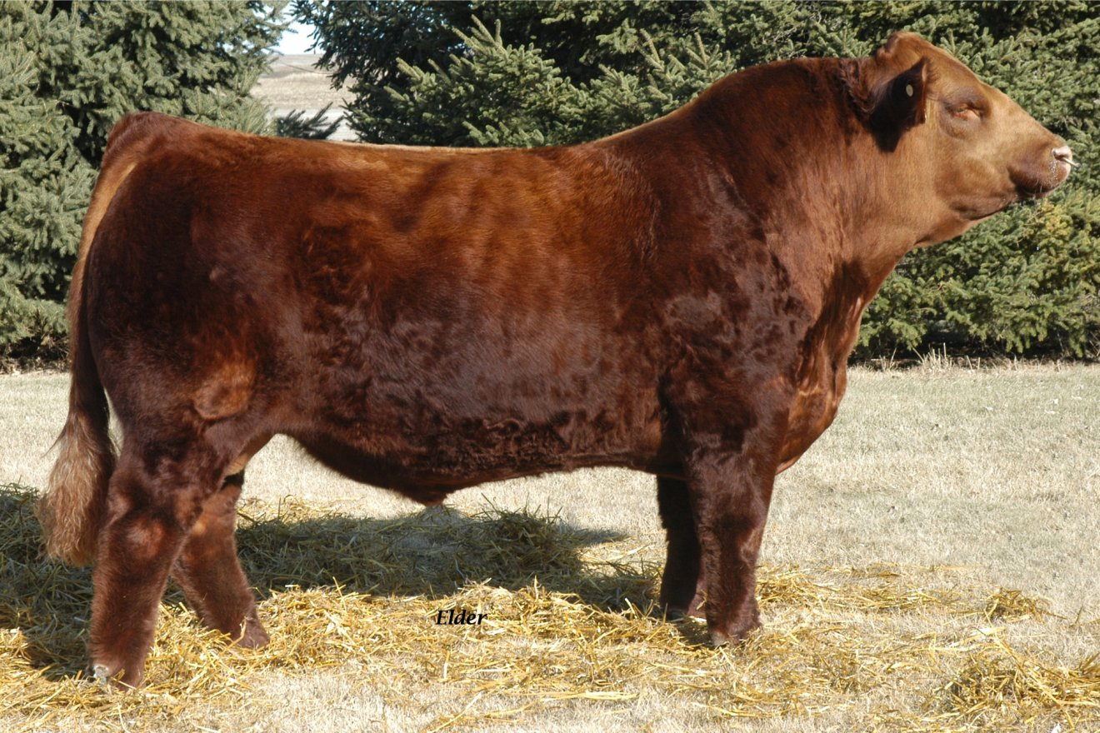
Sex
Androgens, like testosterone, cane increase cross-sectional area of muscle fibers

Slide 31
Nutrition
Lack of adequate available protein in the diet can limit muscle fiber size
Restrictive feeding can limit muscle fiber size

Slide 32
Age
Muscle fiber size increases until muscle maturity
Remember, senescence decreases muscle fiber number at later stages in life
  How does that affect muscle fiber size?
    Remaining muscle fibers actually get bigger because of an increased work load

Slide 33
Growth Promotants
Includes growth hormone, beta andrenergic agonists and steroidal hormones
The effect of some growth promotants are variable across different muscles

Slide 34
Genetic Selection/Anomalies
Callipyge – greek for “beautiful buttocks”

Slide 35
Callipyge
Normal number of muscle fibers
Larger muscle fiber size
  Greater protein: DNA ratio

Slide 36
Species
Only subtle differences exist across species in muscle fiber size
Cross sectional area of:
  Bulls – 3000 µm²
  Large pigs – 3400 µm²
  Rabbits – 2800 µm²

Slide 37
Objectives
Define myogenesis
Explain different ways myogenesis occurs
Define muscle growth
Explain different ways muscle growth occurs
Compare and contrast myogenesis and muscle growth

