Slide 1
Mendel’s Law of Inheritance Genotypes, Phenotypes & Punnett Square
Edited by: Jessica Hawley
Compiled by: Hailey Haberman

Slide 2
Objectives:
Explain Gregor Mendel’s laws of inheritance
Discuss the difference between genotypes and phenotypes
Label the three types of genotypes
Draw and label a Punnett square
Predict outcomes of a Punnett square

Slide 3
Mendel
Modern genetics had its beginnings in an abbey garden, where a monk named Gregor Mendel documented a particulate mechanism of inheritance.
He discovered the basic principles of heredity by breeding garden peas in carefully planned experiments.
His approach to science had been influenced at the University of Vienna by one of his professors: the physicist Doppler.

Slide 4
Mendel’s work
In order to study inheritance, Mendel chose to use peas, probably as they are available in many varieties.
The use of plants also allowed strict control over the mating.
He chose to study only characters that varied in an ‘either-or’ rather than a ‘more-or-less’ manner.

Slide 5
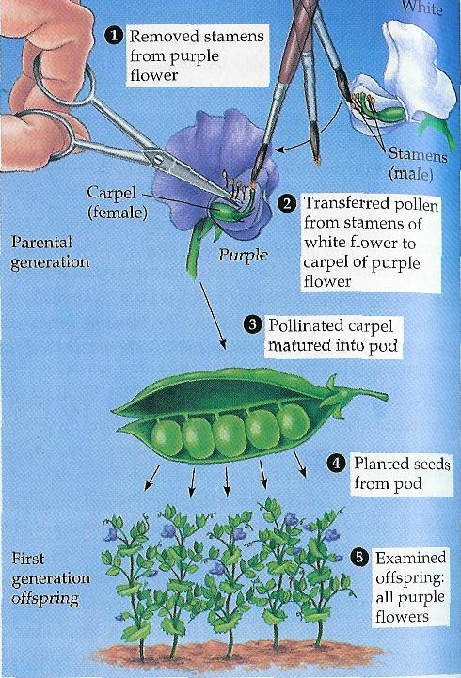
Genetic crosses
To cross two different pea plants, Mendel used an artist’s brush.
He transferred pollen from a true breeding white flower to the carpel of a true breeding purple flower.

Slide 6
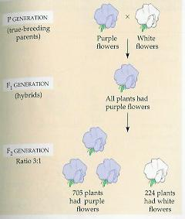
Tracking Characteristics
Mendel tracked heritable characters for 3 generations.
When F₁ hybrids were allowed to self-pollinate a 3:1 ratio of the 2 varieties occurred in the F₂ generation.

Slide 7
Mendel’s terminology
True breeding: When the plants self-pollinate, all their offspring are of the same variety.
Hybridization: Mating, or crossing, of two varieties.
Monohybrid cross: A cross between two parents that breed true for different versions of a single trait.

Slide 8
Mendel’s terminology
P generation: True breeding parents.
F₁ generation: (first filial) Hybrid offspring of the P generation.
F₂ generation: (second filial) Offspring from the self-fertilisation of the F₁ hybrids.

Slide 9
What is Genetics?
All body cells contain “Blueprints” with instructions as to how an animal will look or act etc.
One Gene comes from each parent (pairs)
Genes are divided into sections (Chromosomes) that carry genes
Sex chromosomes: Male = XY, Female = XX

Slide 10
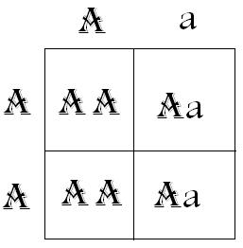
Genotypes
The genotype refers to the entire set of genes in a cell, an organism, or an individual. A gene for a particular character
or trait may exist in
two forms; one is
dominant (E) and the
other is recessive (e).

Slide 11
Dominant and Recessive Genes
Dominant Genes
One gene overshadows the other.
Recessive Gene
The gene that is overshadowed by a dominant gene.

Slide 12
Examples of Genotypes
There are three basic genotypes for a particular
character:
AA = homozygous dominant
Aa = heterozygous
aa = homozygous recessive

Slide 13
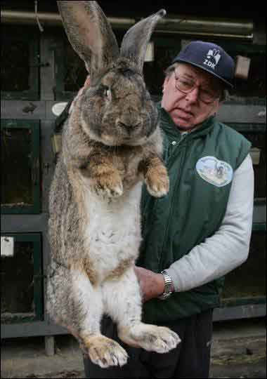
Phenotypes
Phenotype is the physical appearance or other characteristic of an organism as a result of the interaction of its genotype and the environment.
Some examples would be:
Size
Shape
Color

Slide 14
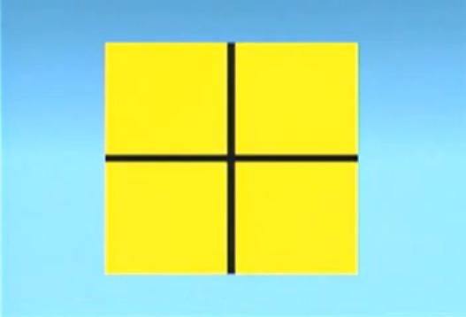
The Punnett Square
Is a square grid used in genetics to calculate the frequencies of the different genotypes and phenotypes among the offspring of a cross

Slide 15
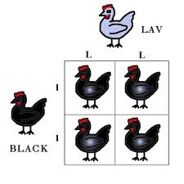
Genotypes and Phenotypes of Offspring's
Use a Punnett Square

Slide 16
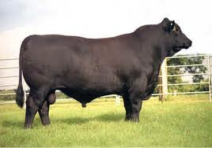
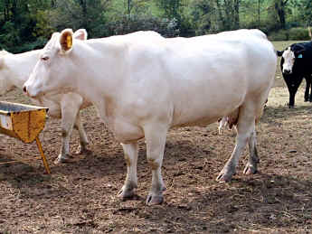
Punnett Square Example
 | A | A
a
a
Traits for color

Slide 17
Punnett Square Example Cont..
 | A | A
a | Aa | Aa
a | Aa | Aa

Slide 18
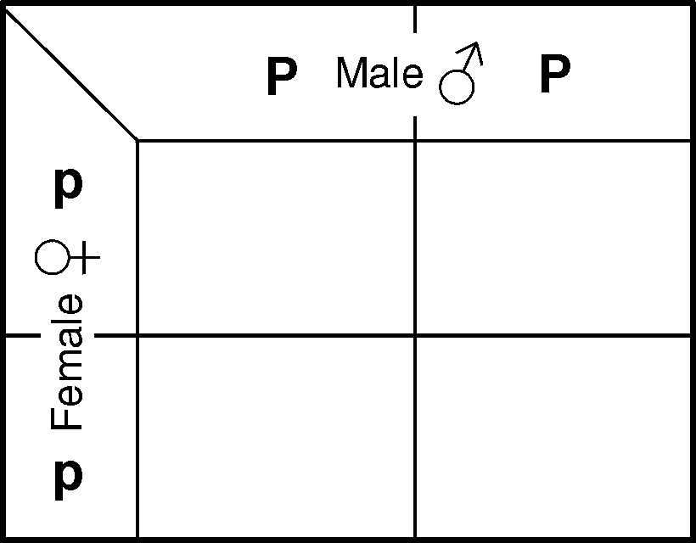
The male genotype is normally indicated at the top and the female genotype is indicated in the vertical margin.

Slide 19
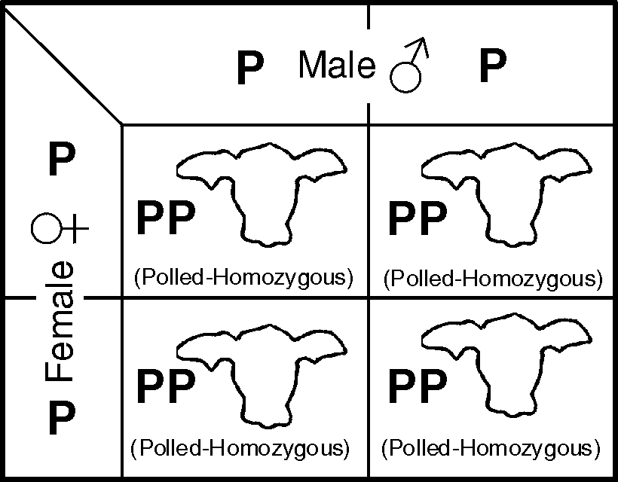
homozygous dominant parents (PP x PP), all offspring will be homozygous dominant polled individuals.

Slide 20
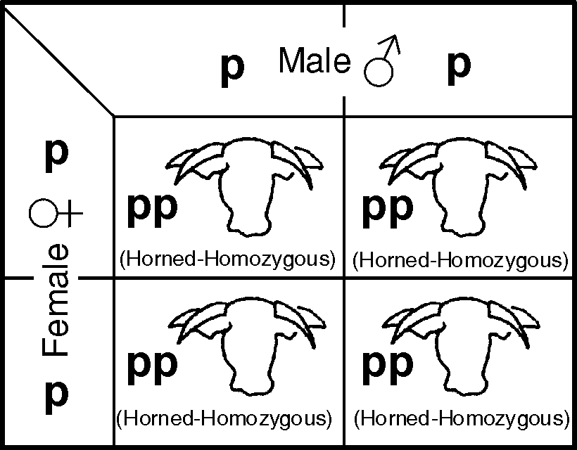
When crossing homozygous recessive parents (pp x pp), all of the offspring will be horned (homozygous recessive) individuals.

Slide 21
Crossing a heterozygous parent with a homozygous dominant parent (Pp x PP), the expected offspring would occur in a 1:1 ratio of homozygous dominant to heterozygous individuals.
Phenotype:
All offspring would be polled.

Slide 22
Punnett Square Example
We have a Angus Bull and a Charolais Cow.
The Angus (black) is Homozygous Dominant
The Charolais (white) is Homozygous Recessive
How would you set up the Punnett Square?

Slide 23
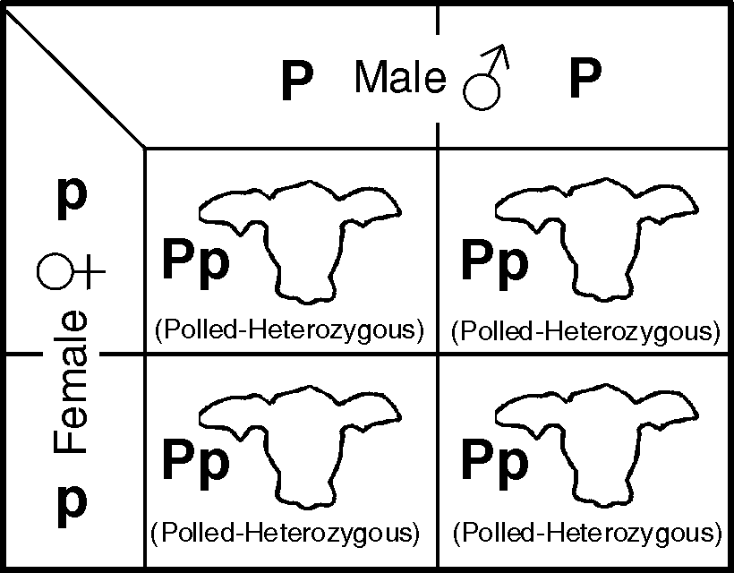
When crossing a homozygous dominant parent with a homozygous recessive parent (PP x pp), all offspring would be heterozygous and polled.

Slide 24
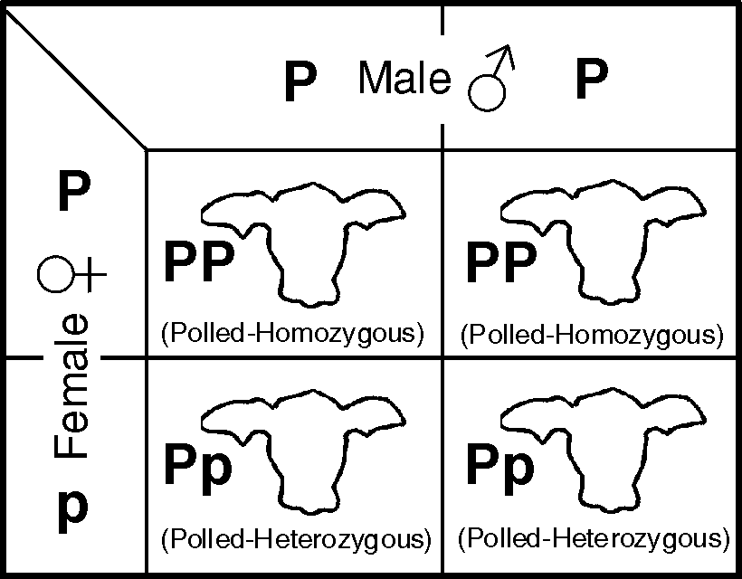

Slide 25
If two heterozygous parents are crossed (Pp x Pp), one can expect a genotypic ratio of 1:2:1, with one homozygous dominant polled, two heterozygous polled, and one homozygous recessive horned individuals.
The expected phenotypic ratio of offspring would be 3:1 (polled to horned).

Slide 26
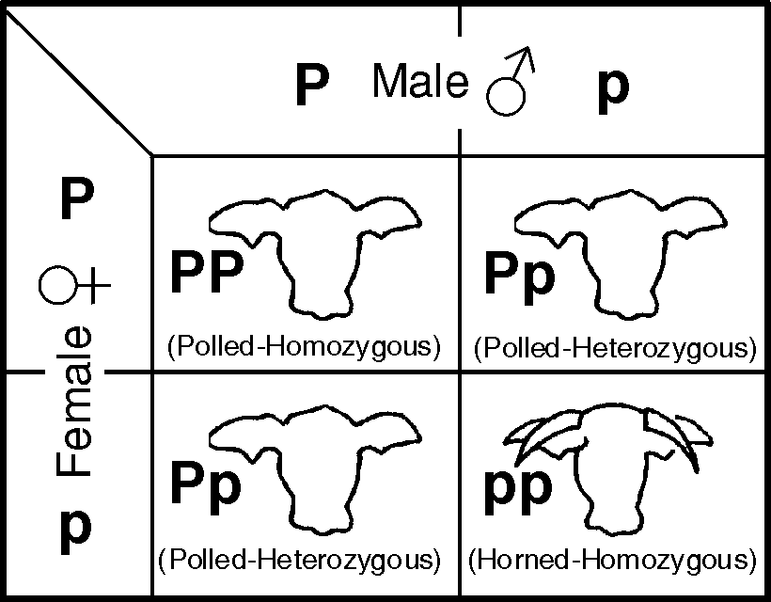

Slide 27
Lets Practice
http://glencoe.mcgraw-hill.com/sites/0078759864/student_view0/unit3/chapter10/virtual_labs.html#

Slide 28
Objectives
Explain Gregor Mendel’s laws of inheritance
Discuss the difference between genotypes and phenotypes
Label the three types of genotypes
Draw and label a Punnett square
Predict outcomes of a Punnett square

