Slide 1
History of Genetics By: Keith King

Slide 2
Objectives
State the history of genetics;
Describe major century events;
Define terms used in genetics

Slide 3
History of Genetics
People have known about inheritance for a long time.
children resemble their parents
domestication of animals and plants, selective breeding for good characteristics
Sumerian horse breeding records
Egyptian data palm breeding
Bible and hemophilia

Slide 4
Old Ideas
A number of incorrect ideas had to be generated and overcome before modern genetics could arise.
1. All life comes from other life
Living organisms are not spontaneously generated from non-living material. Big exception: origin of life.
2. Species concept: offspring arise only when two members of the same species mate.
Monstrous hybrids don’t exist.

Slide 5
More Old Ideas
3. Organisms develop by expressing information carried in their hereditary material.
As opposed to “preformation”, the idea that in each sperm (or egg) is a tiny, fully-formed human that merely grows in size.
4. The environment can’t alter the hereditary material in a directed fashion.
There is no “inheritance of acquired characteristics”.
Mutations are random events.

Slide 6
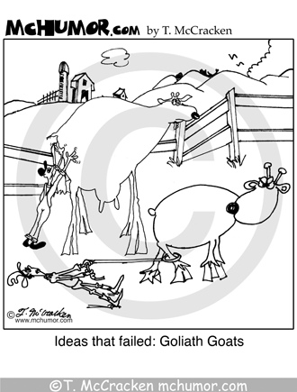
More Old Ideas
5. Male and female parents contribute equally to the offspring.
ancient Greek idea: male plants
a “seed” in the female “garden”.
alleged New Guinea belief: sex is
not related to reproduction.

Slide 7
Mid 1800’s Discoveries
Three major events in the mid-1800’s led directly to the development of modern genetics.
1859: Charles Darwin publishes The Origin of Species, which describes the theory of evolution by natural selection.
This theory requires heredity to work.
1866: Gregor Mendel publishes Experiments in Plant Hybridization, which lays out the basic theory of genetics.
It is widely ignored until 1900.
1871: Friedrich Miescher isolates “nucleic acid” from pus cells.

Slide 8
Major Events in the 20th Century
1900: rediscovery of Mendel’s work by Robert Correns, Hugo de Vries, and Erich von Tschermak
1902: Archibald Garrod discovers that alkaptonuria, a human disease, has a genetic basis.
1904: Gregory Bateson discovers linkage between genes. Also coins the word “genetics”.
1910: Thomas Hunt Morgan proves that genes are located on the chromosomes (using Drosophila).

Slide 9
More 20th Century Events
1918: R. A. Fisher begins the study of quantitative genetics by partitioning phenotypic variance into a genetic and an environmental component.
1926: Hermann J. Muller shows that X-rays induce mutations.
1944: Oswald Avery, Colin MacLeod and Maclyn McCarty show that DNA can transform bacteria, demonstrating that DNA is the hereditary material.
1953: James Watson and Francis Crick determine the structure of the DNA molecule, which leads directly to knowledge of how it replicates
1966: Marshall Nirenberg solves the genetic code, showing that 3 DNA bases code for one amino acid.

Slide 10
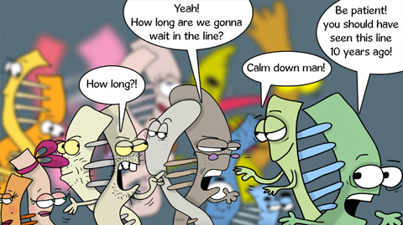
20th Century Events Continued
1972: Stanley Cohen and Herbert Boyer combine DNA from two different species in vitro, then transform it into bacterial cells: first DNA cloning.
2001: Sequence of the entire human genome is announced.

Slide 11
Molecular Reality (current view)
Almost all inheritance is based on DNA:
the sequence of ACGT nucleotides encodes all instructions needed to build and maintain an organism.
A chromosome is a single DNA molecule together with other molecules (proteins and RNA) needed to support and read the DNA.
A gene is a specific region of a chromosome that codes for a single polypeptide.
A polypeptide is a linear chain of amino acids

Slide 12
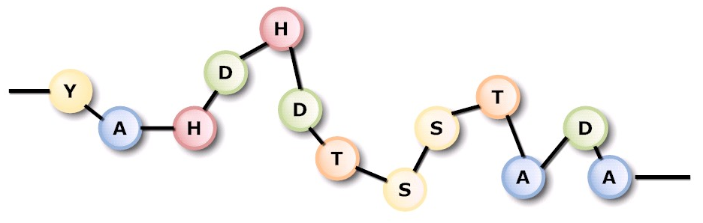
Molecular Reality (current view)
Proteins are composed of one or more polypeptides, plus in some cases other small helper molecules (co-factors). Proteins do most of the work of the cell.

Slide 13
Gene Expression
Genes are expressed in a 2 step process:
First, an RNA copy of a single gene is made (transcription).
Then, the nucleotide sequence of the RNA copy (messenger RNA) is translated into the amino acid sequence of the polypeptide.
the genetic code is a list of which 3 base DNA or RNA sequence (codon) encodes which amino acid. The same genetic code is used in (almost) all organisms.
All cells in the body have the same DNA, but different genes are expressed in different cells and under different conditions.

Slide 14
Gene Differences
Genes often have several alleles: the same gene in the same chromosomal location, but with minor nucleotide changes that yield slightly different proteins.
For a given gene, many different alleles can exist in a population (members of the same species), but an individual diploid organism can have 2 alleles at most: one from each parent. Diploid = having 2 copies of each gene and each chromosome.

Slide 15
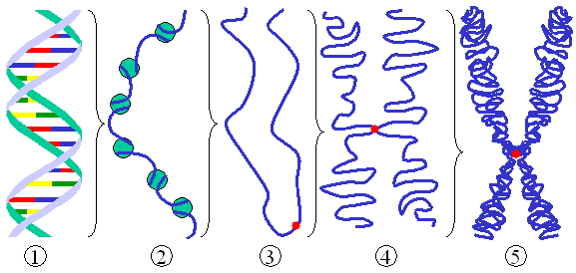
Other Chromosome Components
Chromosomal DNA contains other things besides genes:
centromere (where the mitotic spindle attaches)
telomeres (special structures on the ends of chromosomes)
origins of replication (where copying of DNA starts)
pseudogenes (non-functional, mutated copies of genes)
transposable elements a.k.a. transposons (intranuclear parasites)
genes that make small RNAs and not proteins
“junk” (?)

Slide 16
Prokaryotes vs. Eukaryotes
Prokaryotes:
Eubacteria and Archaea. Usually unicellular.
No internal membrane-bound compartments: DNA floats free in the cytoplasm.
1 circular chromosome (plus optional plasmids, which are also circular)
reproduction usually asexual
sexual processes (mixing DNA from 2 individuals) occur, but with unequal contributions from the 2 partners
transcription and translation simultaneous

Slide 17
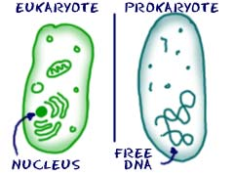
Prokaryotes vs. Eukaryotes
Eukaryotes:
Plants, animals, fungi, protists. Often multicellular.
DNA contained within a membrane-bound nucleus.
linear chromosomes (usually more than 1)
careful division of chromosomes in cell division: mitosis and meiosis
transcription separated from translation
sexual reproduction: 2 partners contribute equally to offspring
life cycle: alternation of haploid and diploid phases (i.e. 1 vs. 2 copies of each gene and chromosome)

Slide 18
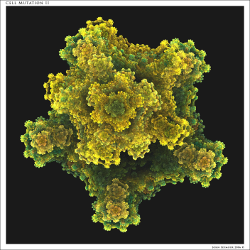
Mutation
Mutations, which are any change in the DNA base sequence), occur constantly in all cells and organisms. Offspring rarely get a perfect copy of the DNA from its parents.
but mutations are rare: about 1 DNA base change per 10⁹ bases each cell generation. (Humans have about 3 x 10⁹ bases and E. coli bacteria have about 4 x 10⁶ bases).
Some mutational changes are much larger: chromosome rearrangements that include genes torn in half and moved to new locations, sometimes combined with other genes.

Slide 19
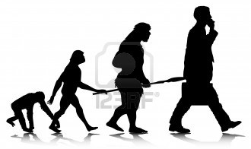
Evolution
Fitness: the ability to survive and reproduce. An individual’s fitness is affected by its genes.
Natural selection: more fit individuals tend to increase their numbers each generation, at the expense of less fit individuals. Alleles that confer higher fitness tend to take over in the population, causing a loss of less fit genes.
Large scale changes, new species, are thought to usually occur in small isolated populations, where they don’t get swamped out or out-competed by the “normal” individuals.

Slide 20
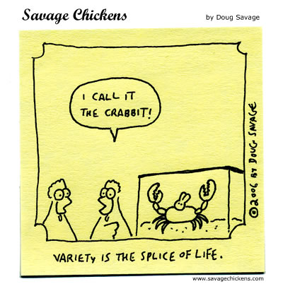
Objectives
State the history of genetics;
Describe major century events;
Define terms used in genetics

