Slide 1
Livestock Improvement through Selection
Learn all genetic traits!!!!

Slide 2
Objectives
Compare and contrast the idea of genetics vs environment
List examples of high and low heritability estimates
Define expected progeny differences
Describe the importance of livestock improvement

Slide 3
Overview
Emphasis on certain traits depend on
Economic importance
Rate of improvement of specific trait
Factors affecting the rate of improvement
Heritability
Selection differential
Generation interval
Expressions of traits are influenced by genetics and environment

Slide 4
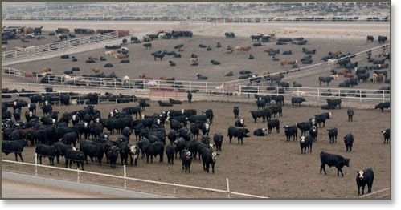
Genetics vs Environment
Different factors affect growth in different ways
How can we tell the difference?
Contemporary trials

Slide 5
Heritability
An estimate of the fraction of the phenotypic superiority or inferiority
Ex: low heritability estimates (.10-.20) 80 -90% of variation is due to environmental factors
Low heritability traits change slowly

Slide 6
High vs Low Heritability
Low heritability
Reproductive traits
Fertility
Calving interval
Litter size
** greatest effect on economic return!!
High heritability
Carcass traits
Fat thickness
Rib eye area
Efficiency of gain
** small effect on economic return!!

Slide 7
Heritable trait example
Qualitative – hair color
Quantitative – performance traits
Single trait – eye color, hair color
Multi trait – calving ease, speed

Slide 8
Expected Progeny Differences
EPD – the expected (or predicted) difference in performance between the progeny of two animals of the same breed.
Most accurate method of comparing breeding value
Accounts for
Individual’s, parent’s, sibling’s and progeny’s performance

Slide 9
Advantages of EPD’s
Most accurate predictors of progeny performance
Provide an accurate depiction of an individual/herd’s strength/weakness
Allow for greater specificity in multi-trait selection

Slide 10
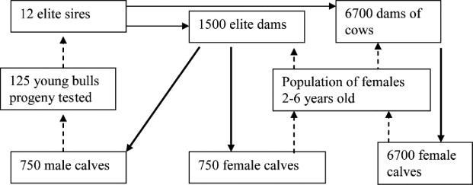
Selection Index
Place added emphasis on the more economically important traits

Slide 11
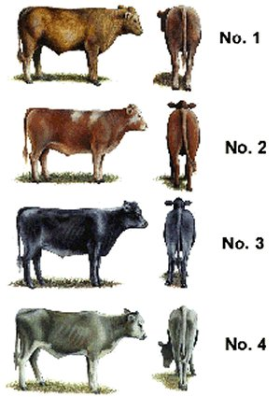
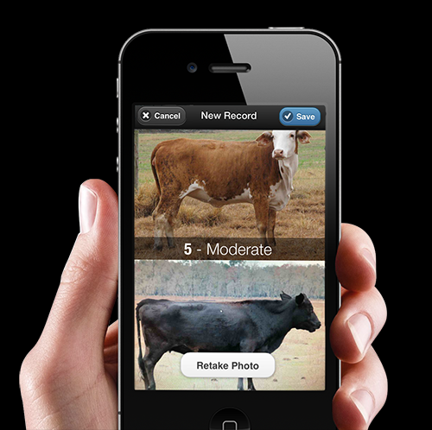
Visual Aids
There’s an app for that!

Slide 12
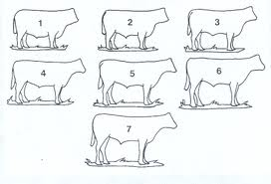
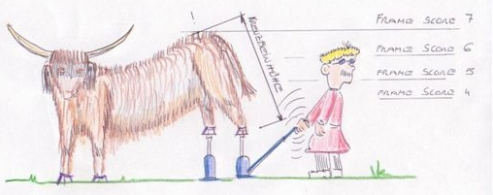
Visual Aids
Frame score

Slide 13
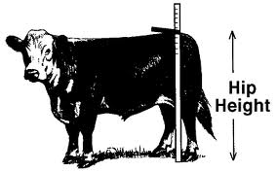
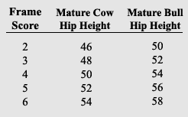
Visual Aids
Hip Height

Slide 14
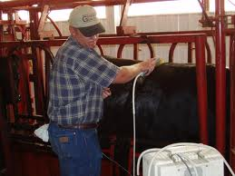
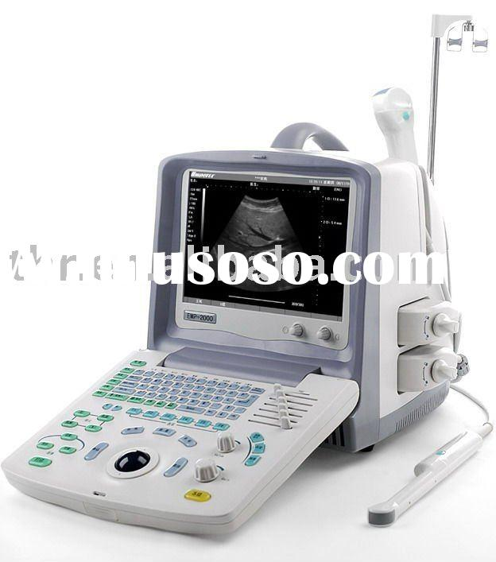
Visual Aids
Ultrasound Technologies
Done in real time
Cross-section of rib eye
Back fat and REA

Slide 15
Objectives
Compare and contrast the idea of genetics vs environment
List examples of high and low heritability estimates
Define expected progeny differences
Describe the importance of livestock improvement

