Slide 1
Introduction to Evaluation

Slide 2
Objectives
Define the purpose of evaluating livestock
Compare and contrast factors affecting livestock selection
Define efficient production
Compare and contrast differences between selection of market and breeding animals
Explain the purpose of fat

Slide 3
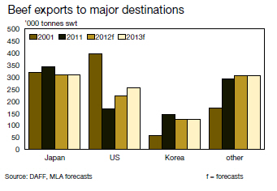
What is the purpose of evaluating livestock?
Essential to
Economic success of individual farmers and ranchers
Success and reputation of the livestock and meat industry

Slide 4
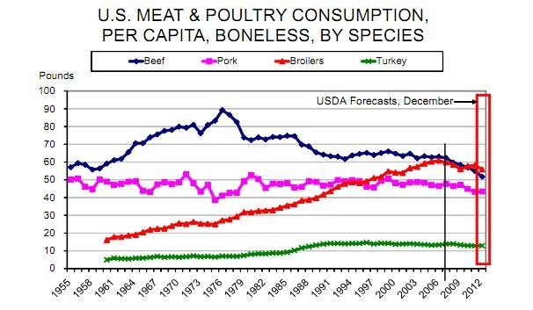
What must a producer know?
Market trends
Feed sources
Consumer demands
These all change!!

Slide 5
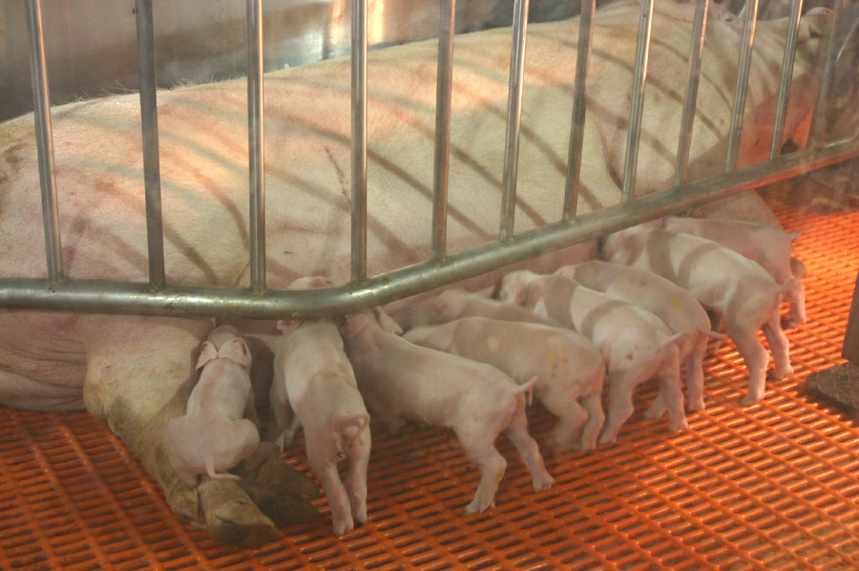
Breeding
Keep or Cull
Replacements
Objective and Subjective
Eyeball and EPD’s
Breeding potential
Necessary traits
Economic value of specific traits
Could traits be altered through genetic selection?

Slide 6
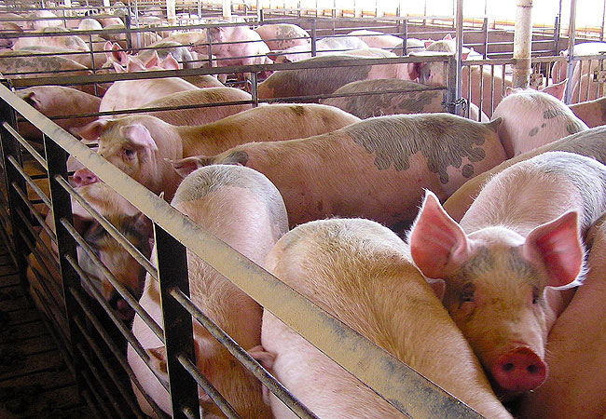
Market
Market demands
Value added programs
Consumer trends
Value of slaughter animal
Weight
Body condition
Carcass merit
Yield and quality grade

Slide 7
Growth
Growth- an increase in the structural tissues
Bone, muscle, and connective tissues associated with muscle
Is NOT an increase in size
Not all portions of the body develop equally
Development
Growth difference in body parts
Occurs from embryonic stages through maturity
Ex. Head – postnatal increase < all other body parts

Slide 8
Factors affecting market animal selection
Muscle tissue
This is what is consumed
Skeletal structure
Maximize production efficiency
Ensure longevity of breeding stock
Fat
Ensures eating quality
Subcutaneous fat ensure protection during handling

Slide 9
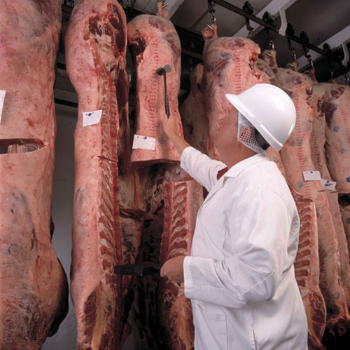
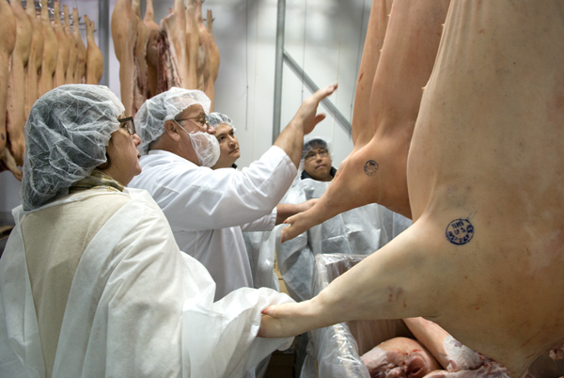
Efficient Production
Maximum muscle and minimum fat
Goal is consistent with consumer attitudes
Fat considered undesirable
Bone considered undesirable

Slide 10
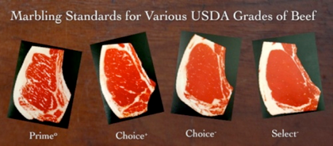
Fat
Is necessary
Protects during handling and storage
Impacts eating quality
Four deposits of fat are:
Subcutaneous (under the skin)
Intermuscular (between muscle groups)
Intramuscular (within muscles)
Kidney (KPH)

Slide 11
Fat con’t
Subcutantenous (back fat)
Measurements of back fat thickness is highly correlated with yield of retail cuts
Used on foot or on rail
Intermuscular (seam fat)
Not easily measured or estimated
Not included in live or carcass evaluation

Slide 12
Fat con’t
Intramuscular (marbling)
Most important in beef evaluation
Major factor in determining quality grade
Kidney
KPH –Kidney, pelvic, heart
In beef deposits in abdominal, pelvic and thoracic cavityies are evaluated

Slide 13
Terms to be familiar with
Physiological Age-Difference in stage of maturity among animals
Early maturing- smaller, mature faster
Late maturing- larger, mature slower

Slide 14
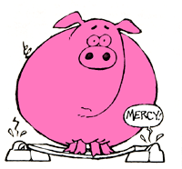
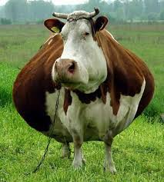
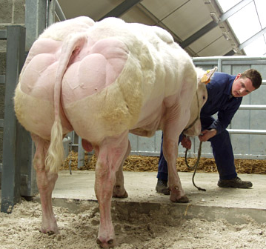
Criteria used to evaluate live animals
Weight
Muscle
Fat

Slide 15
Objectives
Define the purpose of evaluating livestock
Compare and contrast factors affecting livestock selection
Define efficient production
Compare and contrast differences between selection of market and breeding animals
Explain the purpose of fat

