Slide 1
Introduction to Animal Growth and Development
By: Jessica Hawley

Slide 2
Objectives
Define growth
Explain the three ways growth can occur
Compare and contrast differences in true growth and fattening
Explain differences in animal growth from past and present

Slide 3
What is growth?
Fundamental to every living creature
The general or normal expansion of size as produced by the accretion of tissues similar to that of the original tissue or organ
Time Lapse Growth of Parakeets

Slide 4
How can growth occur?
Hypertrophy
Increase in cell size
Hyperplasia
Increase in cell number
Accretion
A growth or enlargement by a gradual build up
Whole body growth does not occur independently
Individual cellular changes allow tissues and organs to assume different roles.

Slide 5
True Growth vs. Fattening
True growth – increase in the amount of muscle and bone
Skeletal, Cardiac and Smooth muscle
Fattening – increase in the accumulation of fat
New calf has true growth
Fattening occurs at the end of a life stage

Slide 6
Why study growth?
By understanding the processes related to animal growth we can alter true growth and fattening as a result of growth rate
Subtle or substantial changes in growth and development of animals can directly impact animal productivity
Large Scale Production
What if animals ate fast food?

Slide 7
How do we measure growth?
ADG-Average Daily Gain
This is the most common measurement
Weight at day X – weight at day 0
# of days on feed

Slide 8
Why would we want a faster growth rate
Goes to market sooner
Use less feed
More time to put on fate
Hopefully achieve a higher quality grade over the same period
All comes down to being more efficient!

Slide 9
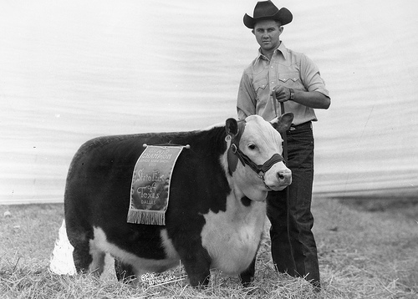
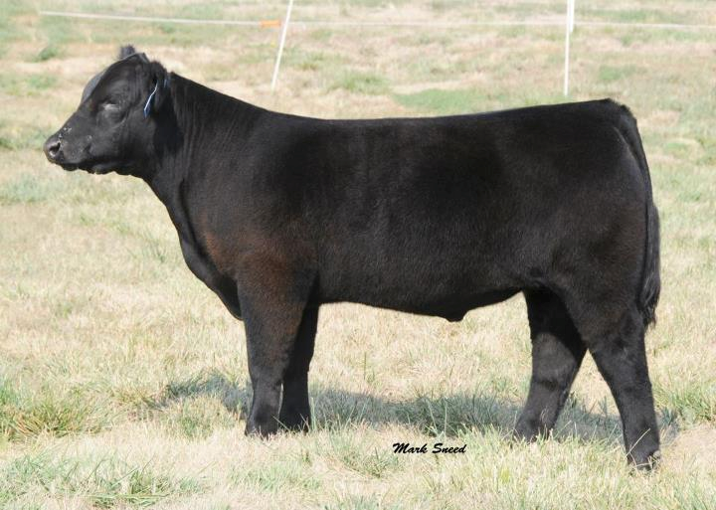
Cattle 1950’s - present

Slide 10
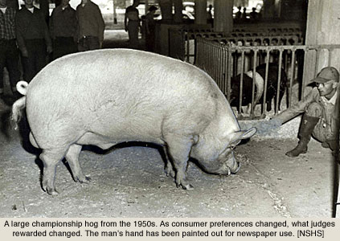
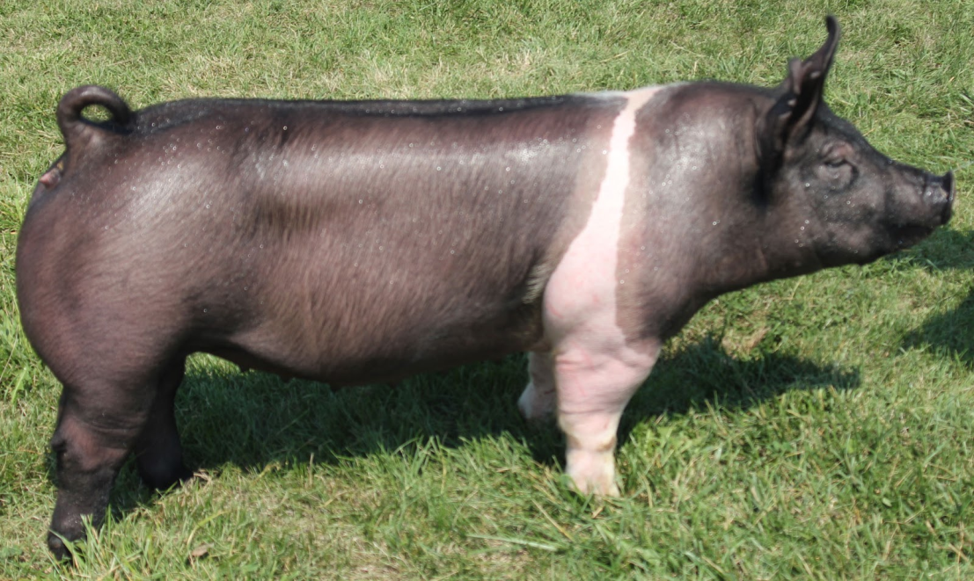
Swine 1950’s - present

Slide 11
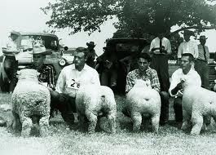
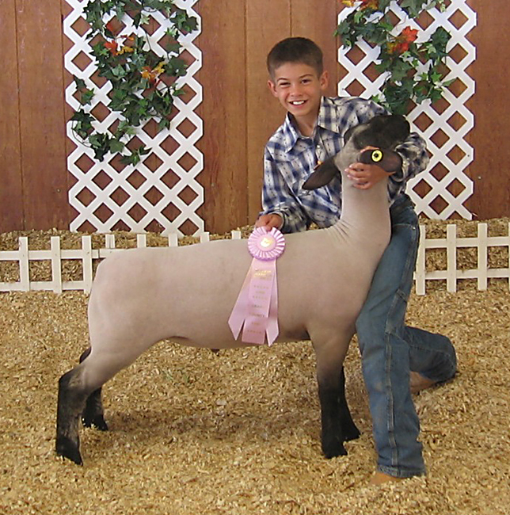
Sheep 1950’s - present

Slide 12
Objectives
Define growth
Explain the three ways growth can occur
Compare and contrast differences in true growth and fattening
Explain differences in animal growth from past and present

