Slide 1
Inheritance
Compiled by: Jessica Hawley
Stolen and edited from: IMS Dr. Kyle Stutts (SHSU) and Brandon Freel

Slide 2
Objectives
Discuss genetic inheritance.
Investigate principles of inheritance.
Demonstrate how inheritance plays a role in sex-linked genes
Explain the difference between sex- linked, limited, and influenced inheritance
Genetic Inheritance Video

Slide 3
Randomness of Inheritance
Genetics are random in nature
Prior to Mendel’s findings
  Most widely accepted thought involved a blending theory
  If blending theory is true, we would all look the same today
  No way to predict the combination of genes in a gamete
Randomness of inheritance is
  critical from an evolutionary standpoint
  important to the success of artificial selection

Slide 4
Inheritance
For a number of traits, gene expression differs in males and females
The causes fall under 3 categories:
Sex-Linked
Sex-Limited
Sex-Influenced

Slide 5
Considering multiple traits
There are multiple traits that need to be considered when mating animals.
  consider that cattle can be horned or polled and white-faced or red-faced.
Polled and white-faced are dominant
Horns and red-faced coloring are recessive.

Slide 6
Considering multiple traits
What are the genotypic and phenotypic ratios if two individuals with two pairs of heterozygous genes (each affecting a different trait) are mated?
Set up your punnett square

Slide 7
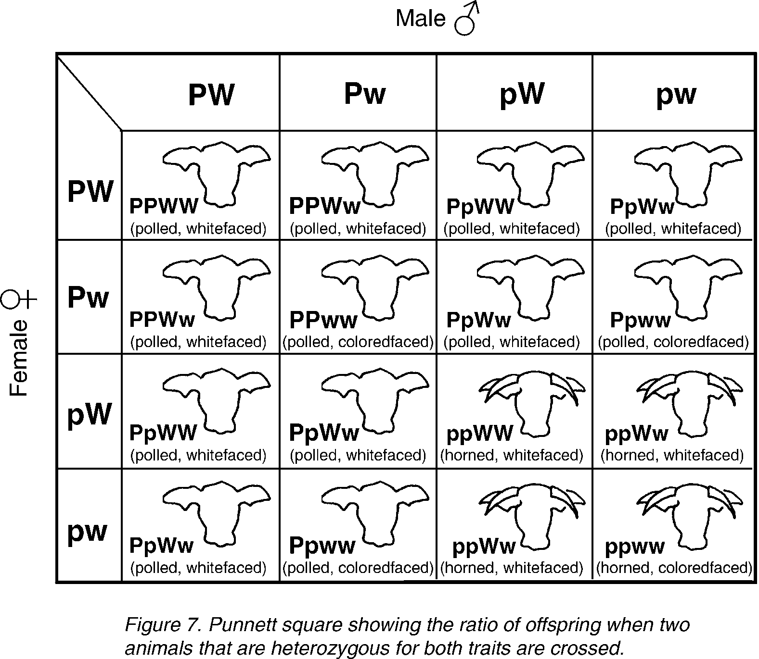
Should look like this

Slide 8
Now take time to fill in your punnett square
What are the genotypic ratios?
What are the phenotypic ratios?

Slide 9
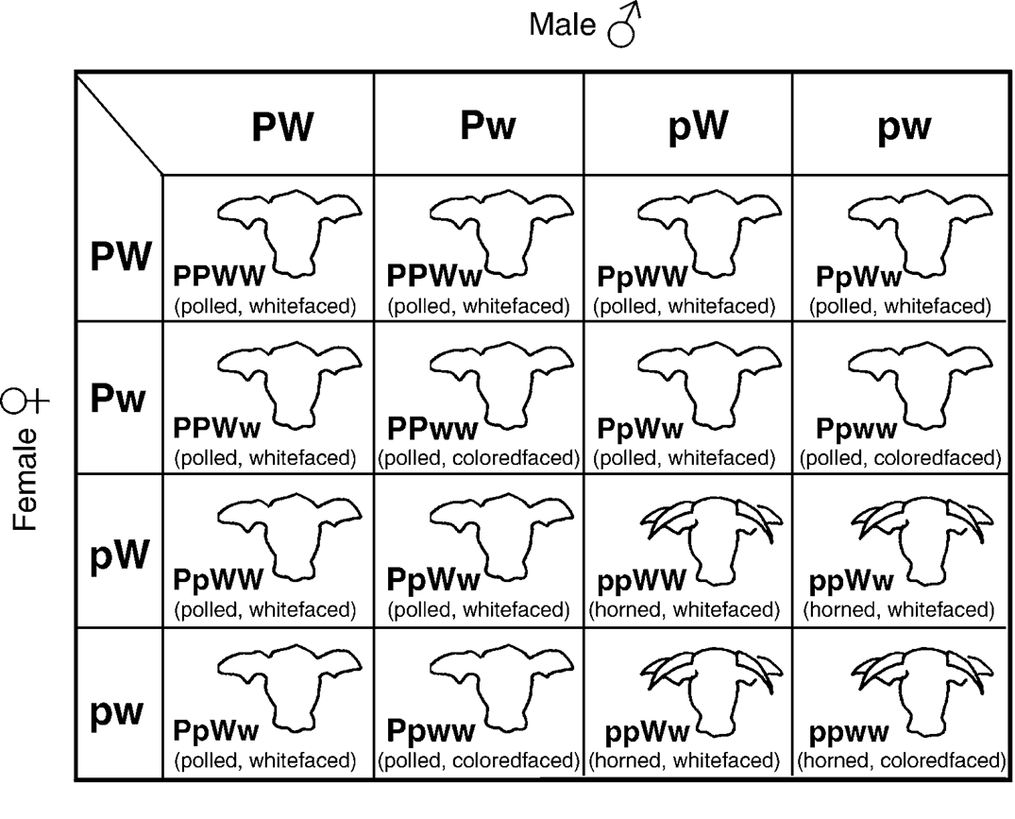

Slide 10
Considering multiple traits
Genotypes – 1 PPWW, 2 PPWw, 2 PpWW, 4 PpWw, 1 PPww, 2 Ppww, 1 ppWW, 2 ppWw, and 1 ppww;
Phenotypes
9 polled, white-faced;
3 polled, red-faced;
3 horned, white-faced; and
1 horned, red-faced offspring.

Slide 11
Sex-linked Traits
Involve genes that are carried only on the X or Y chromosomes
  These are involved in determining the sex of animals.
The female genotype is XX, while the male genotype is XY.

Slide 12
Sex-linked Traits
The X chromosome is larger and longer than the Y chromosome, which means a portion of the X chromosome does not pair with genes on the Y chromosome.
Sex-linked Trait Video

Slide 13
Sex-linked Traits
The sex of an animal may determine whether a gene is dominant or recessive (Ex. Scurs in polled European cattle).
  Sex-linked traits in females are recessive and covered by dominant genes.
  A certain portion of the Y chromosome does not link with the X chromosome.
  The traits on this portion of the Y chromosome are transmitted only from fathers to sons.

Slide 14
Sex-linked Traits
The expression of certain genes, which are carried on the regular body chromosomes of animals, is also affected by the sex of the animal.
In poultry, the male has the genotype XX, while the female has the genotype Xw.
An example of a sex-linked trait in poultry is the barring of Barred Plymouth Rock chickens.

Slide 15
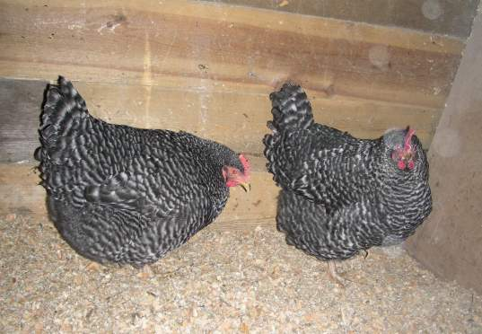
Sex-linked Traits
If barred hens are mated to non-barred males, all of the barred chicks from this cross are males, and the non-barred chicks are females.
Photo courtesy of Wikipedia.

Slide 16
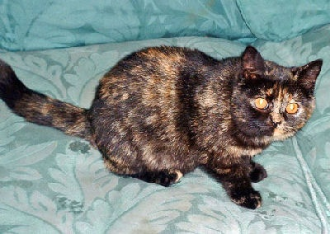
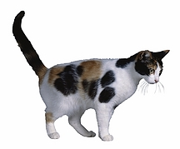
Sex-Linked Inheritance
Ex- Tortoise shell color in cats
- mixture of color that appears in patches
* orange, white, black, gray, tabby
* much white called calico
- always female (almost)
- Locus for orange color occurs on the X chromosome

Slide 17
Sex-Linked Inheritance
Females OO | Males Oo
OO = Orange | O = Orange
Oo = Tortoiseshell | o = non-orange
Oo = non- orange

Slide 18
Sex- Influence Inheritance
Modes of gene expression differ between males and females
An allele may be expressed as a dominant in one sex and a recessive in the other
Scurs for cattle is a sex-influenced inheritance
The allele for scurs is dominant in males and recessive in females
A male with one copy will have scurs, but a female must have 2 copies

Slide 19
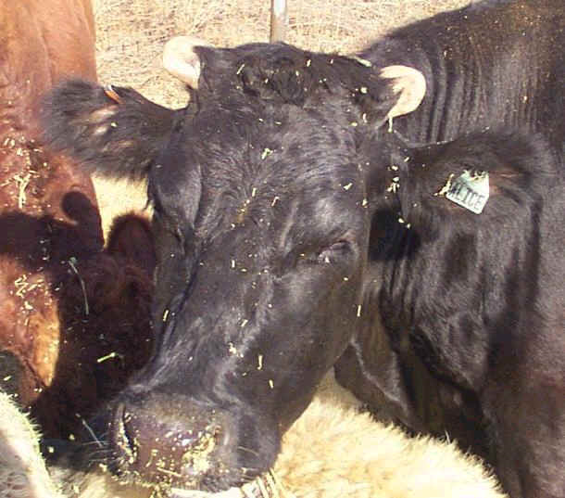

Slide 20
Sex-Limited Inheritance
Phenotypic expression is limited to one sex
Ex. Milk production, and scrotal circumference
These genes are not necessarily on the sex chromosomes but are only expressed in the male or female
Thought to be hormonally conditioned

Slide 21
Objectives
Discuss genetic inheritance.
Investigate principles of inheritance.
Demonstrate how inheritance plays a role in sex-linked genes
Explain the difference between sex- linked, limited, and influenced inheritance

