Slide 1
Hormonal Regulation of Growth

Slide 2
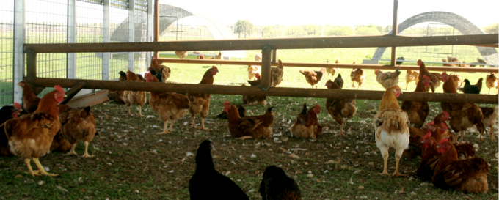
Objectives
Define hormone action
Explain the 5 types of hormone action
Know the function and effects of hormones in detail

Slide 3
Hormone Action
Definition
Chemical messengers secreted by various tissues, not necessarily secreted by ductless glands.
Hormones act in an endocrine manner when secreted by cells and then transmitted via the bloodstream to act on distant target cells

Slide 4
Types of action
Endocrine-secretions come from cells and are then transmitted via the blood stream

Slide 5
Types of action
Neurocrine
Hormone is synthesized in a cell body of a neuron and stored in axons such as neurotransmmitters, but secreted into the bloodstream to act on distant target cells
A key regulator of animal growth and development by the hypothalamic-pituitary-peripheral gland axes
Neuroendocrine system
relies on close coordination between the nervous and endocrine system

Slide 6
Types of action
Local conveyance- acting near the site of secretion
Paracrine- when a hormone from one cell is conveyed to an adjacent cell of different type over a short distance via interstitial fluid
Autocrine – where a hormone from one cell acts on itself or a neighboring cell of the same type
Intracrine – acts intracellularly and does not require secretion to alter the process

Slide 7
Types of action
Tissue specificity
Allows hormones to act on target tissues without affecting other tissues or organs
Receptors – has an affinity for specific hormones that may be located at the cell
Hormones will bind and act through various enzyme systems, ion transport, or gene regulation
Negative feedback loops may also regulate hormonal function

Slide 8
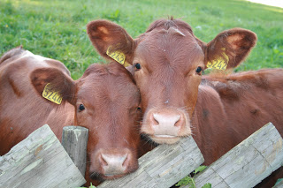
Chemical Nature of Hormones
Classification
Peptides/amino acid derivatives
Water soluble
Ex. Thyroxine, LH, FSH
Steroid/cholesterol derivatives
Ex. Estrogen, testosterone, progesterone
Fat soluble

Slide 9
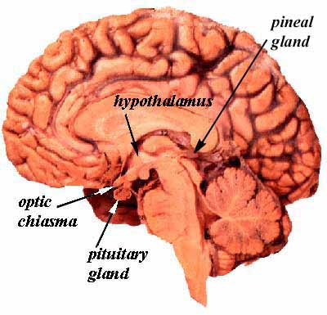
Hypothalamic-Pituitary-Peripheral Gland Axis
Hypothalamus – the central organ of the neuroendrocrine system
Secretions regulate the secretions from the pituitary
Located at the base of the brain
Two sections: adenohypophysis and neurohypophysis

Slide 10
Androgens
Two types: testicular and adrenal
Testicular hormones are testosterone and androstenone
Testosterone is produced in the Leydig cells of the testes.
Androstenone is a pheromone
Known to contribute to the boar taint odor in pork

Slide 11
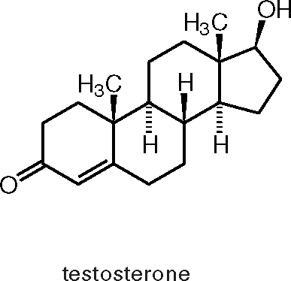
Androgens
Androstenone is stored in the salivary gland and accumulates in fat depots
Growth effects are seen by the influence of testosterone of bone and muscle.
This is seen by the increasing deposition of bone salts. Thus, increased bone mass is seen more in males

Slide 12
Androgens
Muscle development is seen through androgen secretions in three ways
In utero, declines after birth, and increases at puberty
Prenatal androgens affects myogenesis
Castrated males have lower circulating GH than intact males
Androgens increase both protein synthesis and degradation, yet synthesis is stimulated more

Slide 13
Androgens
Androgens synthesis induces the development of mature male characteristics such as: larger muscles in the forequarter, neck and crest region.
Castration diverts energy from growth of muscle development to fat deposition
Castration helps improve quality by less muscle and more fat development at an earlier age

Slide 14
Estrogen
General classification for three hormones: Estrone, Estriol, Beta-estradiol
Responsible for: growth, maturation of repro tract, female behavior, mammary development
Impact: bone, fat, and muscle tissue growth
Females have shorter skeletons due to: earlier epiphyseal closure that is a result of chondrocyte proliferation and a function of bone formation

Slide 15
Estrogen
Facilitates fat deposition
Anabolic for ruminants
Effective in castrate males for growth, yet is less effective in non-ruminants
Have little effect on intact males
In steers, estrogens increases muscle protein

Slide 16
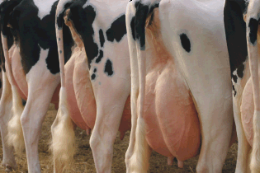
Progestins
Classified as steroid hormones
Progesterone
member of the progestin family
responsible for maintenance of pregnancy and mammary growth and development
MGA is a synthetic progestin that is 100X more potent than progesterone
Improves feed to gain ratios in heifers and suppresses estrus

Slide 17
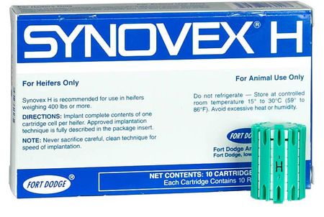
Synthetic hormones
Anabolic steroids – those that result in increased tissue accretion
Androgens – improve growth, FE, carcass protein esp. in heifers
Testosterone is anabolic
Combined with estrogens, testosterone is more effective for growth parameters

Slide 18
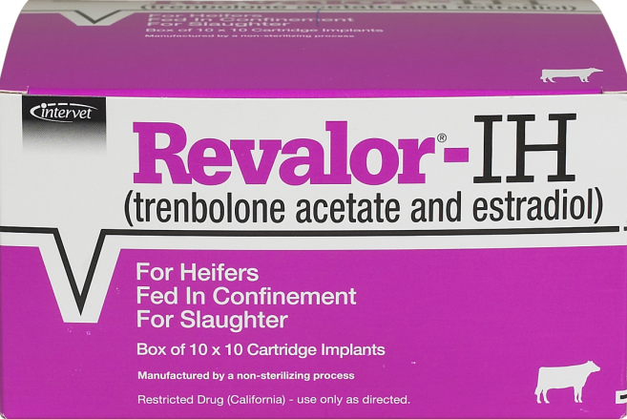
Synthetic hormones
TBA – Trenbolone Acetate – a synthetic steroid is weak, yet when combined with estrogen is very effective in steers
It binds to testosterone and estrogen receptors in skeletal muscle.
This yields a slight decrease in protein synthesis and a significant result in (decrease) in protein degradation, thus an increase in protein accretion

Slide 19
Growth Hormone
GH or Somatotrophin (ST)
Produced by the anterior pituitary
Acts in an endocrine manner
Liver can synthesize growth factors to help regulate growth, acts as a mediator
GH also increases lipolysis of fatty acids from adipocytes

Slide 20
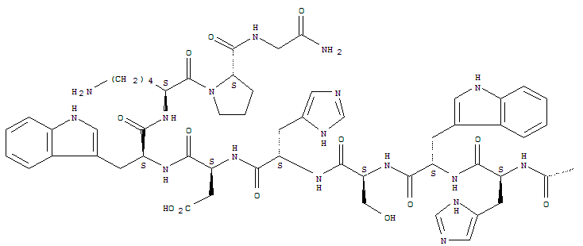
Growth Hormone
GH is a protein hormone
It is not a orally active hormone and admin. Via injection
GH has been shown to increase wt. gain, feed conversion while decreasing feed intake
When nutrients are limited, GH increases lipolysis, and decreases growth because IGF-I becomes uncoupled from GH, therefore IGF-I decreases. These changes causes a transfer of calories from adipose to vital functions

Slide 21
Insulin and Glucagon
Insulin – increases the storage of glucose, fatty acids, and amino acids as glycogen, triglyceride and protein
Glucagon – opposite actions of insulin
Glucagon and Insulin act on a negative feedback system
When one goes up the other goes down
Functions to mobilize glucose, fatty acids, and increase amino acid catabolism
Insulin dominates the system in mammals

Slide 22
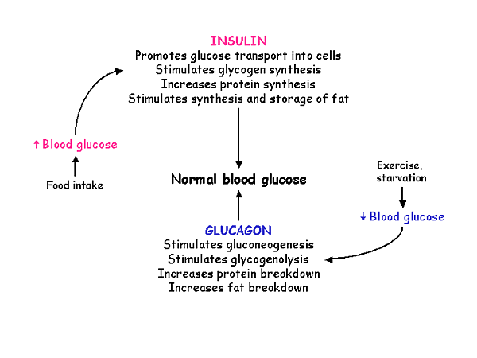
Helpful Chart

Slide 23
Glucocorticoids
Cortisol exert permissive effects by enhancing the action of other hormones on many tissues. They support and regulate a variety of important cardiovascular, metabolic, immunologic, and homeostatic function.

Slide 24
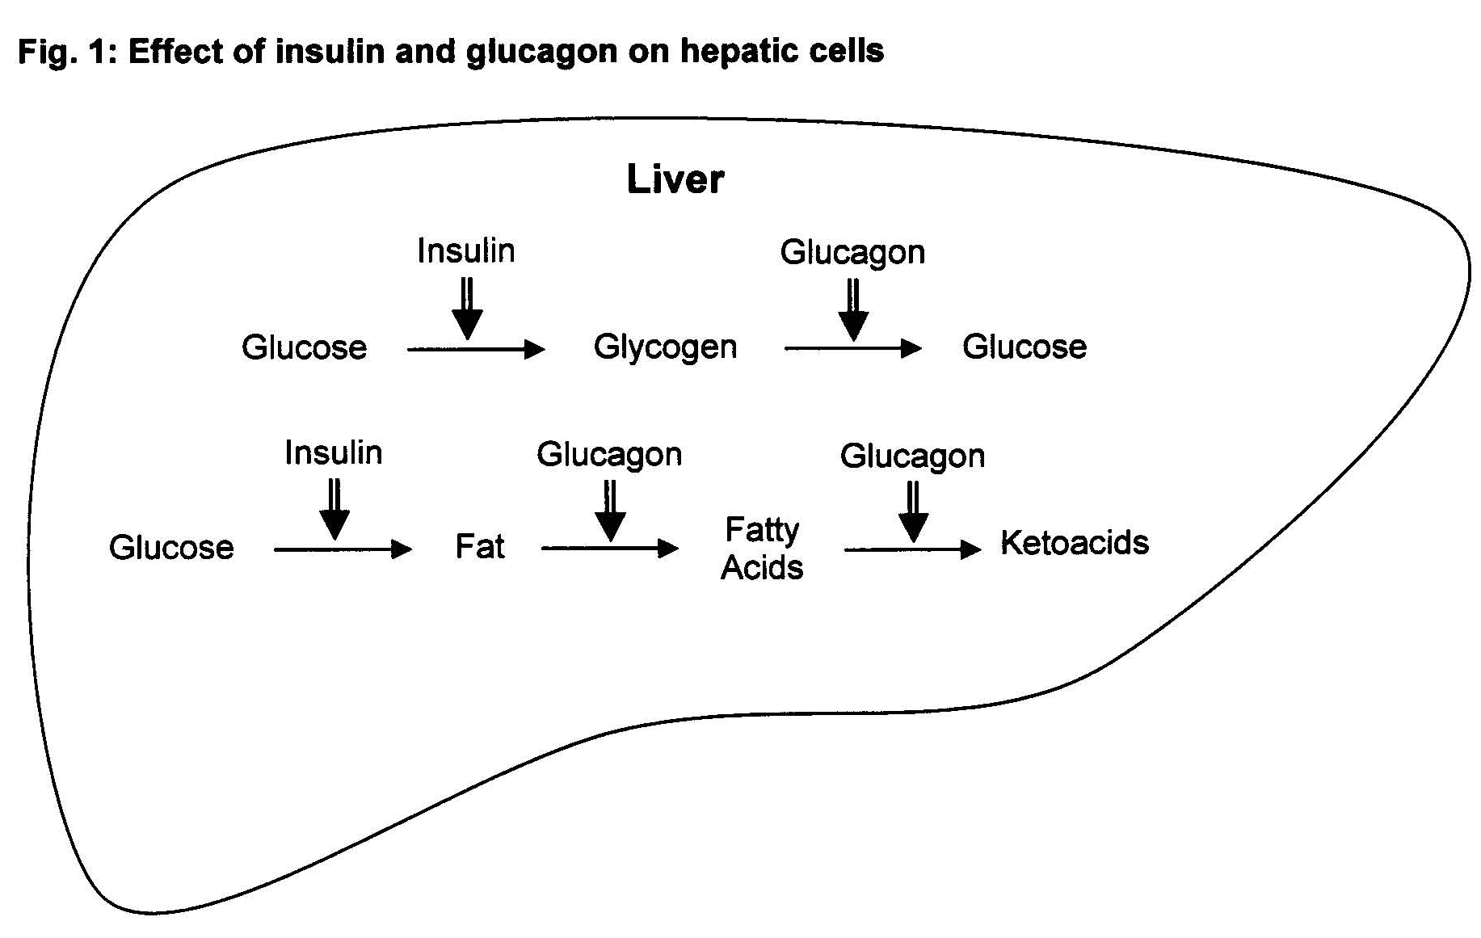

Slide 25
Catecholamines
Epinephrine (adrenaline)
Stored in the adrenal medulla
Released when stimulated by nerve fibers
Induces significant metabolic effects on various tissues in response to stress
Stress
Causes adjustments in metabolism
Epinephrine maintains sufficient blood circulation by impacting the heart and blood vessels.

Slide 26
Effects of Epinephrine
Mobilization of glycogen for energy
Increased heart rate
Increased blood flow
Increased body temperature
Increased respiration

Slide 28
Effects of Stress
Long term stress (several days) depletes glycogen stores prior to processing
Dark cutting beef
Dark, firm, dry pork
Acute stress (short term) prior to slaughter accelerates metabolism that occurs post mortem
Leads to earlier onset of rigor
Pale, soft, exudative pork

Slide 29
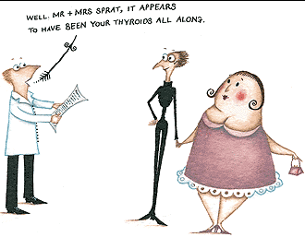
Thyroid Hormones
Play an important part in metabolism, growth, and development
Increase protein synthesis
Stimulate lipid metabolism

Slide 30
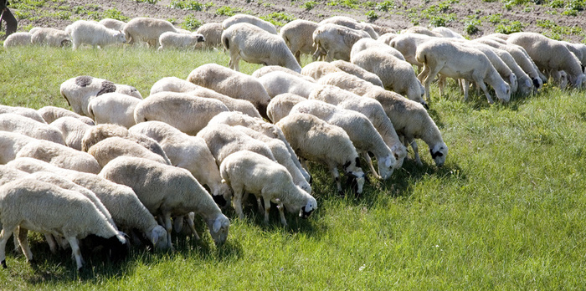
Objectives
Define hormone action
Explain the 5 types of hormone action
Know the function and effects of hormones in detail

