Slide 1
Embryonic Growth

Slide 2
Objectives
Explain prenatal development from fertilization to birth
Understand different biological process’ in all phases of prenatal development
Define key vocabulary
Chart different phases in somitogenesis

Slide 3
Prenatal Development
A multitude of events need to occur at the appropriate time with little to no errors
Embryonic development

Slide 4
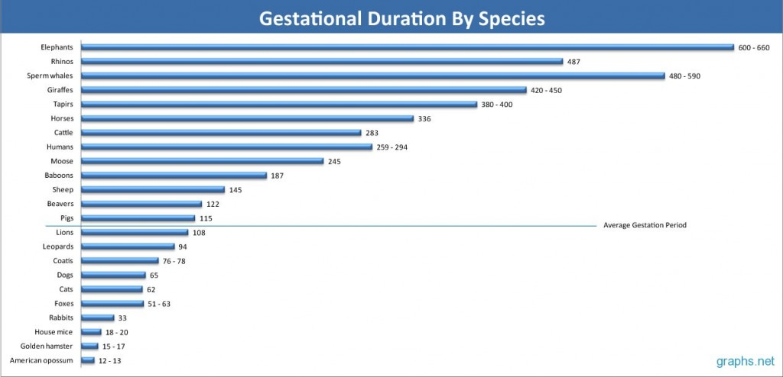
Gestation Comparison

Slide 5
Prenatal Development
Ovum Phase
  Zygote to morula
Embryonic Phase
  Blastocyst to fetus
Fetal Phase
  Fetus to birth

Slide 6
Prenatal Development

Slide 7
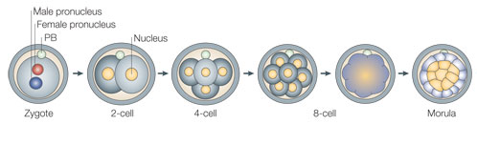
Ovum Phase
Zygote – Early DNA and protein synthesis
Two-cell stage – Start of M, T, and tRNA synthesis
Morula – Cells are totipotent
  Totipotent- ability to become any cell in the entire body
    Stem Cells

Slide 8
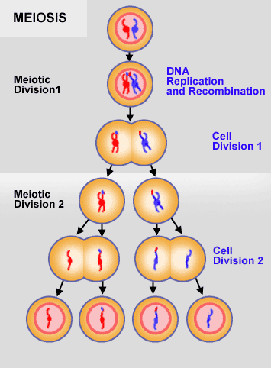
Meiosis
Formation of gametes
  Contain half of the information that you need for reproduction
Formation of four 1N daughter cells
  1N indicates that half of the necessary information is present
Provides variation in sexually reproducing animals

Slide 9
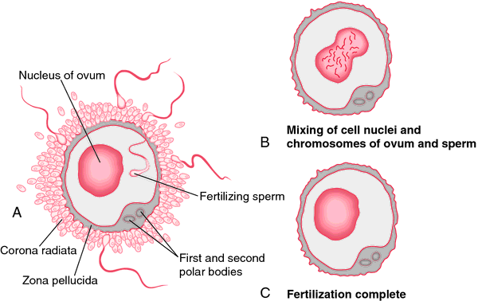
Zygote
Fertilized egg
  Unfertilized egg from mother
  Sperm from father

Slide 10

Cell Cleavage
There is an increase in DNA, but cells are not getting larger
Simply making more DNA

Slide 11
Cell Cleavage
Morula composed of 20-30 cells
Hatching – As the cell nears implantation the zona pellucida begins to break down
Blastomeres have great developmental plasticity

Slide 12
Ovum Phase
Cells maintain totipotency
If some cells of the blastomere are damaged it can still undergo normal development.
Embryo splitting can be performed at this stage
  Identical twins
Characterized by cellular replication
No protein synthesis
Little to no increase in size of organism

Slide 13
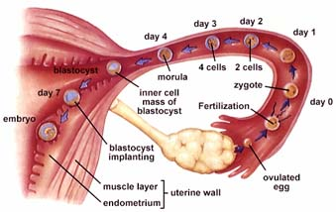
Implantation

Slide 14
Embryonic Phase
Characterized by morphogenesis
  Creation of shape
Single layer of cells giving rise to multiple cell layers
Blastulation
  Rapid increase in blastomere (embryonic cell) number
  Formation of a flat layer of cells (trophoblasts) that surround the blastocoele (fluid filled cavity)

Slide 15
Embryonic Growth
Blastulation
  Rapid increase in blastomere (embryonic cell) number
Formation of a flat layer of cells that surround the fluid filled cavity
  This is how the placenta is formed.
Embryonic Development

Slide 16
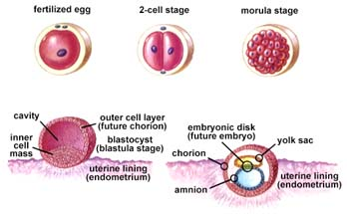

Slide 17
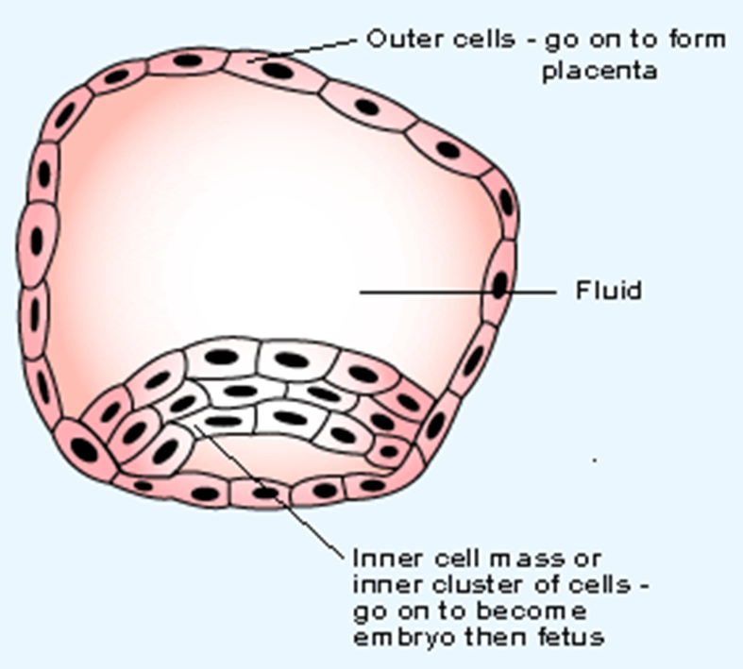
Blastocyst
Inner Cell Mass (ICM)
  Destined to become the embryo
Trophoblast
  Flattened layer of cells destined to become the placenta

Slide 18
Embryonic phase
Begins with blastocyst formation
Implantation into the uterine wall occurs
Cells lose totipotency
Characterized by tissue differentiation

Slide 19
Germ Layers
Ectoderm
  Skin and neural tissue
Mesoderm
  Muscle, bone, and dermis tissue
Endoderm
  Respiratory and gastrointestinal tracts

Slide 20
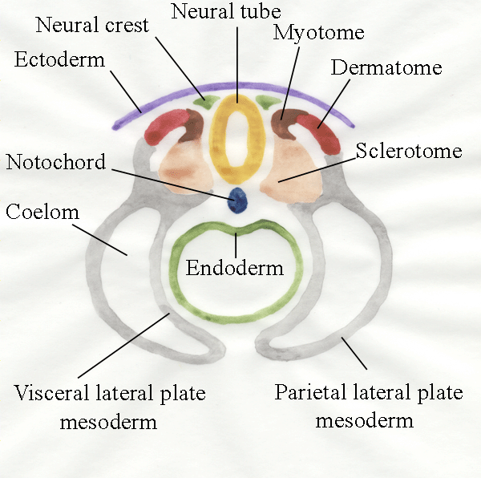
Neuralation
Form the precursors of the spinal cord and column
  Neural tube
    Precursor to the spinal cord and central nervous system
  Notochord
    Precursor to the spinal column

Slide 21
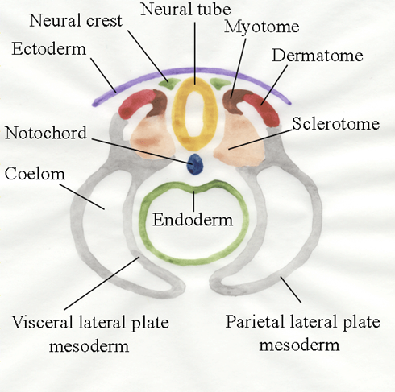
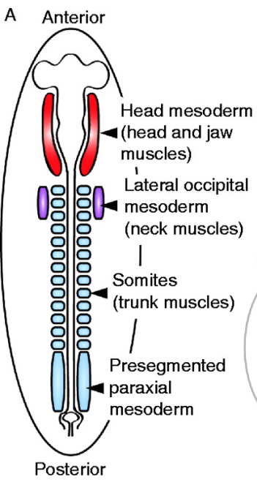
Somitogenesis
Develop from cranial to caudal
Three cell areas
  Sclerotome
  Myotome
  Dermatome

Slide 22
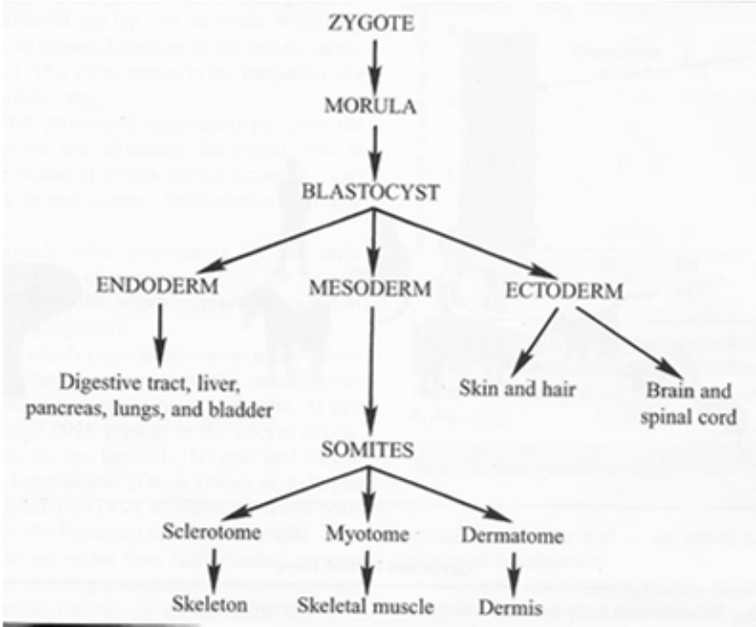
Somitogenesis
Sclerotome
  Bone formation
Myotome
  Muscle formation
Dermatome
  Dermis formation

Slide 23
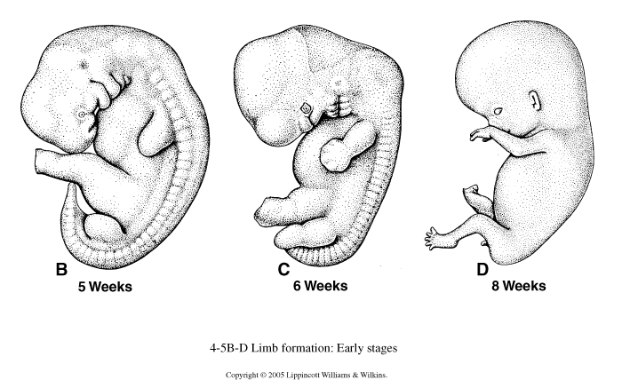
Limb Bud Formation
Limb bud somites- located in a spot where you find a limb

Slide 24
Fetal Phase
Most tissues are already formed
Characterized by a dramatic increase in size of existing organs and tissues.

Slide 25
Measurements of Prenatal Development
Somite Formation
Weight
Length
Anatomical changes
  Hair
  Eyelids

Slide 26
Objectives
Explain prenatal development from fertilization to birth
Understand different biological process’ in all phases of prenatal development
Define key vocabulary
Chart different phases in somitogenesis

