Slide 1
Bone Growth and Development

Slide 2
Objectives
List types of bone
Know the function of cells involved in bone growth
Describe the two methods of bone formation in detail
Explain the factors that affect bone growth

Slide 3
Bone video
Bone Resorption

Slide 4
Cells Involved in Bone Formation
Osteo – greek for bone
Osteogenesis – formation of bone
Occurs both prenatally and postnatally
Chondro- cartilage

Slide 5
Osteogenesis
Two methods of bone formation
  Endochondral Ossification
  Intramembranous Ossification

Slide 6
Osteogenesis
Endochondral Ossification
  Ossification from a cartilage template
Intramembranous Ossification
    Ossification in the absence of a cartilage template

Slide 7
Types of bone
Compact bone – hard layer around the outside
Spongy bone
  Trabeculae
  Spicules
Medullary bone

Slide 8
Medullary Bone
Metabolically active layer found in birds
Used as an available source of calcium for egg shell production

Slide 9
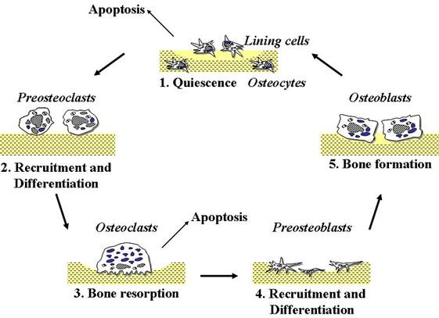
Cells involved in Bone Formation

Slide 10
Cells Involved in Bone Formation
Osteoblasts – involved in the bone matrix production
Osteocytes – mature osteoblasts; Responsible for maintenance of the bone matrix

Slide 11
Cells involved in Bone Formation
Chondroblasts/ Chondrocytes – Form cartilage that is associated with bone and can be required for bone growth
  Long bones require cartilage before bone can be made
Osteoclasts – involved in bone reabsorption (breakdown) and remodeling.
Osteoblast/Osteocytes

Slide 12
Cells Involved in Bone Formation
Bone lining cells – inactive cells found on the surface of bone that may serve as osteoblast precursors.
Fibroblasts – part of connective tissue proper that is associated with synthesizing fibers and ground substance.
  Ligaments and tendons

Slide 13
Endochondral Ossification
Ossification that occurs with the replacement of cartilage with bone
Prenatally a cartilaginous structure develops that will serve as the template for ossification

Slide 14
Endochondral Ossification
Ossification of cartilage around the outside of the diaphysis
Primary ossification center in the central portion of the diaphysis
Secondary ossification center is established in the center of each epiphysis

Slide 15
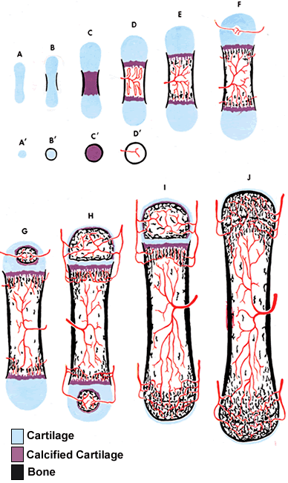

Slide 16
Endochondral Ossification
A thin layer of articular cartilage remains on the surface of each epiphysis to reduce friction

Slide 17
Epiphyseal Plate
Growth plate
  Increases the length of long bones
Growth of cartilage on the epiphyseal side
Ossification of cartilage on the diaphyseal

Slide 18
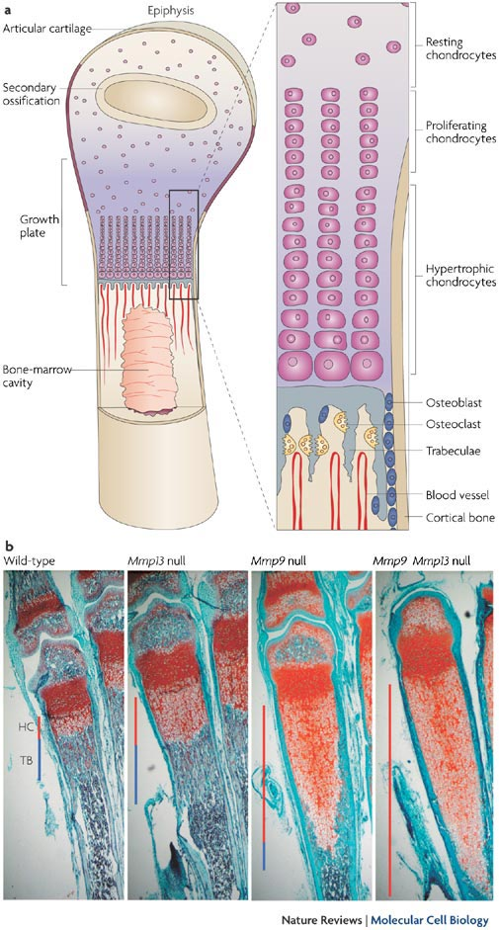
Endochondral Ossification

Slide 19
Termination of long bone growth
The growth of long bones will continue as long as the rate of cartilage growth remains faster than the rate of osteoblast invasion into the growth plate
  It groaws until the growth plate ossifies
Epiphyseal closure – fusion of the diaphysis and the epiphyses into a single bone

Slide 20
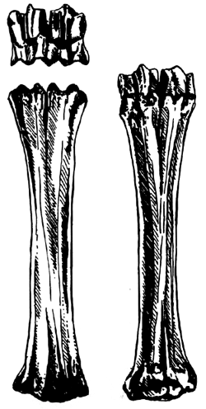
Termination of long bone growth
Example is the break joint in lambs under 12 months of age

Slide 21
Intramembranous Ossification
Bone formation that occurs with the replacement of connective tissue with bone, but in the absence of cartilage
Occurs in the formation of bones of the skull
Responsible for increasing bone diameter

Slide 22
Intramembranous Ossification

Slide 23
Bone Resorption
During bone growth, osteoclasts are removing bone from the inner surface and enlarging the marrow cavity
Balance between growth on the exterior and degredation on the interior

Slide 24
Bone Marrow
Red marrow
  Chief site of red blood cell formation
Yellow marrow
  Composed mainly of adipose tissue and is found in the medullary cavity of bones

Slide 25
Bone Remodling
Is a balance between osteoblast formation and osteoclast degredation
Bone remodling allows bones to adapt to stresses
Heavily stressed bones becomes thicker and stronger
  Increased muscle growth will result in increased bone growth at the protuberances of bone

Slide 26
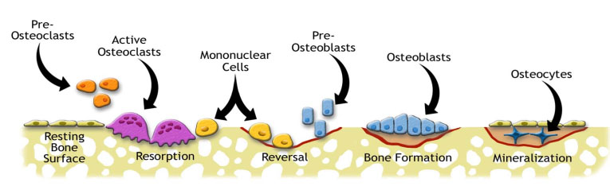
Bone Remodling
Remodling is usually initiated through osteoclast activation and removal of the bone matrix
Followed by osteoblast production of new bone

Slide 27
Nutrition
Vitamin and mineral deficiencies can result in abnormal bone growth
Management strategies uncouple the balance of muscle, bone, and fat growth so that an immature skeleton must bear excess muscle and fat mass

Slide 28
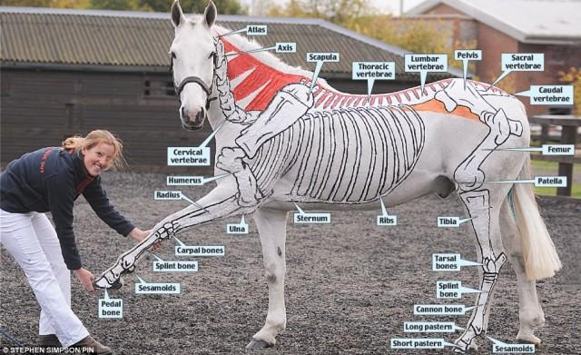

Slide 29
Objectives
List types of bone
Know the function of cells involved in bone growth
Describe the two methods of bone formation in detail
Explain the factors that affect bone growth

