Slide 1
Agriculture Scientist

Slide 2
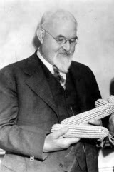
George Harrison Shull
Considered the father of hybrid corn, Shull devoted 30 years of his life to corn breeding. A botanist by training, Shull began his famous experiments at Cold Spring Harbor, Long Island New York.

Slide 3
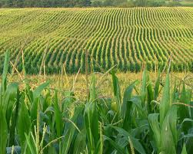
George Harrison Shull
His experiments began in 1905 and centered on inheritance in corn. Although there are several geneticists/botanists who made contributions to the development of hybrid corn, Shull made the critical observations on the reduction in vigor on inbreeding corn and the subsequent improvement of vigor on crossing corn.

Slide 4
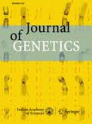
George Harrison Shull
These experiments provided the basis for hybrid corn. Although it was ground breaking research, it would not be until 1922 before hybridized corn was made commercially available. Shull founded the journal Genetics (which is considered to this day one of the top international science journals), and served as a Professor of Botany and Genetics at Princeton University.

Slide 5
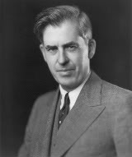
Henry A. Wallace
Wallace’s accomplishments are many: Vice President of the United States, Secretary of Agriculture, Secretary of Commerce, and other distinguished roles. Wallace was considered an active Secretary of Agriculture and his Department of Agriculture oversaw the creation and development of the food stamp and school lunch programs.

Slide 6
Henry A. Wallace
He supported government intervention and implemented controversial measures to regulate production in American farming with government planning designed to battle overproduction and low prices. Specifically, Wallace ordered slaughtering pigs and plowing up cotton fields in rural America to drive the price of these commodities back up in order to improve American farmers’ economic situation.

Slide 7
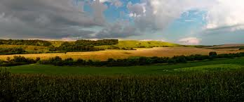
Henry A. Wallace
He experimented with breeding high-yielding strains of corn and founded the Hi-Bred Corn Company in 1926, which we know today as Pioneer Hi-Bred.

Slide 8
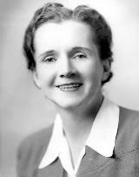
Rachel Carson
Carson’s book Silent Spring was published in 1962, the book was a landmark event in the history of the environmental movement. Carson focused the book on pesticides and their use in agriculture, and argued that those chemicals were dangerous to the environment, wildlife, and humans.

Slide 9
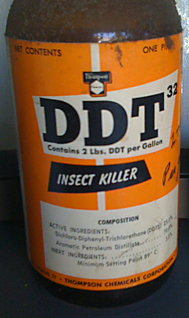
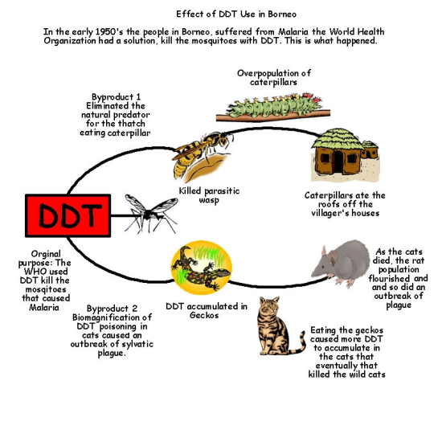
Rachel Carson
Carson was adept at presenting thorough documentation to make her point and concluded that the effects were akin to pesticide poisoning. The book is not without great controversy, which led to severe use restrictions and bans of DDT.

Slide 10
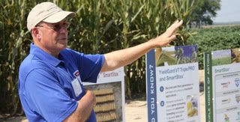
Robert Fraley
Chimeric bacterial genes conferring resistance to aminoglycoside antibiotics have been inserted…” And so begins the opening of Fraley’s 1983 paper where he and his research team at Monsanto indicate they have found a method of creating transgenic plants by using a pathogenic bacterium, Agrobacterium tumefaciens.

Slide 11
Robert Fraley
Fraley’s ambition led to the commercialization of genetically modified plants. The first genetically modified plants from Monsanto which achieved widespread success were soybeans resistant to glyphosate herbicide.

Slide 12
Robert Fraley
Fraley has contributed to years of agricultural development through a number of significant activities, including authoring more than 100 publications and patent applications relating to technical advances in agricultural biotechnology.

Slide 13
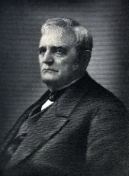
John Deere
The plow is cited as one of the most important inventions in the advancement of society. John Deere certainly did not invent the plow, but he improved on the plow by making his out of steel in 1837.

Slide 14
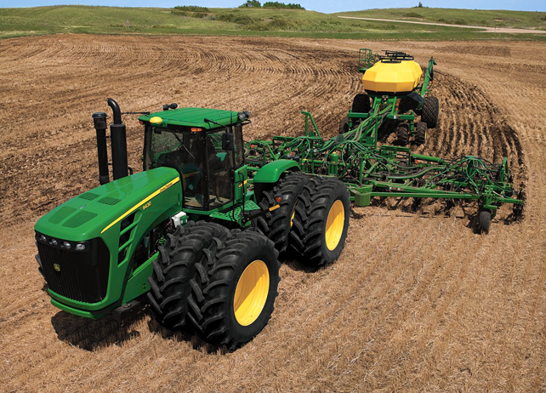
John Deere
The steel plow that Deere developed worked superior in American Midwest soils compared to the cast-iron plow. His plow unlocked the vast fertility of the Midwest soils which ultimately unleashed the incredible yield potential and food producing ability of the American Midwest.

Slide 15
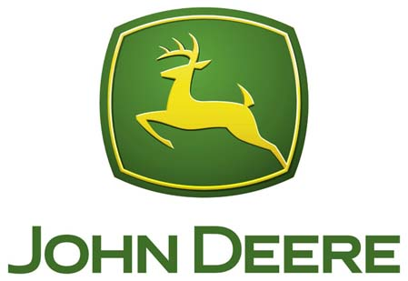
John Deere
Deere positioned his newborn company in Moline, Illinois, close to the Mississippi River and was better able to transport his products to farmers. John Deere built high quality products, and his company’s namesake maintains that reputation as a high quality agricultural and construction equipment manufacturer to this day.

Slide 16
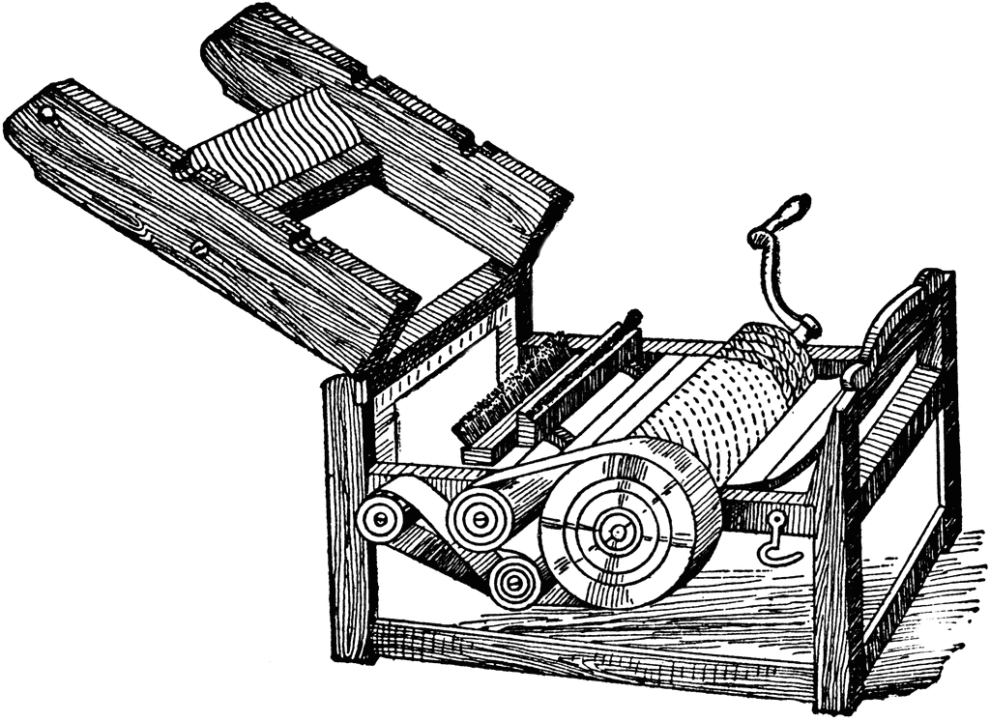
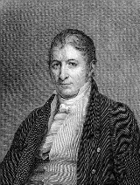
Eli Whitney
Eli Whitney is best known for the invention of the cotton gin in 1793. A cotton gin is a machine that is used to pull cotton fibers from the cotton seed.

Slide 17
Eli Whitney
The cotton gin was a groundbreaking invention in the southern United States, and it had an enormous positive impact on the economies of the southern states in the U.S. The cotton gin also had an equally important impact on slavery in this country. Prior to Whitney’s cotton gin, raising cotton was very labor intensive and only a few plantations could profitably raise cotton.

Slide 18
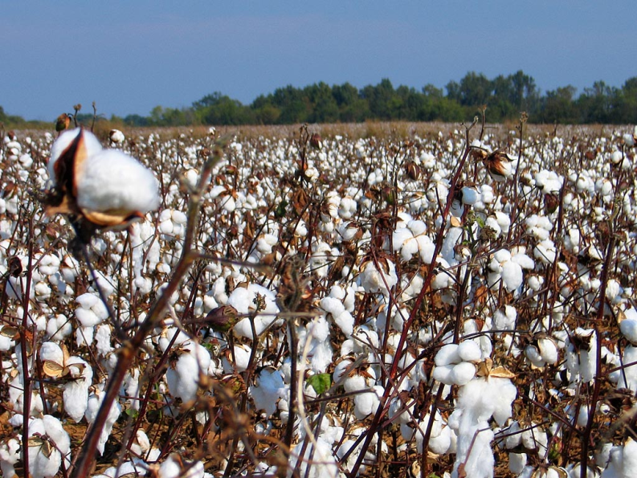
Eli Whitney
The cotton gin catapulted cotton to a widespread, lucrative and less labor-intensive crop, contributing to the rise of cotton production in the Deep South. The availability of large supplies of cotton fiber also contributed to the rise of the textile industry.

Slide 19
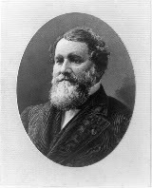
Cyrus McCormick
Cyrus McCormick created the world’s first mechanical reaper in 1831. A mechanical reaper was needed, as harvesting crops required numerous men to cut and gather.
Cyrus McCormick is referred to as the ‘Father of Modern Agriculture,’ however he did not work alone. Jo Anderson, a slave, is cited to have worked on the reaper as well

Slide 20
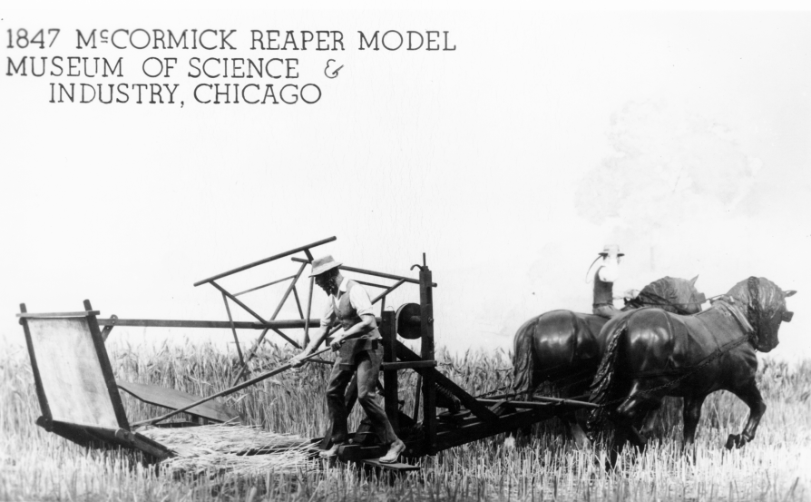
Cyrus McCormick
McCormkick’s reaper was able to replace manpower for machine power and is often cited as a key driver for the westward expansion of the United States. In 1851, the reaper won the highest award of the day, the Gold Medal at London’s Crystal Palace Exhibition.

Slide 21
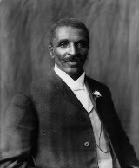
George Washington Carver
Carver improved the lives of thousands of poor southern farmers by providing information on crops, cultivation techniques, and recipes for meals.
He is best known for research into and promotion of alternative crops to cotton, particularly focusing on peanuts and sweet potatoes.

Slide 22
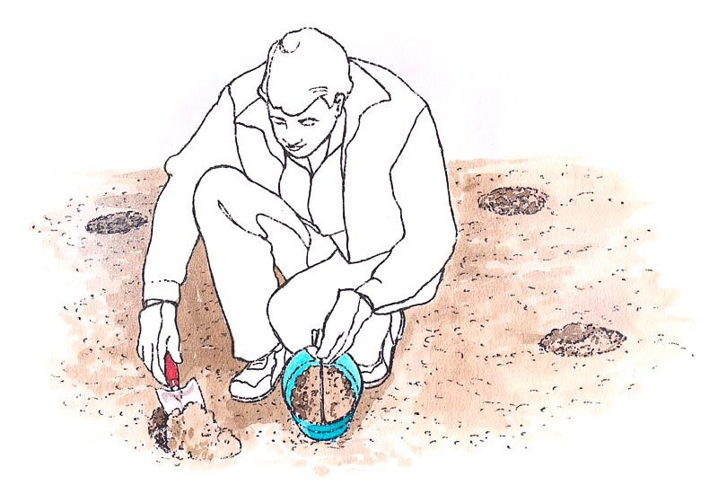
George Washington Carver
Carver was a progressive agricultural thinker, encouraging farmers to submit soil samples for analysis to determine causes of poor yield. Beyond crops and soils, Carver also taught livestock care and food preservation techniques.

Slide 23
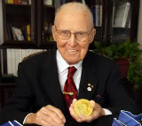
Norman Borlaug
Awarded the Nobel Peace Prize in 1970 for his work on the world’s food supply, Borlaug is known for his highly successful wheat breeding and wheat research programs in Mexico.

Slide 24
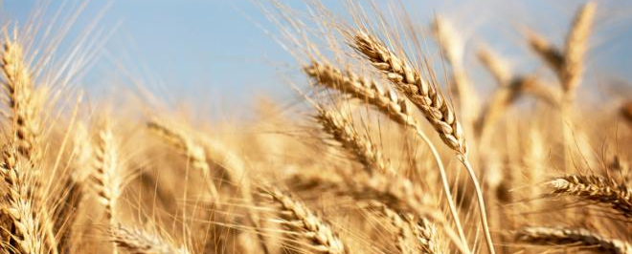
Norman Borlaug
He created the World Food Prize in 1986 to recognize the achievements of individuals who have improved the quality, quantity or availability of food in the world. Borlaug championed an adequate food supply for every human being, and spent his lifetime working on improving food production to feed an ever-growing world population

Slide 25
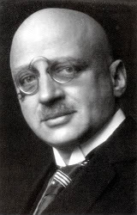
Fritz Haber
Although co-developed with Carl Bosch, the process of ammonia synthesis bears Haber’s name and is known the world over as the Haber Process. (There is an attempt to give credit to Bosch by referring to the process as Haber-Bosch).
Without the Haber-Bosch process, we would not be able to feed our global population.

Slide 26
Fritz Haber
In 1908 Haber developed the technique still used today to take the vast amount of nitrogen available in the atmosphere and convert it into nitrogen that plants can use.
In 1918 Haber won the Nobel Prize for this discovery. Although nitrogen fertilizer had been previously available, this major leap forward allowed for the relatively inexpensive production of nitrogen fertilizer which ultimately led to its widespread availability.

Slide 27
Other people of influence
Dwayne Orville Andreas
Hugh Bennett- Created Soil Conservation Service
James G Boswell II – head of J.G. Boswell. Played an important role in shaping the water use policy in California
Earl Butz – Served as the secretary of Agriculture
John Franz and Paul Muller – Chemist who separately developed glyphosate and DDT
Temple Grandin – Professor at CSU focusing on Animal Handling and care

Slide 28
Other people of influence
Thomas Jefferson – “cultivators of the earth are the most valuable citizens” Designed a moldboard plow
Seaman Knapp- developed a demonstration farm which is credited to the founding of the cooperative demonstration farm program and country agent system
Aldo Leopold – A Sand County Almanac
Richard Marshall, Earl Kooi, Y. Takasaki- invented and refined the process of making high fructose corn syrup

Slide 29
Other people of influence
Andrew Meikle – credited for creating the thresher in 1796
Ingo Potrykus – co-credited with creating golden rice, rice fortified with Vitamin A
Henry David Thoreau – Walden, chronicles modest farm efforts
Jethro Tull – vastly improved seeding crops by the invention and refinement of seed drill.

