Slide 1
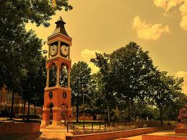
Active Shooter

Slide 2
What is an Active Shooter?
An active shooter is an individual actively engaged in killing or attempting to kill people in a conﬁned and populated area

Slide 4
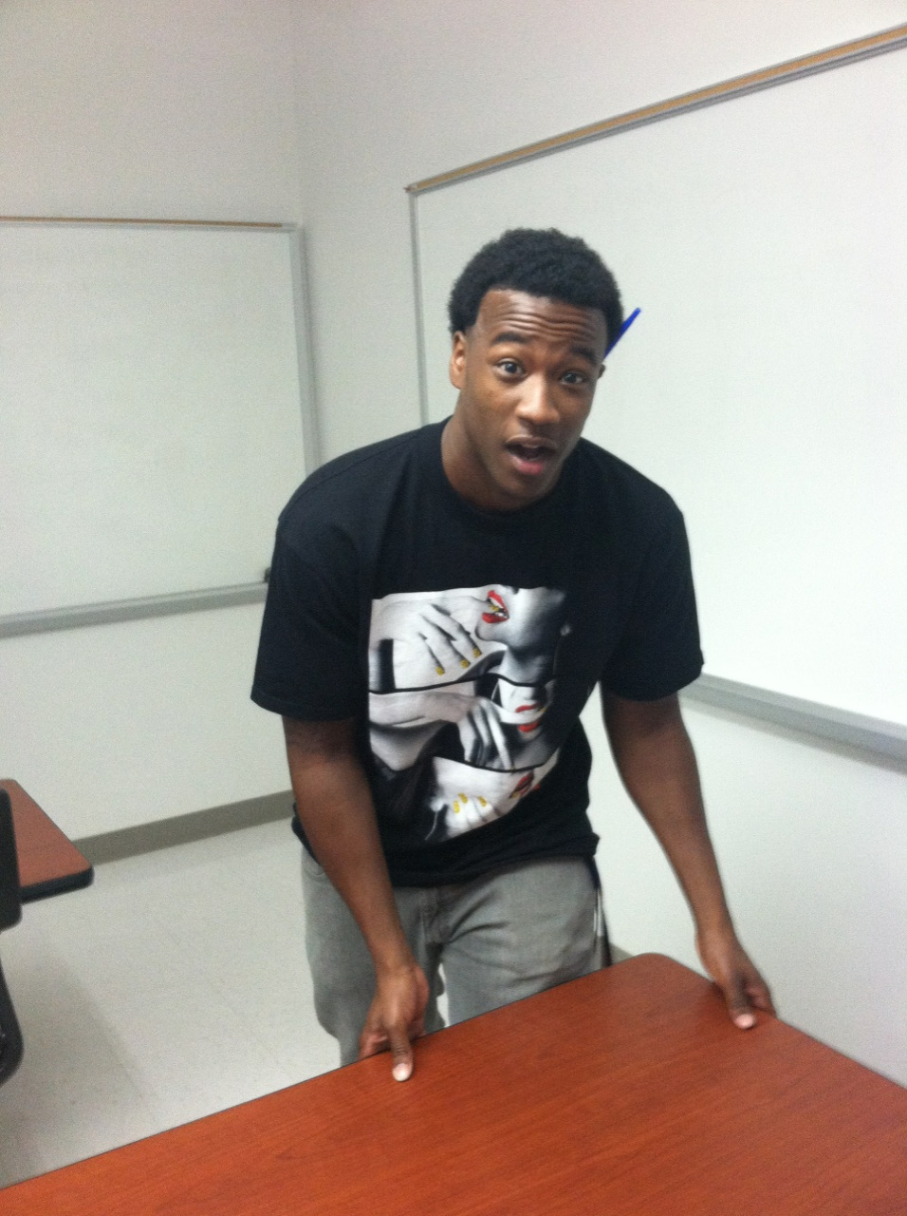
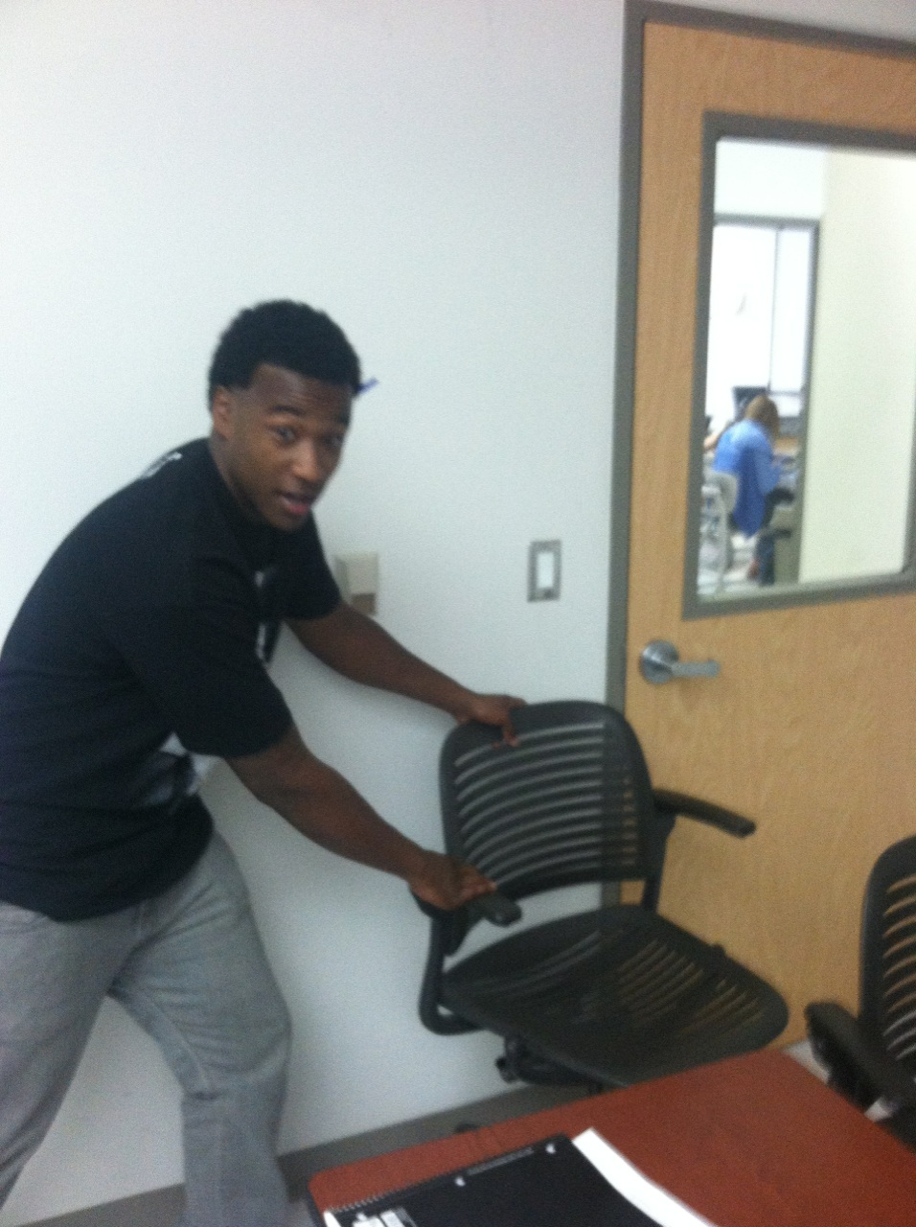
If you are in a classroom,
room or office,
secure the door,
and “Stay There”

Slide 5
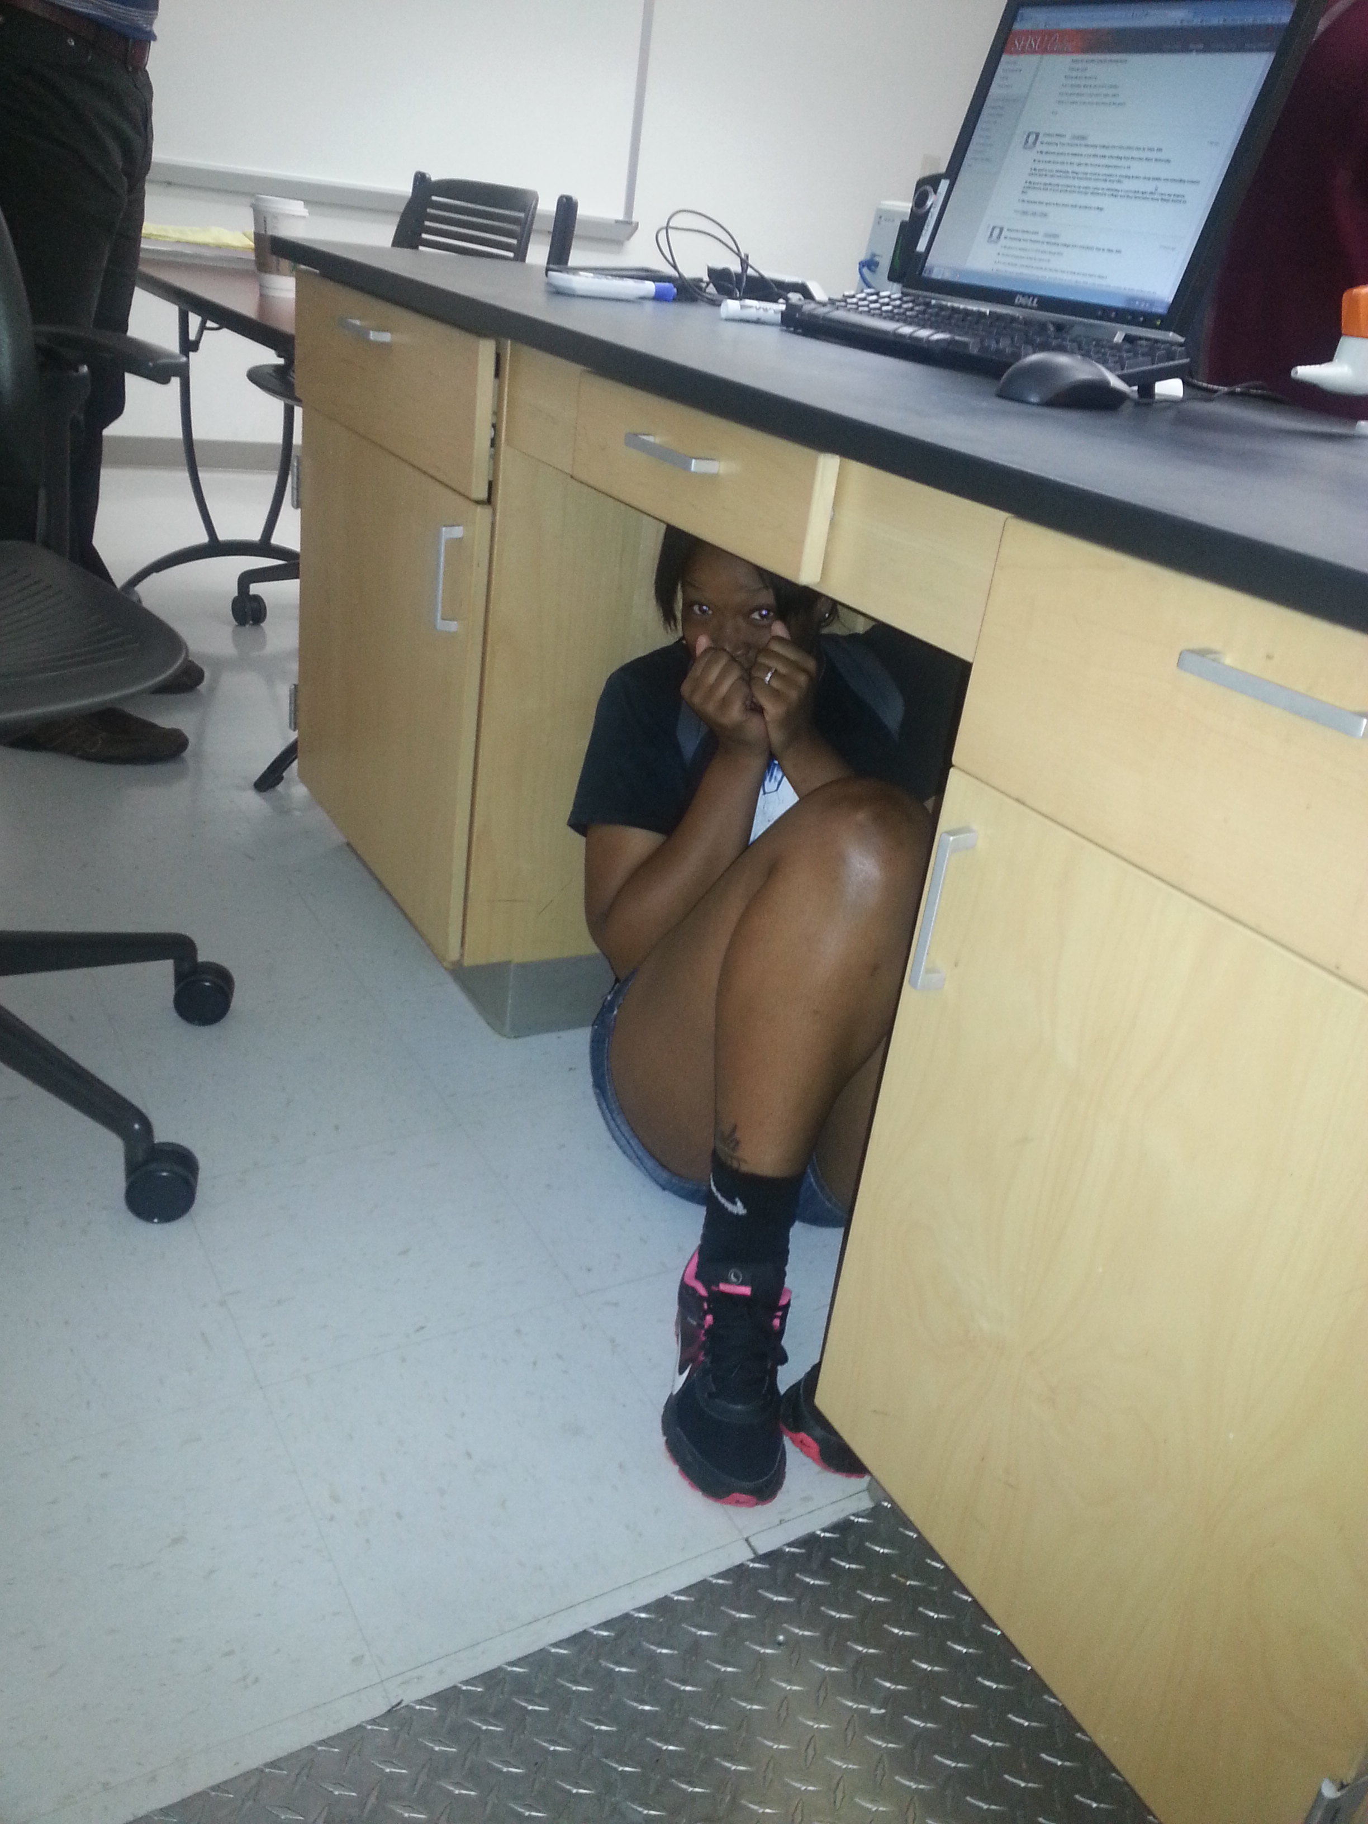
Get out of sight from the
door and stay
low and quiet.

Slide 6
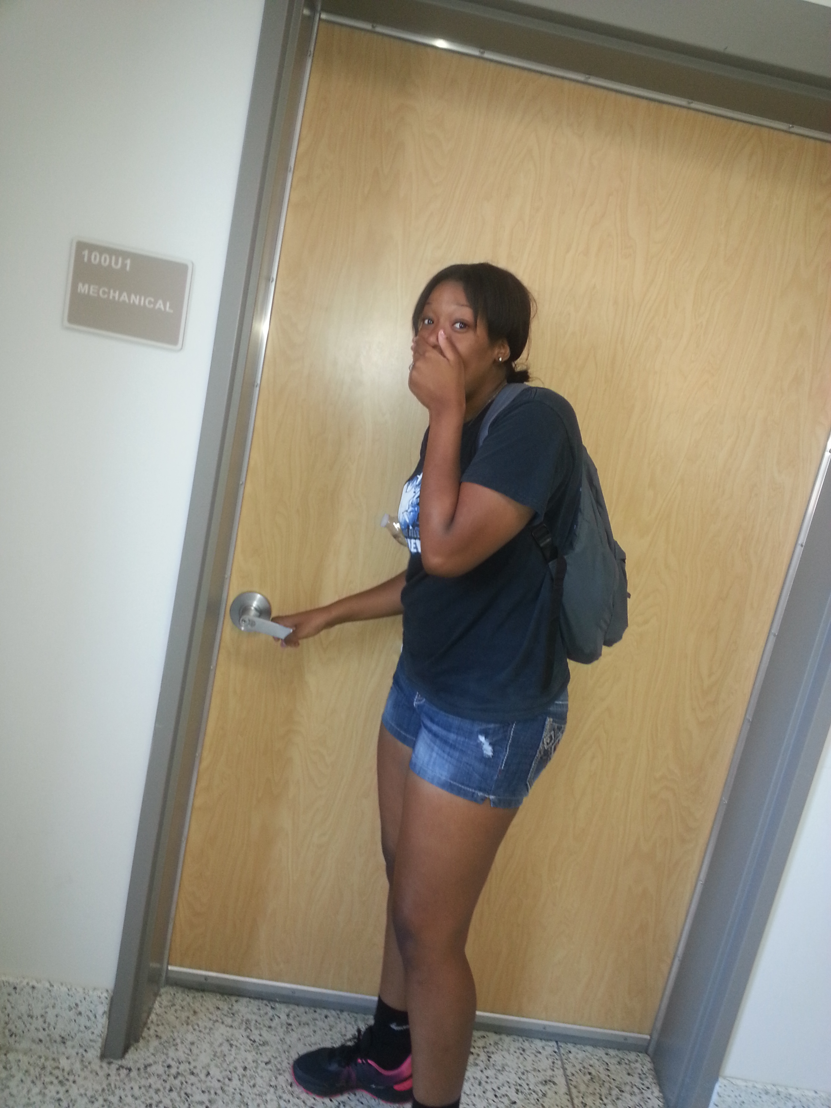
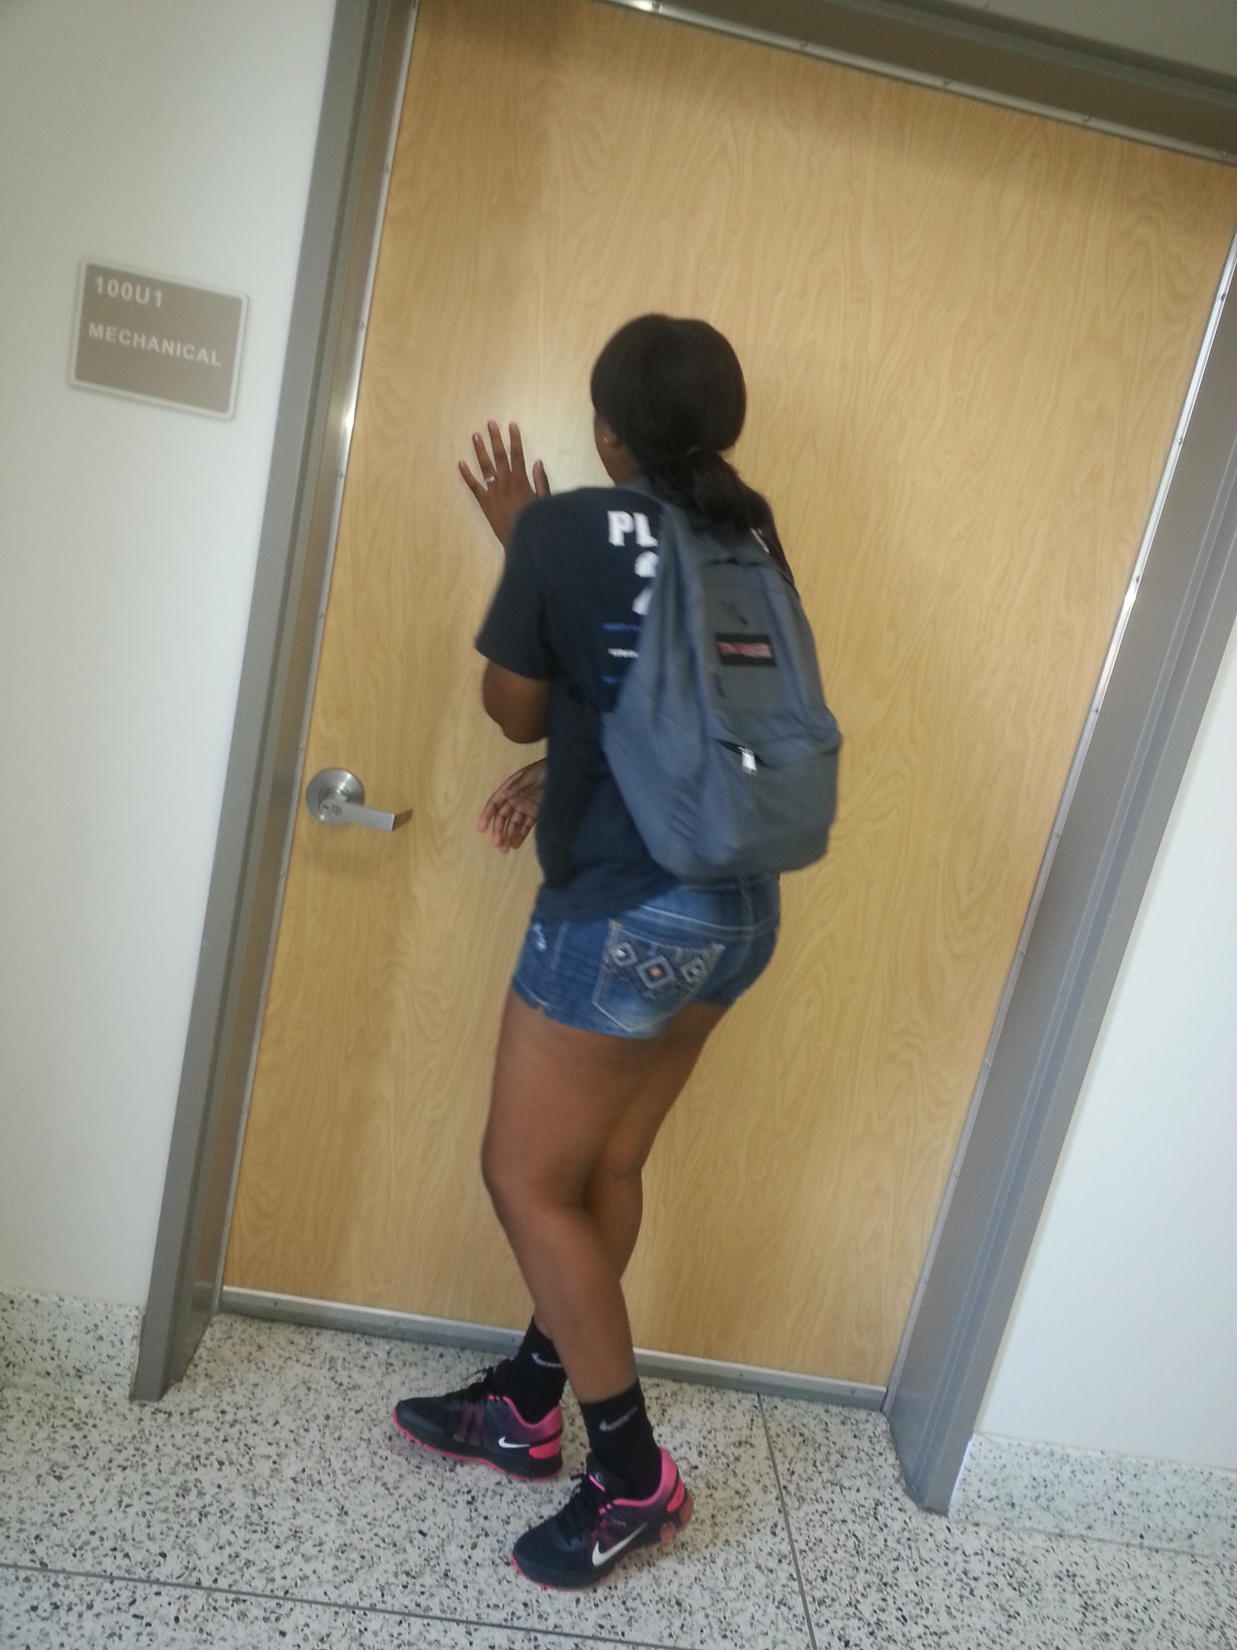
If in the hallways, get in a room
that is not already
secured and secure it.

Slide 7
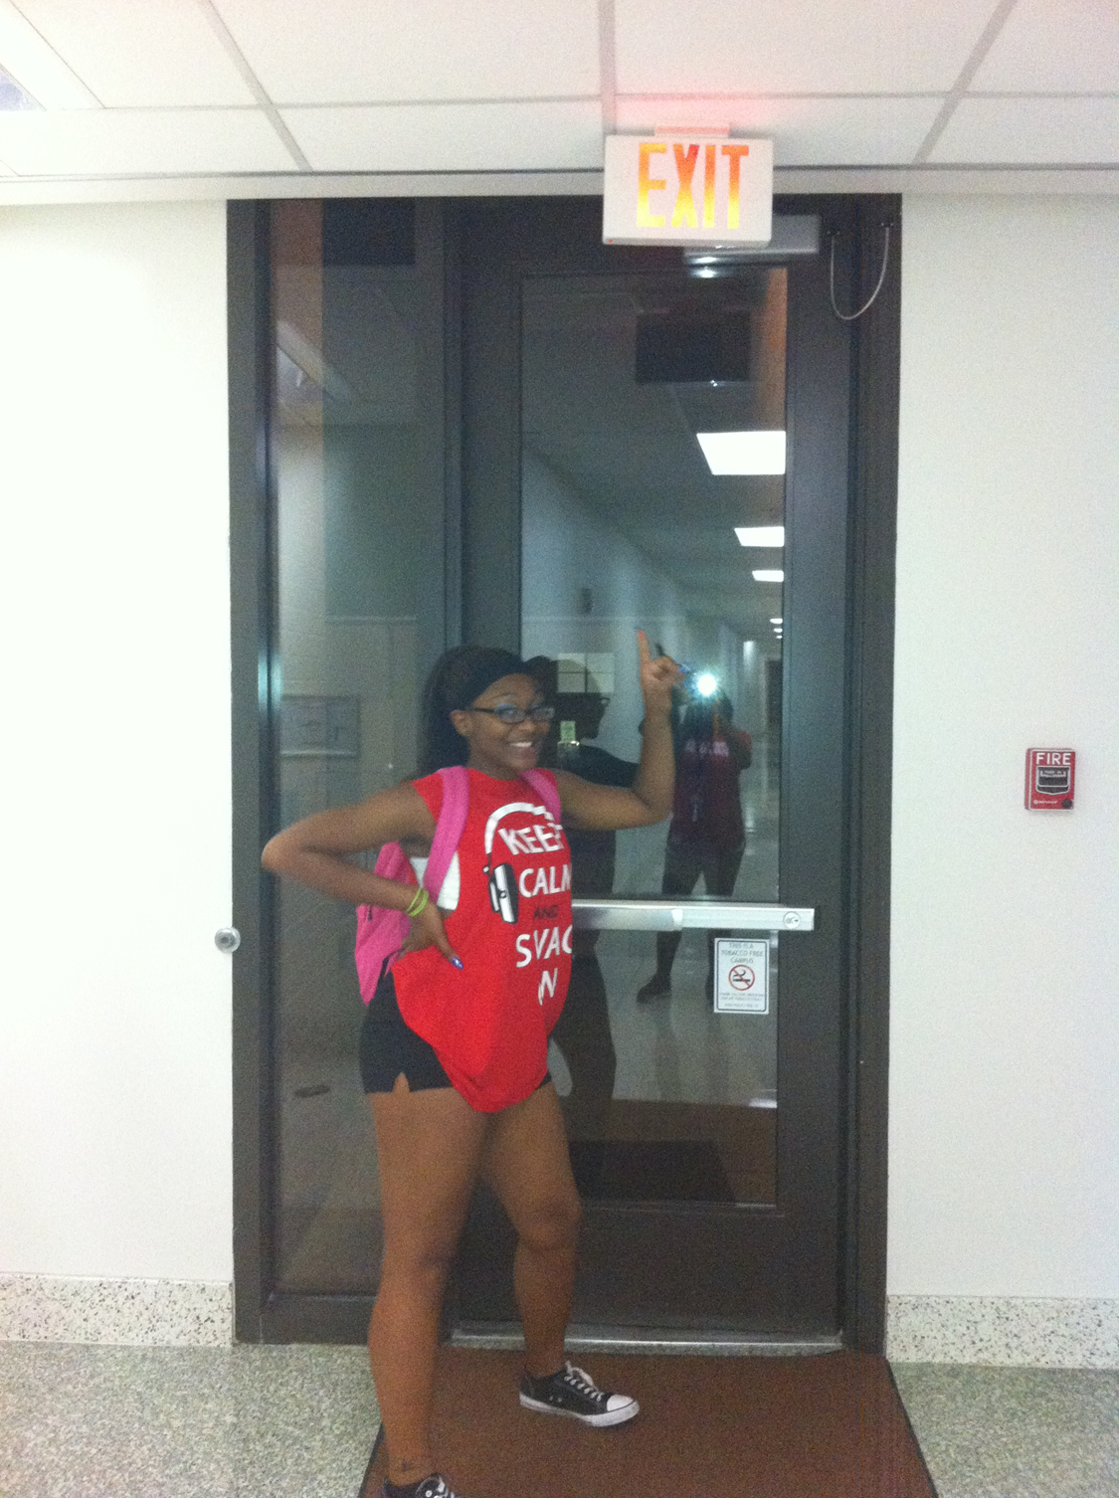
If you’re close to an exit, use it.
Don’t run through a long hall to get to one,
you may encounter the gunmen or
hostage taker.

Slide 8
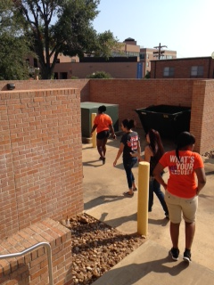
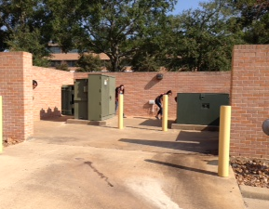
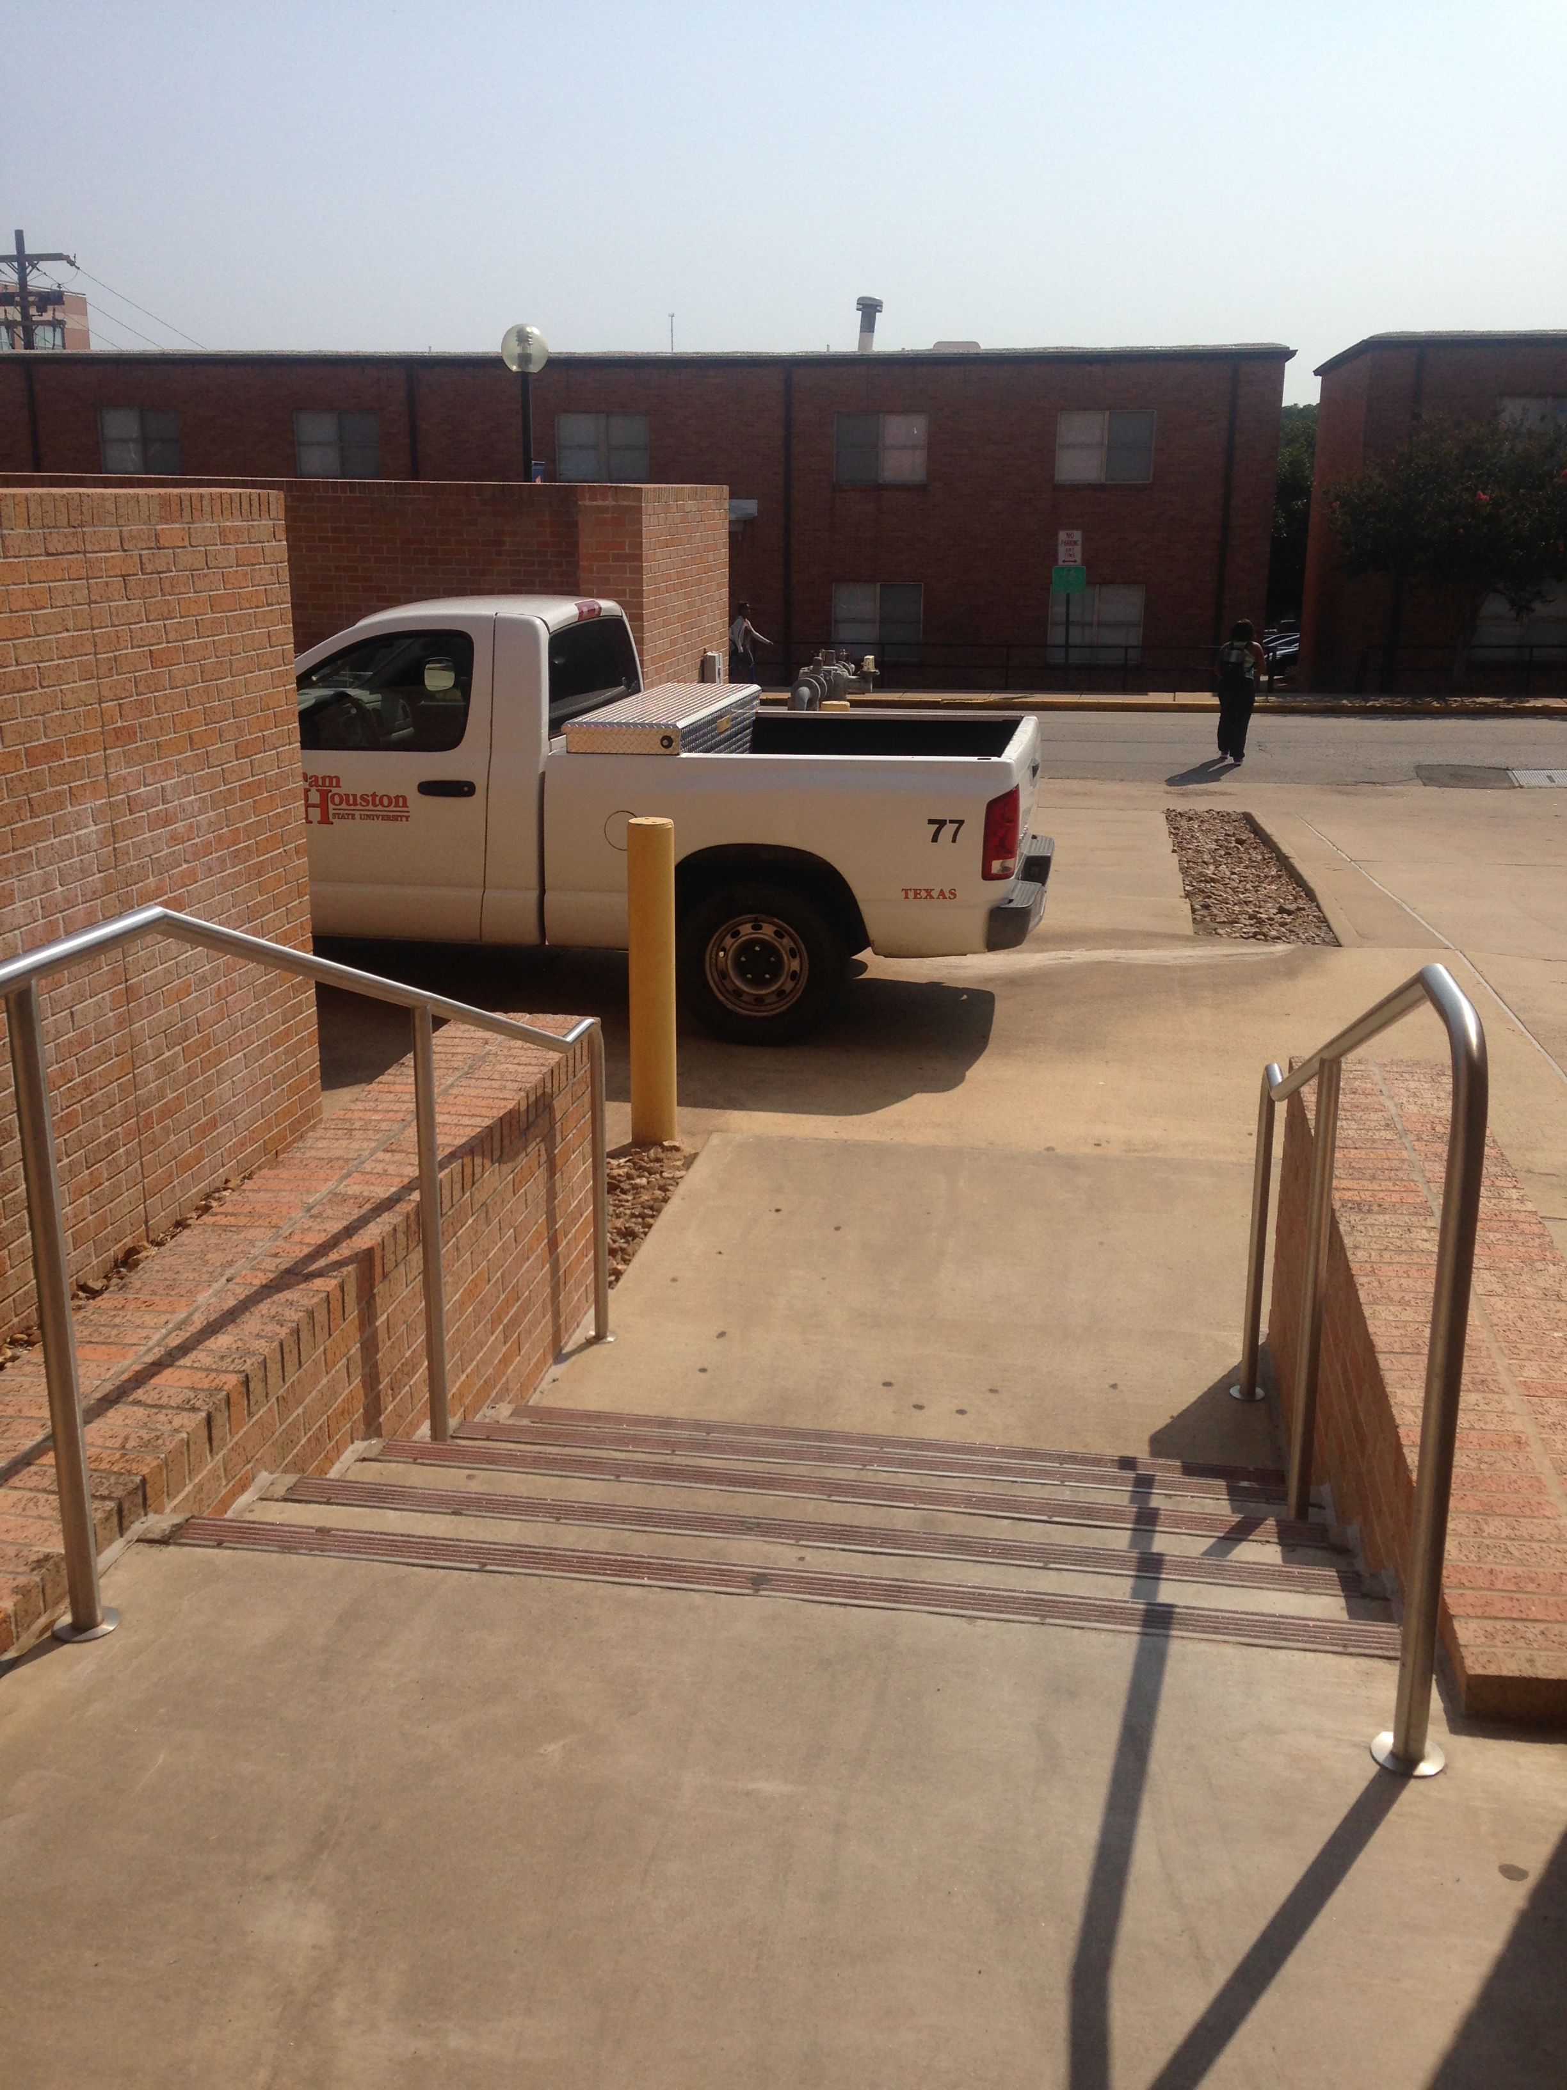
Stay alert and look for appropriate cover locations.
Brick walls, large trees, retaining walls, parked vehicles

Slide 9
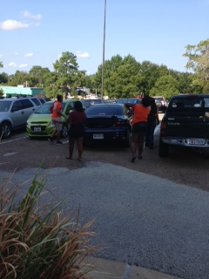
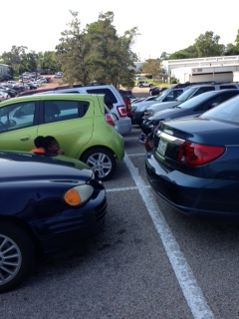
Stay alert and look for appropriate cover locations.
Brick walls, large trees, retaining walls, parked vehicles

Slide 10
If necessary, you may have to distract or overwhelm the shooter.
To do this, you will need to identify weapons and have a plan.

Slide 11
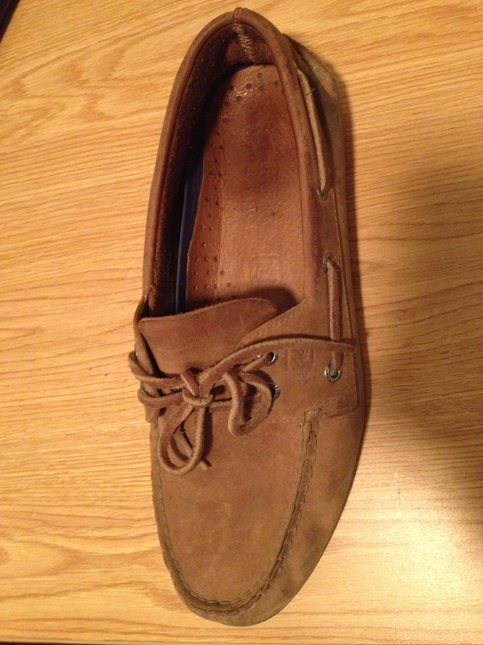
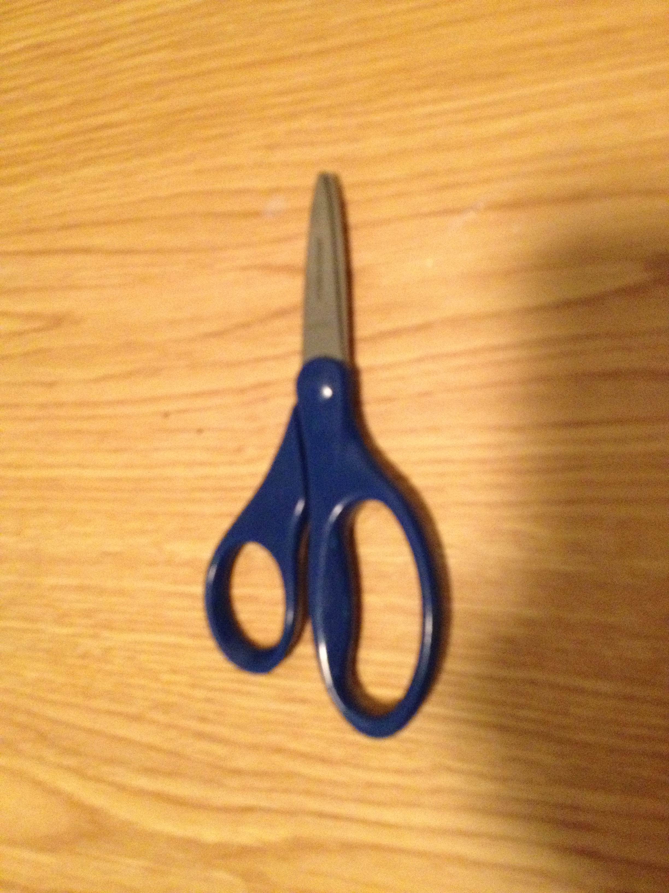
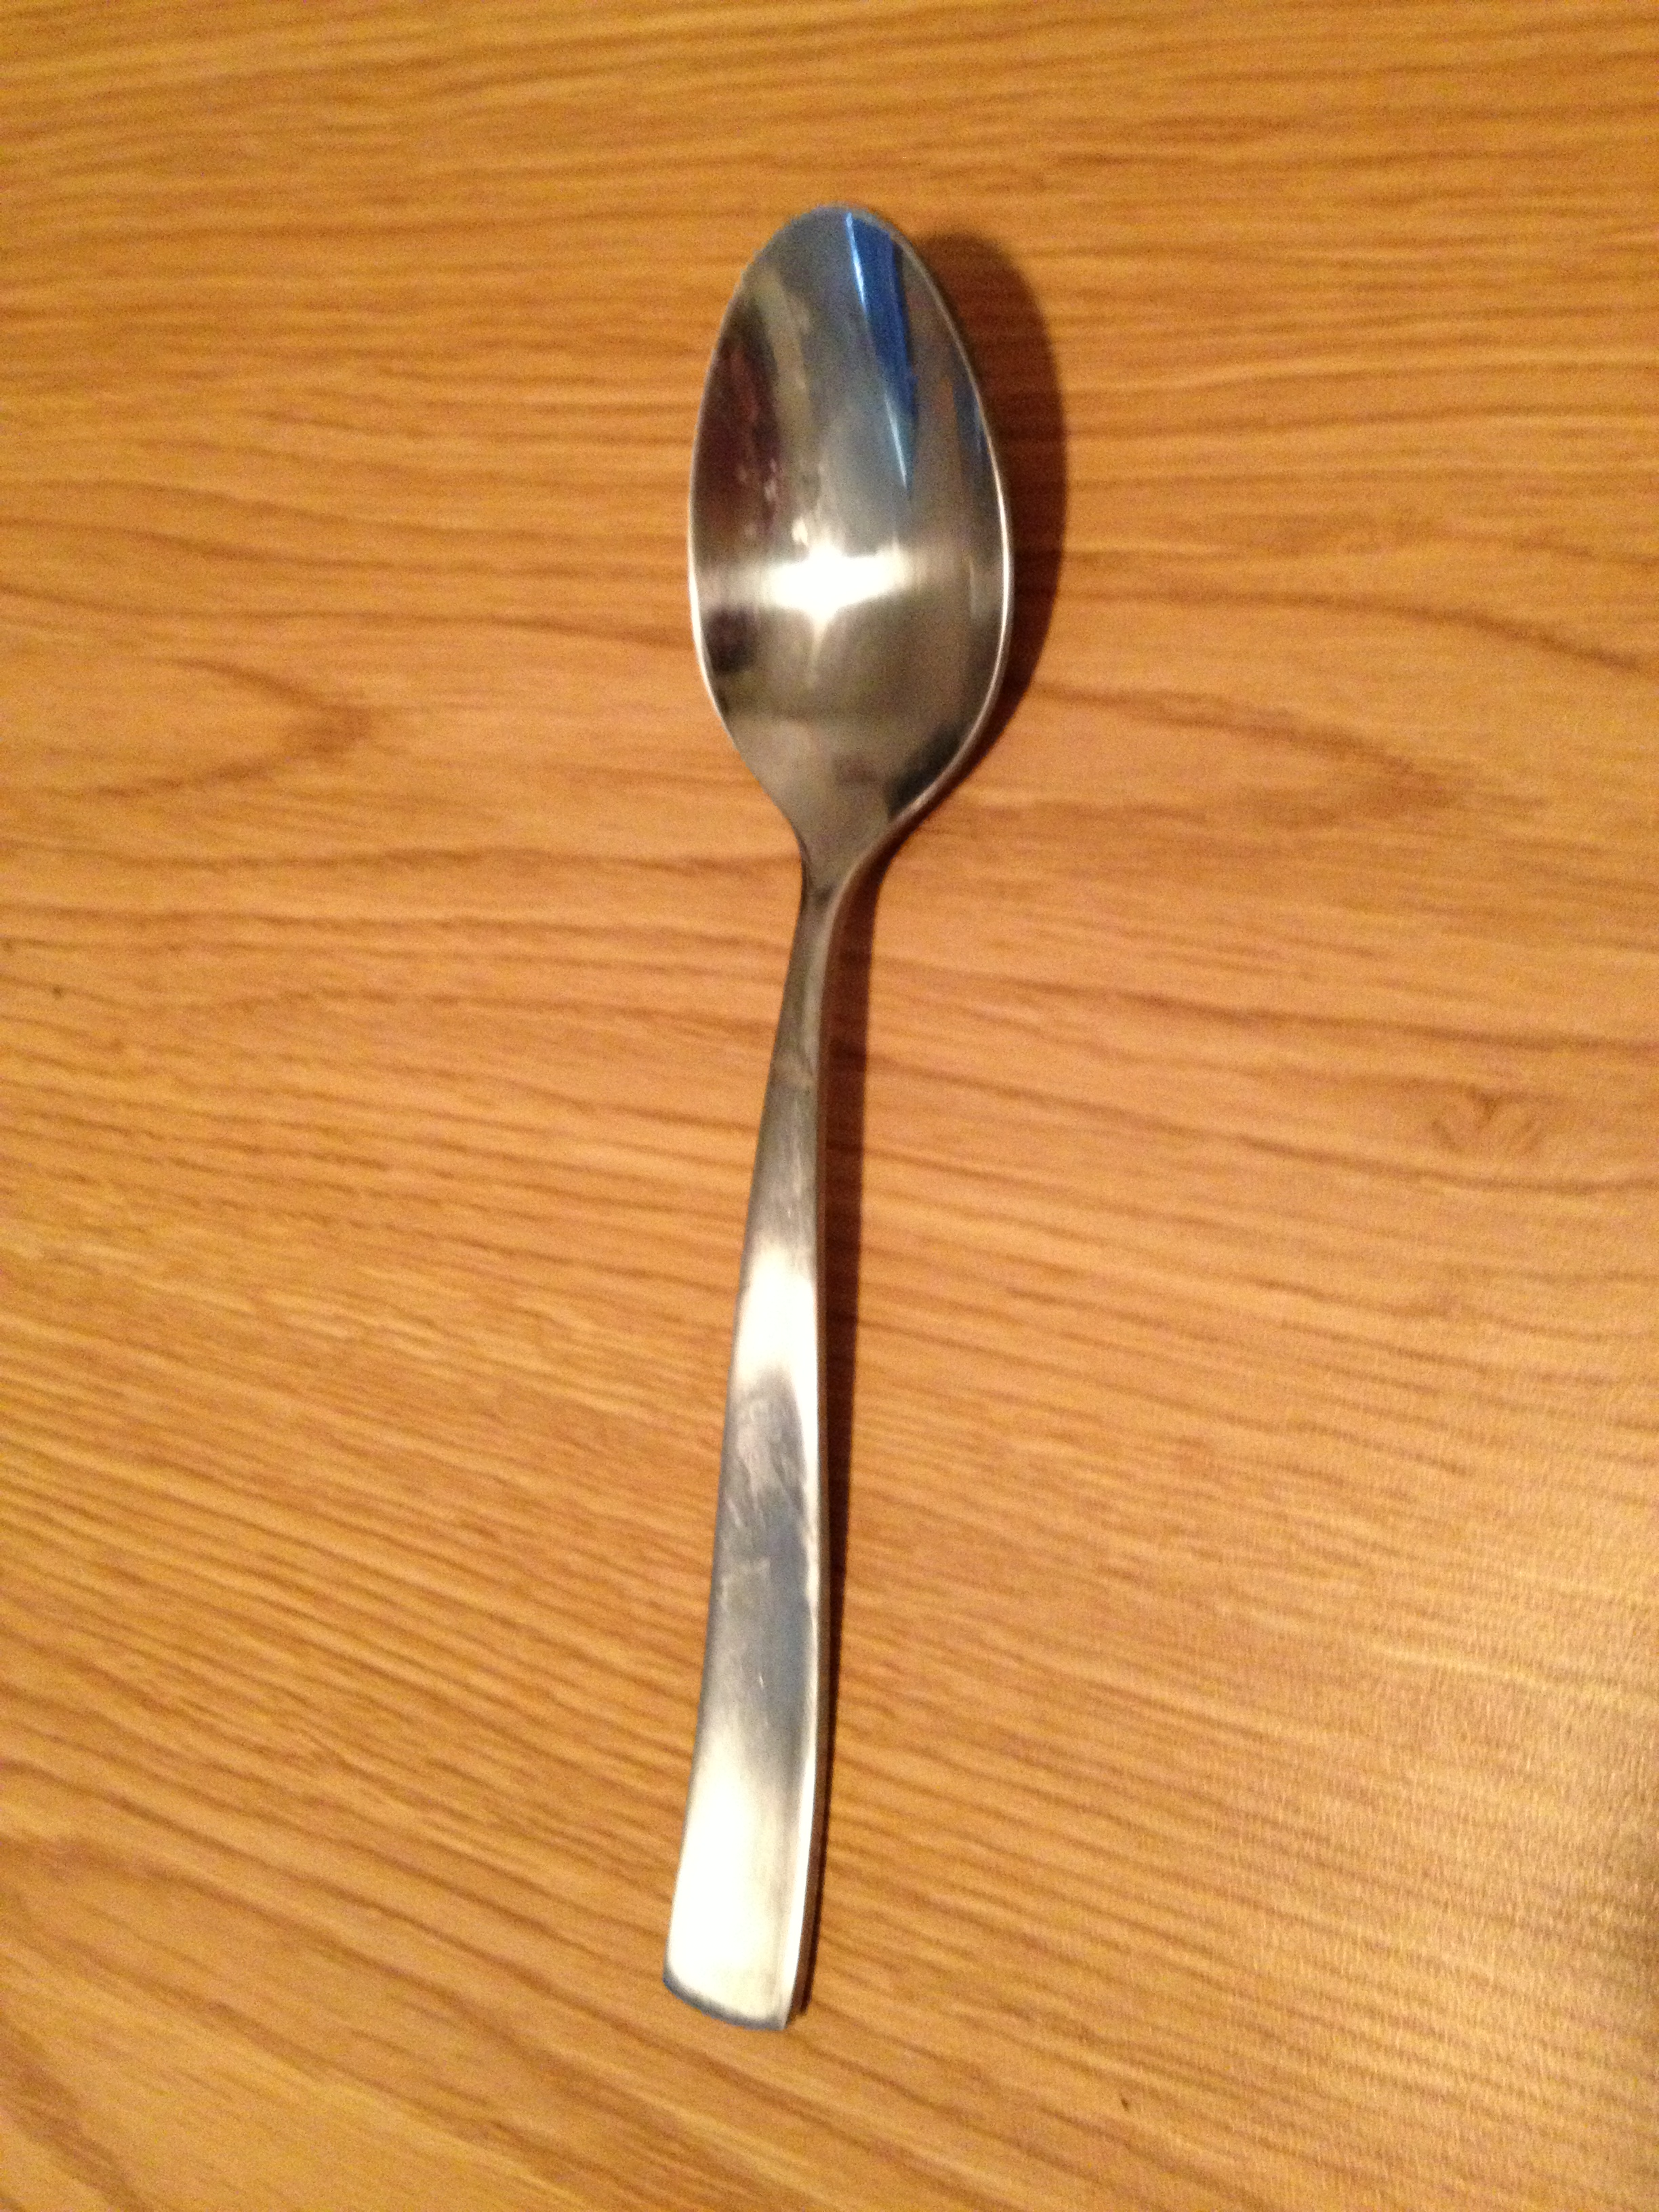
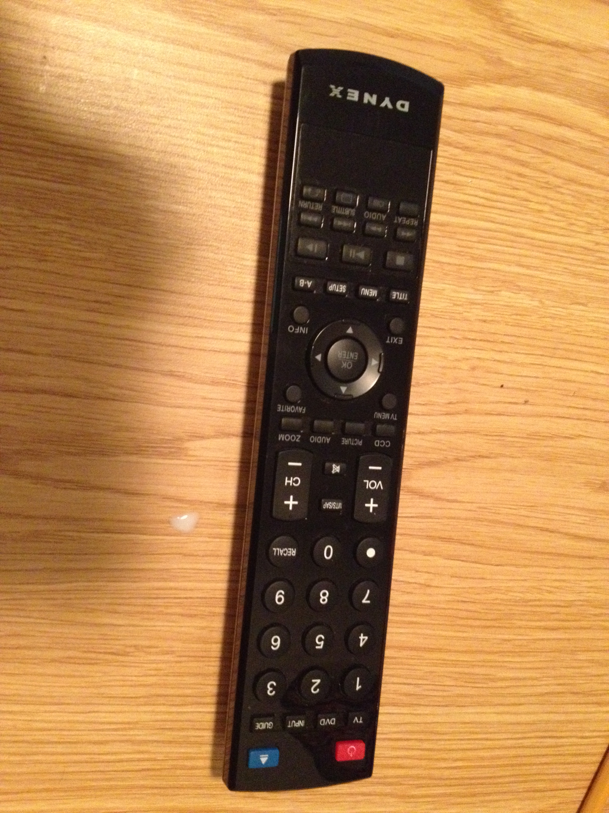
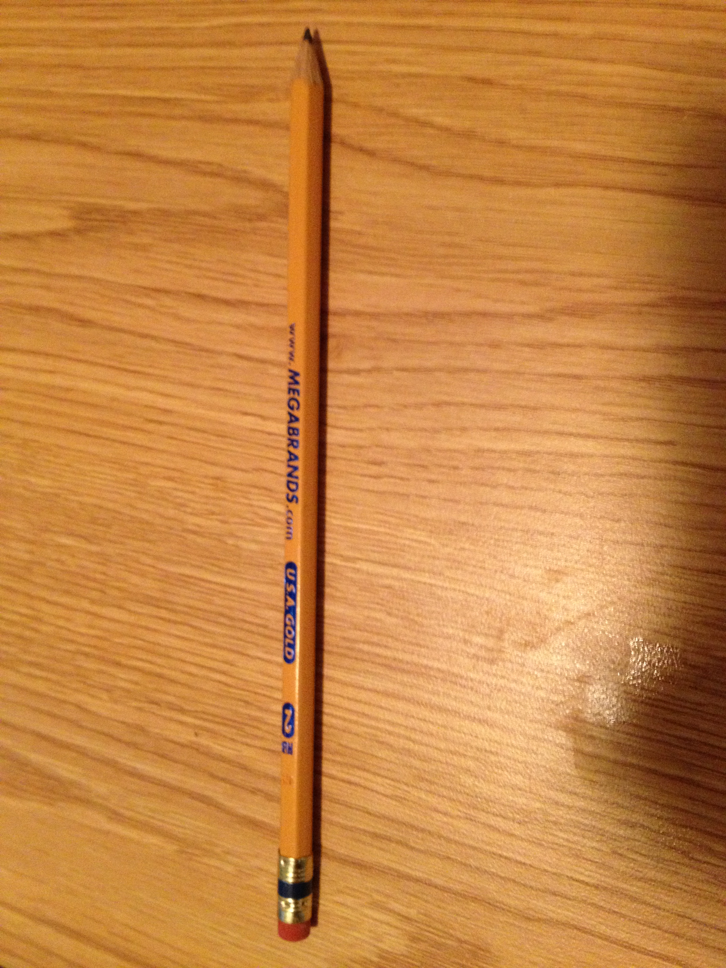
weapons
An improvised weapon is a device that was not designed to be used as a weapon but can be put to that use.

