Slide 1
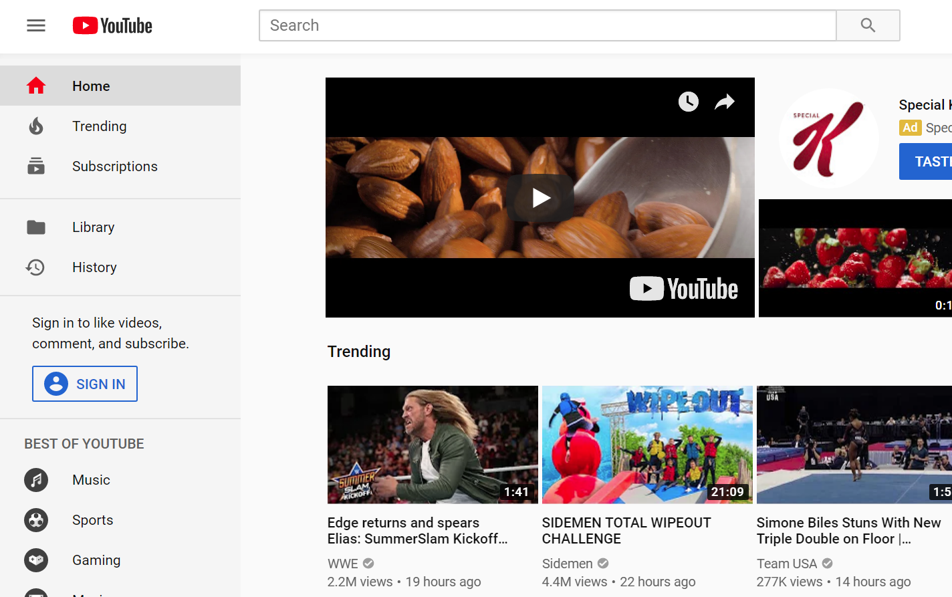
Creating YouTube Channels and Video Content Dr. Darren Williams, Chemistry Department – SHSU

Slide 2
Roadmap: Where are we going?
Today’s Cohort – Who’s in the room?
Teaching and Learning
My Reasons for Starting a YouTube Channel?
Educational Benefit Review
IDEA Questionnaire Review
Mechanics
Hardware Requirements
Software Requirements
YouTube Requirements
Unexpected Benefits

Slide 3
Roadmap
Today’s Cohort – Who’s in the room?
Teaching and Learning
My Reasons for Starting a YouTube Channel?
Educational Benefit Review
IDEA Questionnaire Review
Mechanics
Hardware Requirements
Software Requirements
YouTube Requirements
Unexpected Benefits

Slide 4
Who’s in the room?
There are ______ people in this session.
How many already record classroom activity? _____
How many post this activity on Blackboard? _____
How many post classroom activity on YouTube? _____
My Concerns were 1. Time, 2. Copyright, 3. Student Privacy, 4. Educational Benefit, 5. Vulnerability.
What are YOUR concerns? (Everybody participates.)

Slide 5
Roadmap
Today’s Cohort – Who’s in the room?
Teaching and Learning
My Reasons for Starting a YouTube Channel?
Educational Benefit Review
IDEA Questionnaire Review
Mechanics
Hardware Requirements
Software Requirements
YouTube Requirements
Unexpected Benefits

Slide 6
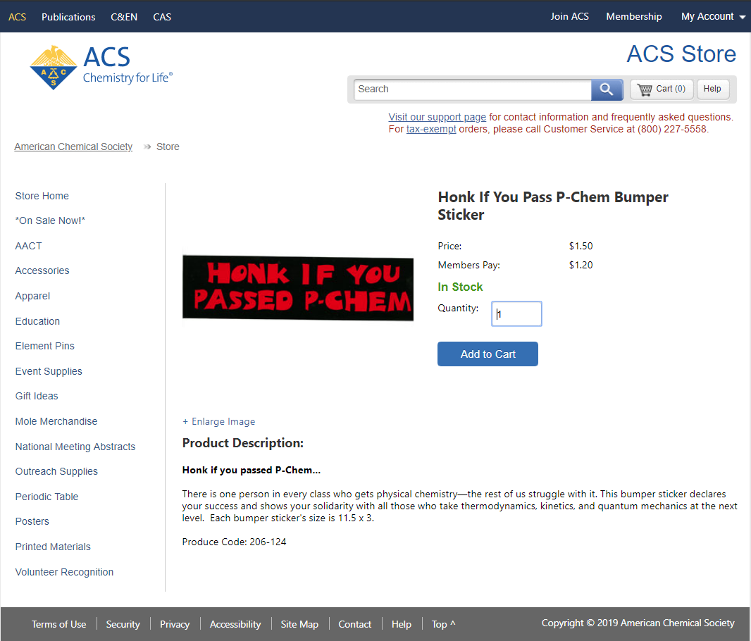
In 2017, students asked to video my class.
Why?
Because, Physical Chemistry (PCHEM) is the most hated course in my discipline, worldwide.
No joke! The ACS has a bumper sticker for it.
Notes:
https://www.store.acs.org/eweb/ACSTemplatePage.aspx?site=ACS_Store&WebCode=storeItemDetail&parentKey=a671e0b0-8980-4faa-8d58-8306e5a77c6b
Product Description:
Honk if you passed P-Chem...
There is one person in every class who gets physical chemistry—the rest of us struggle with it. This bumper sticker declares your success and shows your solidarity with all those who take thermodynamics, kinetics, and quantum mechanics at the next level. Each bumper sticker's size is 11.5 x 3.

Slide 7
Two-year Progression
Year 1 (2017-18)
Three students (Fernandez, Peavy, and Butler)
Video camera in front row
Posted to YouTube as is
Year 2 (2018-19)
I began using my personal laptop/web cam
Wacom tablet with stylus
Open Broadcaster Software
Posted to YouTube as is
Notes:
https://www.store.acs.org/eweb/ACSTemplatePage.aspx?site=ACS_Store&WebCode=storeItemDetail&parentKey=a671e0b0-8980-4faa-8d58-8306e5a77c6b
Product Description:
Honk if you passed P-Chem...
There is one person in every class who gets physical chemistry—the rest of us struggle with it. This bumper sticker declares your success and shows your solidarity with all those who take thermodynamics, kinetics, and quantum mechanics at the next level. Each bumper sticker's size is 11.5 x 3.

Slide 8
Educational Benefit Review
From https://edtechtimes.com/
Video can help in many ways:
Flipped classroom models
Skills mastery (through repetition)
Other clever tools (video annotation tools*)
Ways I have used video:
Lecture capture for their review and repetition
*Tutorials for homework problems and Excel techniques
Commentary on rubric levels of achievement
Commentary on exemplars of student work
Motivational content

Slide 9
IDEA Questionnaire Review
2017“The videos are awesome! They are extremely helpful!! Especially the review videos for the tests!”
2018“When entering this course, I was terrified, as many others were. I like how you acknowledged this fear in the beginning ... I REALLY enjoyed how much effort you put into your videos also--your videos are what makes this course do-able.”
2017 “Thank you for recording the lectures, because it really helps to go back and listen to it again. However, sometimes the video was a little blurry. I think it would be even better if you used a capture technology, ... I feel like I have made tremendous strides in this class, and this is the first class where I felt like I have learned a great deal.”
2018 “After taking this course a second time, I can say that the improvements made from last year made a substantial difference in my performance this time around. ... The lecture recordings are also great and much improved from last year.”

Slide 10
Roadmap
Today’s Cohort – Who’s in the room?
Teaching and Learning
My Reasons for Starting a YouTube Channel?
Educational Benefit Review
IDEA Questionnaire Review
Mechanics
Hardware Requirements
Software Requirements
YouTube Requirements
Unexpected Benefits

Slide 11
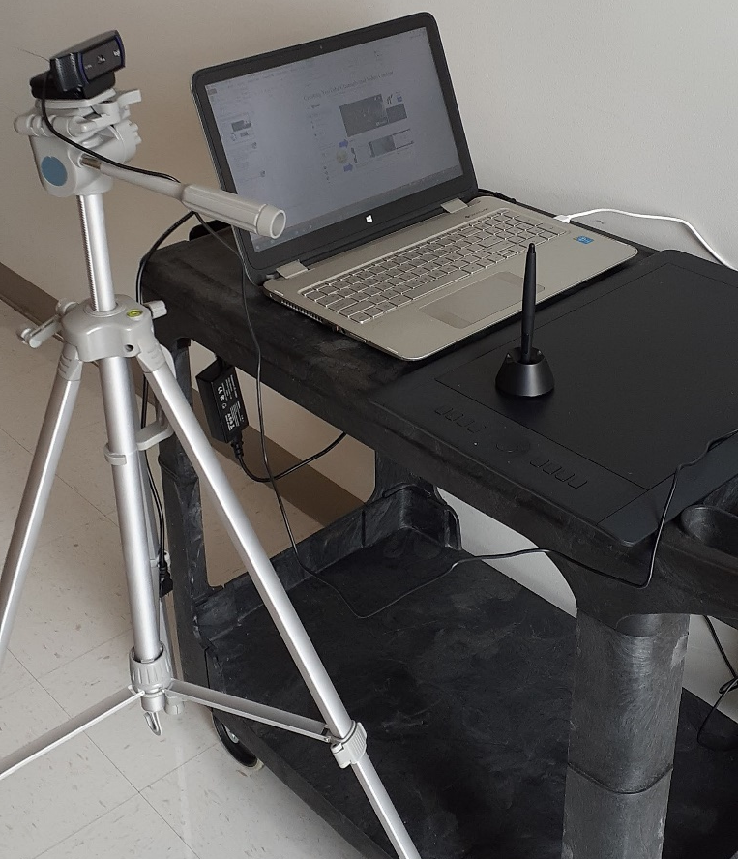
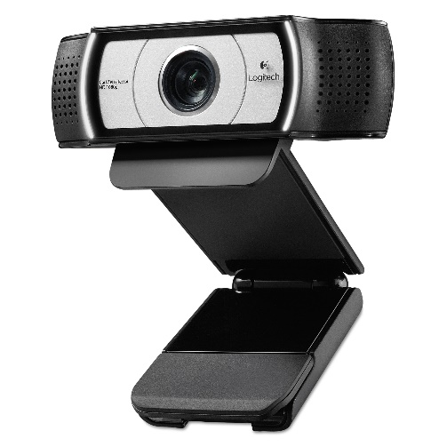
My In-Class Video/Lecture System
$50
1TB USB 3.0 External Hard Drive
Bought in 2014
$650 to $800 Laptop
Intel Core i7
8GB RAM
1 TB Hard Drive
In Office
$50 to $90
Logitech C930e HD Web Cam
$250 to $500
Wacom Intuos Pro Pen and Tablet

Slide 12
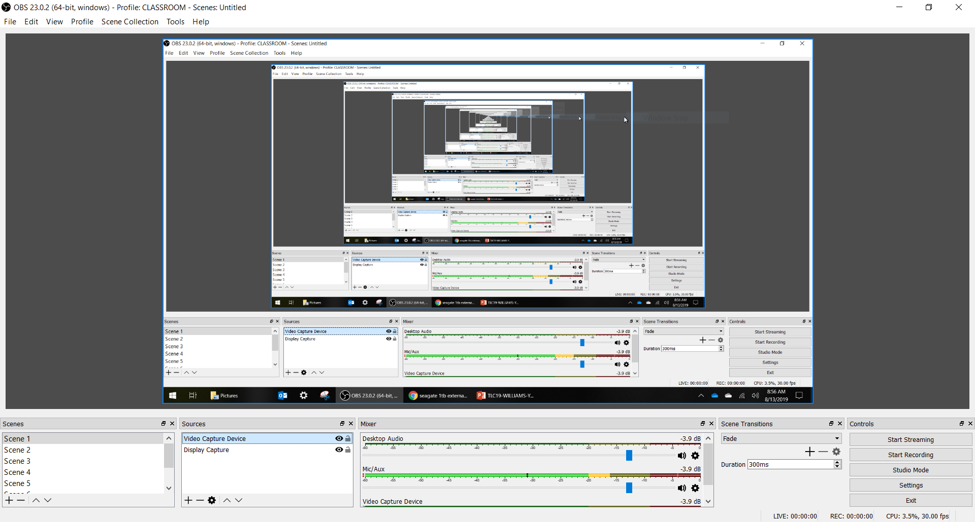
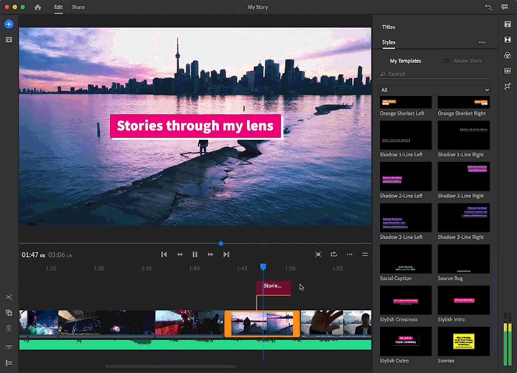
My Software Setup
Open Broadcaster Software
OBS for short
Adobe Rush
Only used occasionally to snip and clip edit

Slide 13
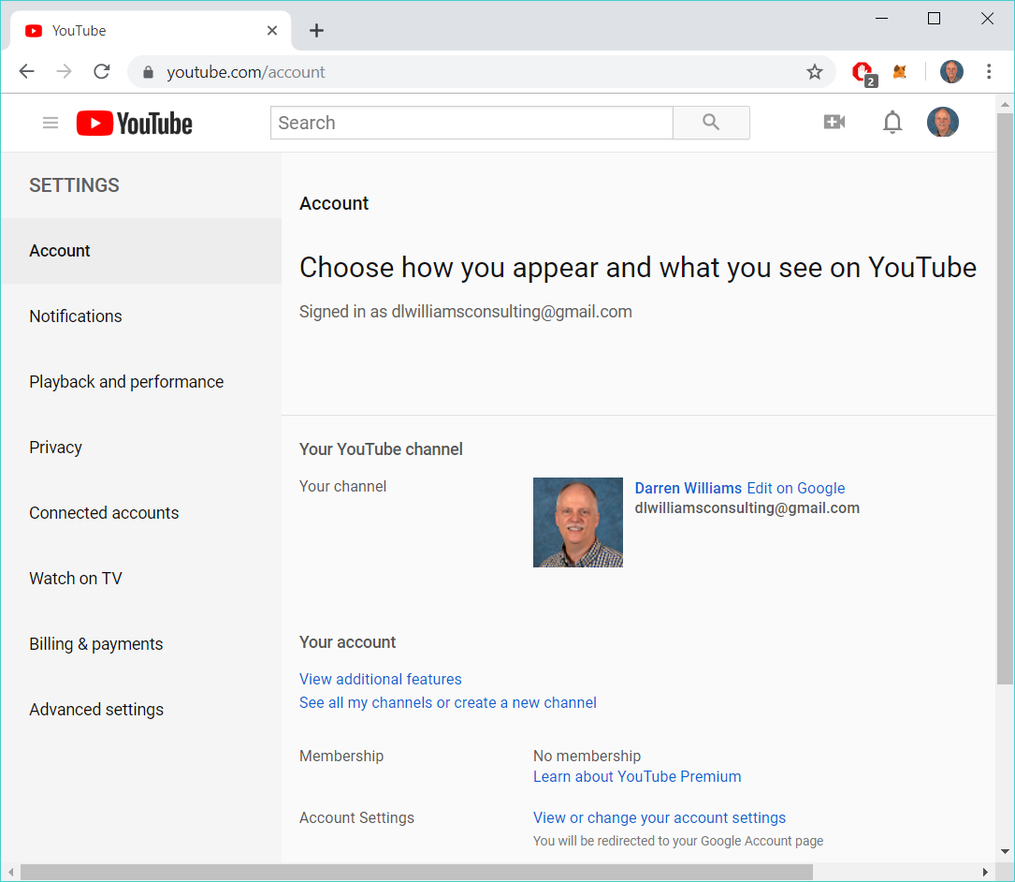
YouTube Channel Creation (as of this week ☹)
1
2
3

Slide 14
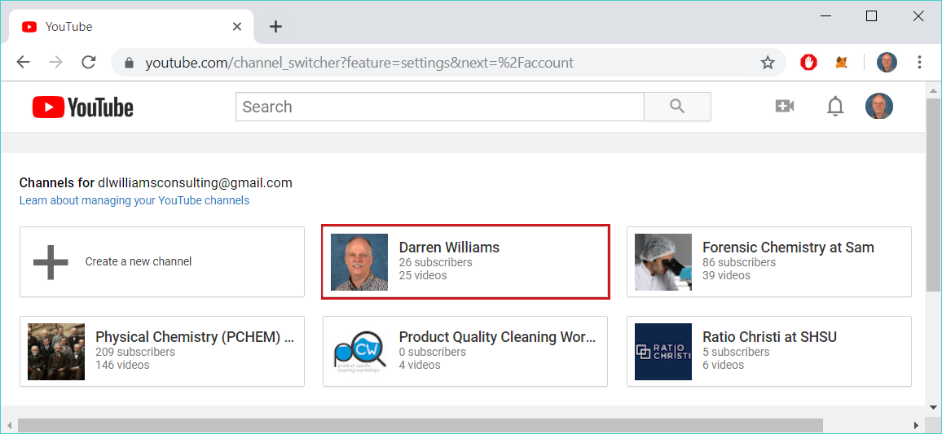
YouTube Channel Creation (as of this week ☹)
1
4
2
3

Slide 15
Roadmap
Today’s Cohort – Who’s in the room?
Teaching and Learning
My Reasons for Starting a YouTube Channel?
Educational Benefit Review
IDEA Questionnaire Review
Mechanics
Hardware Requirements
Software Requirements
YouTube Requirements
Unexpected Benefits

Slide 16
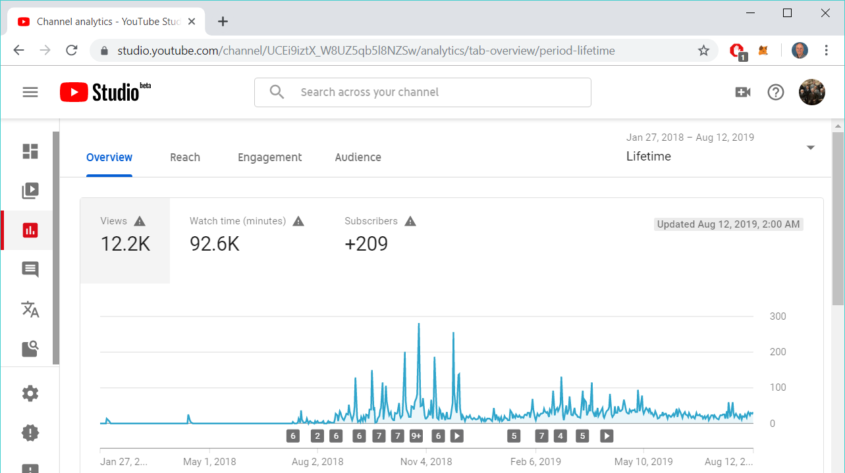
Unexpected Benefits
Sustained Interest beyond the initial semester.
Fall Semester
Continued Interest →

Slide 17
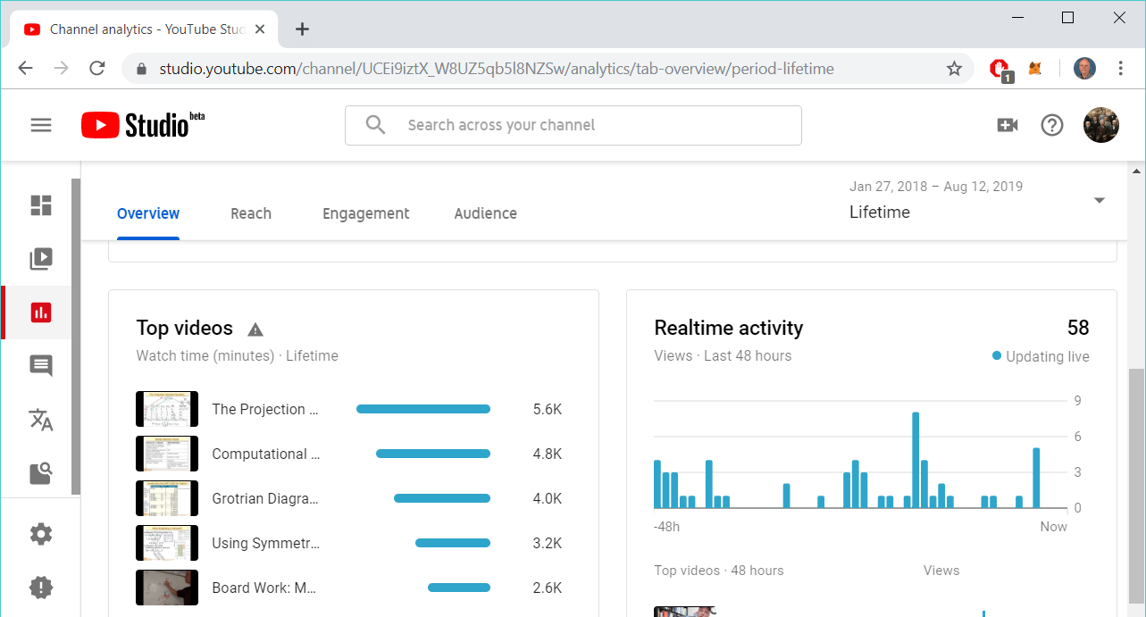
Unexpected Benefits
Most popular topics!
A very difficult topic = most viewed.

Slide 18
Unexpected Benefits
International Viewers
Only 39% of the views are listed as US Viewers.
743 in India

Slide 19
Conclusions: Is this worth the effort?
YES.
Students are more engaged.
Students can drill on difficult topics.
ESL Students can pause video and mentally relax.
Problems can be slowly developed and replayed.
Impact goes beyond campus to the world.
Your contribution and impact will grow quickly.

