Slide 1
Evaluating High Impact Research Assignments for Undergraduates: Incorporating Research in Freshman/Sophomore Classes
Lisa van Raalte, Ph.D.

Slide 2
High Impact Practices (HIP) Grant Proposal
The Center for Enhancing Undergraduate Research Experiences and Creative Activities (EURECA)
American Association of State Colleges and Universities (AASCU)
Spring 2018 – Fall 2018
Reimagining the First Year (RFY)
Notes:
High Impact Practices (HIP) Grant Proposal, The Center for Enhancing Undergraduate Research Experiences and Creative Activities (EURECA), mini-grant funds provided by the American Association of State Colleges and Universities (AASCU) through the Reimagining the First Year (RFY) project, Sam Houston State University. Dates: Spring 2018 – Fall 2018.

Slide 3
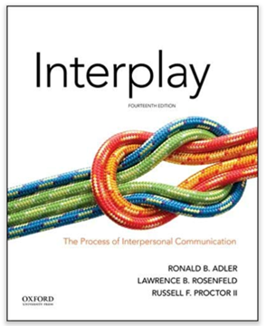
COMS 2386: Interpersonal Communication
Interpersonal theory and research
Original assignments: individual reflection and application papers, tests, activities
Adapted assignments: reading journal articles, group research paper, tests, activities

Slide 4
Assignments
Groups assigned according to topic interests
4x Journal article fill-in-form (independently, then with group)
Individual annotated bibliography for group literature review
Group RQ and Qualtrics survey (TA instruction)
Final paper and group presentation

Slide 5
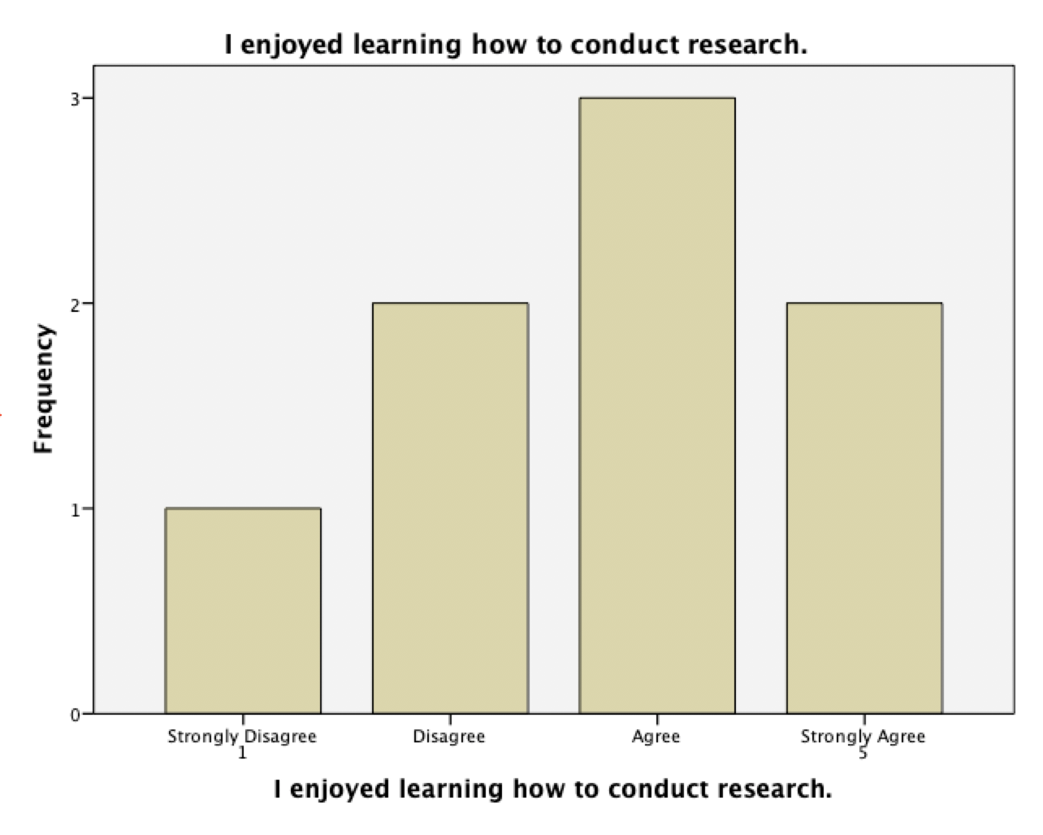

Slide 6
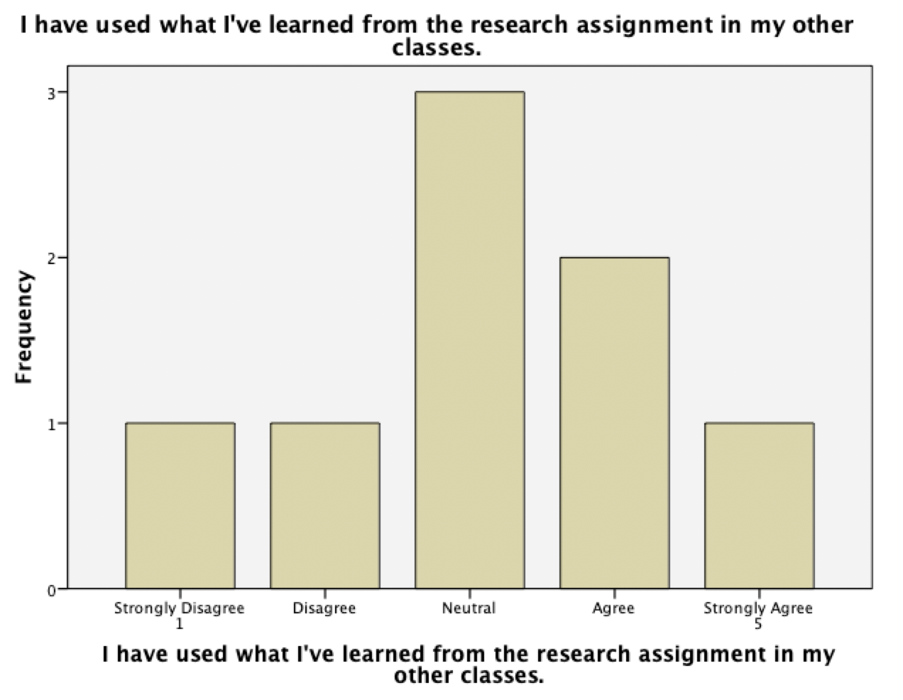

Slide 7
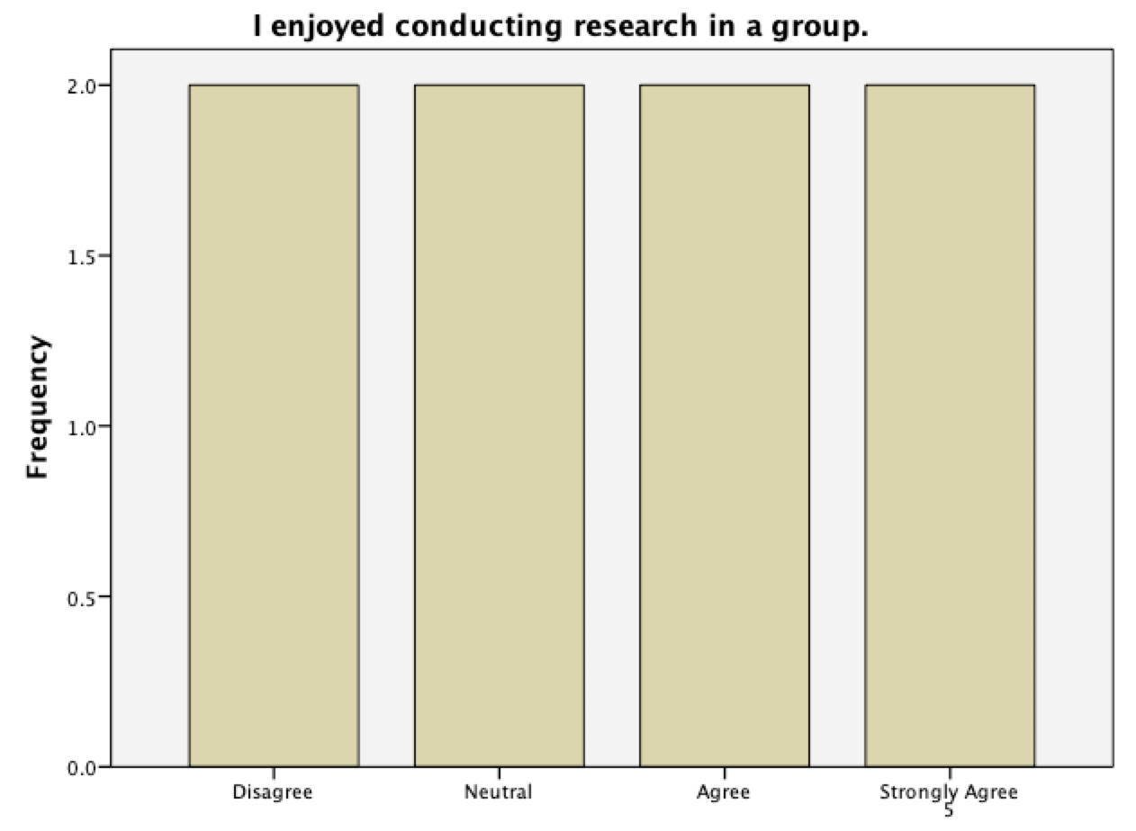

Slide 8
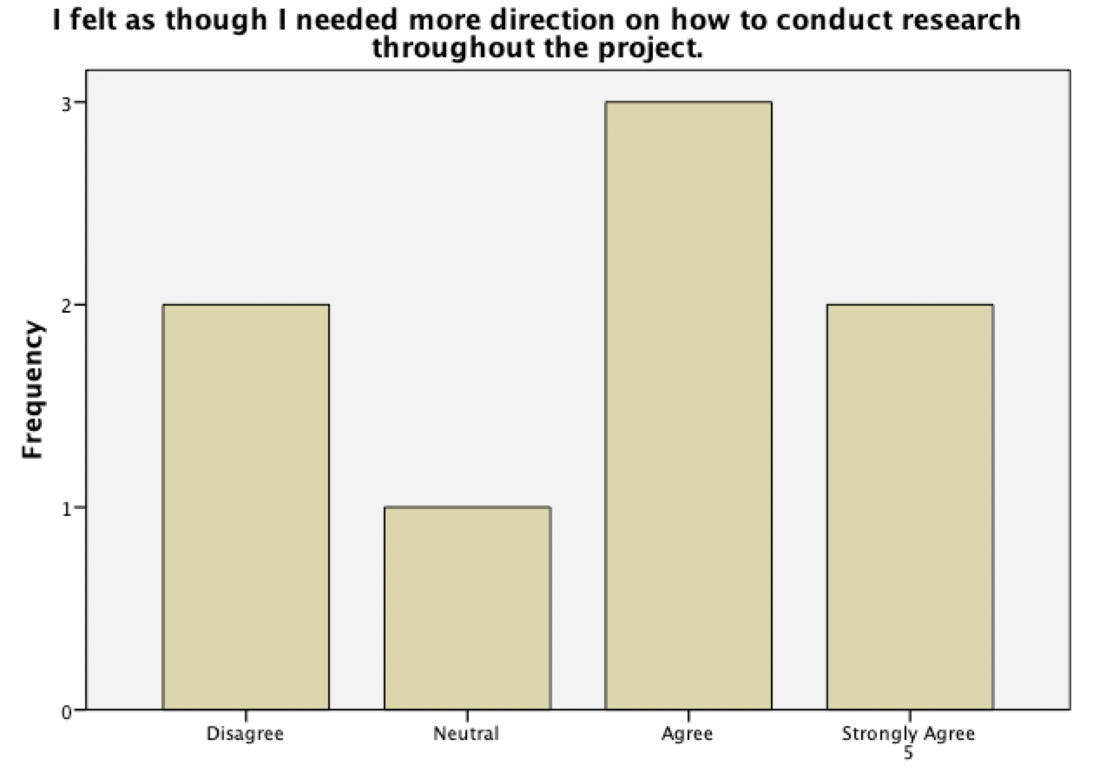

Slide 9
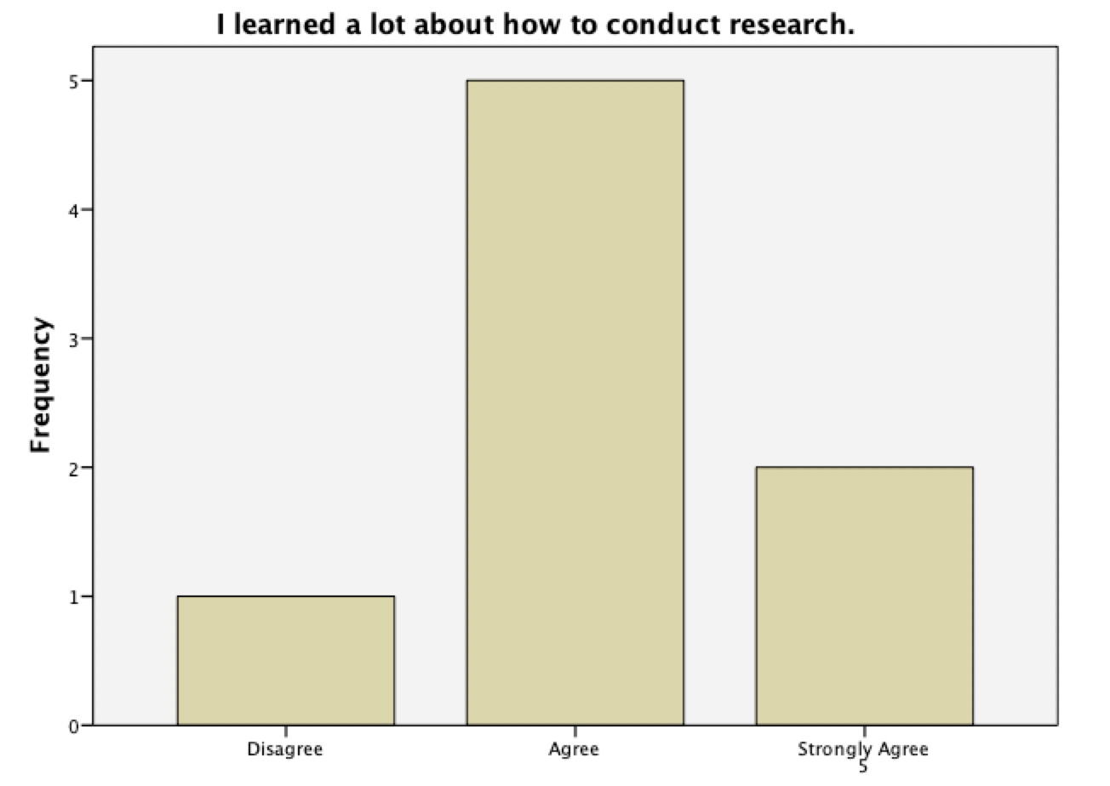

Slide 10
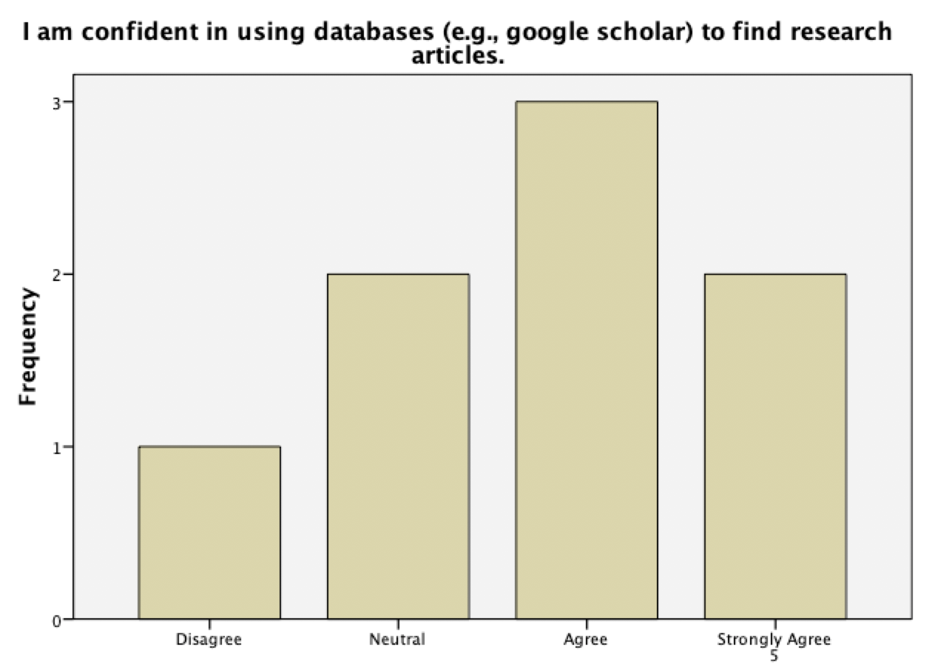

Slide 11
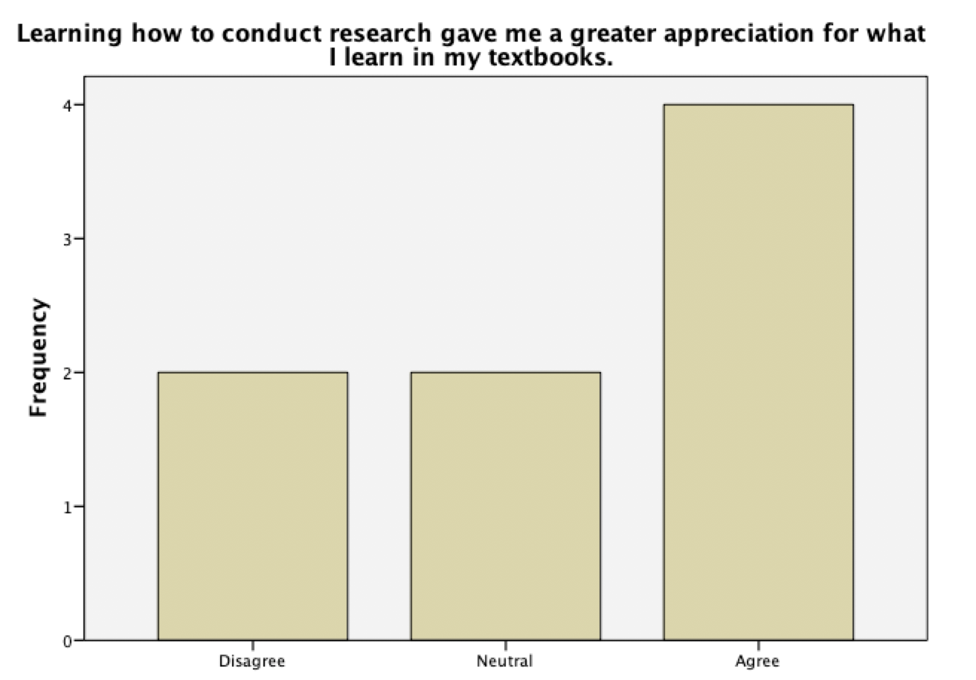

Slide 12
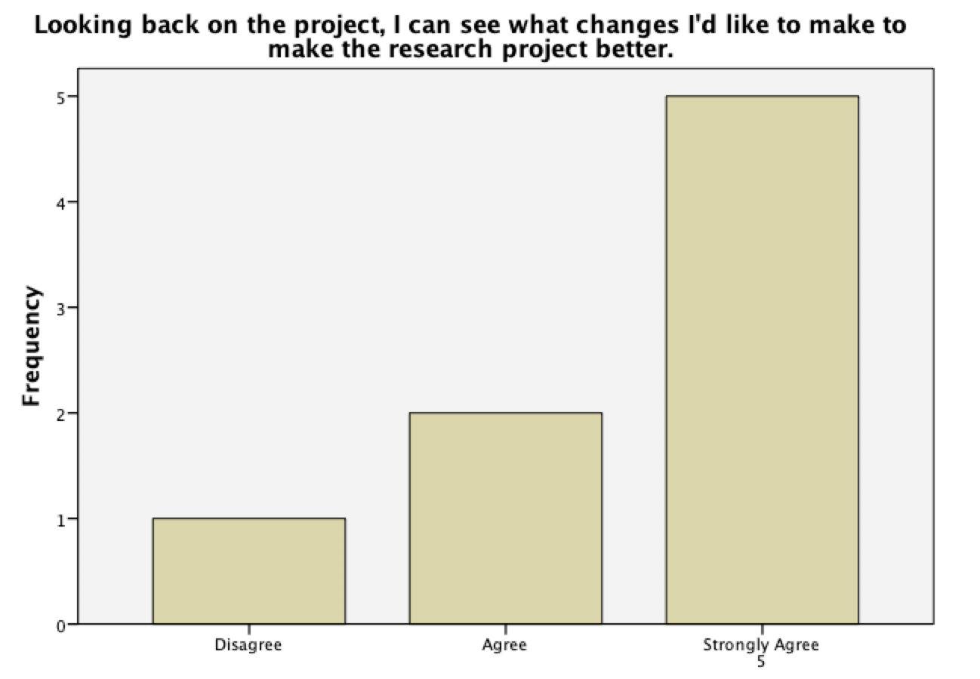

Slide 13
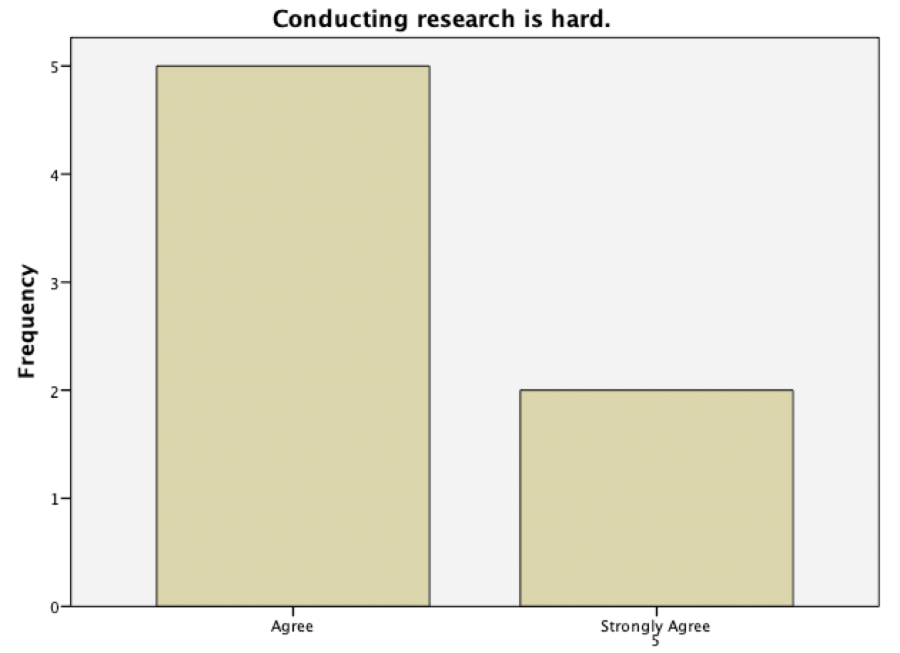

Slide 14
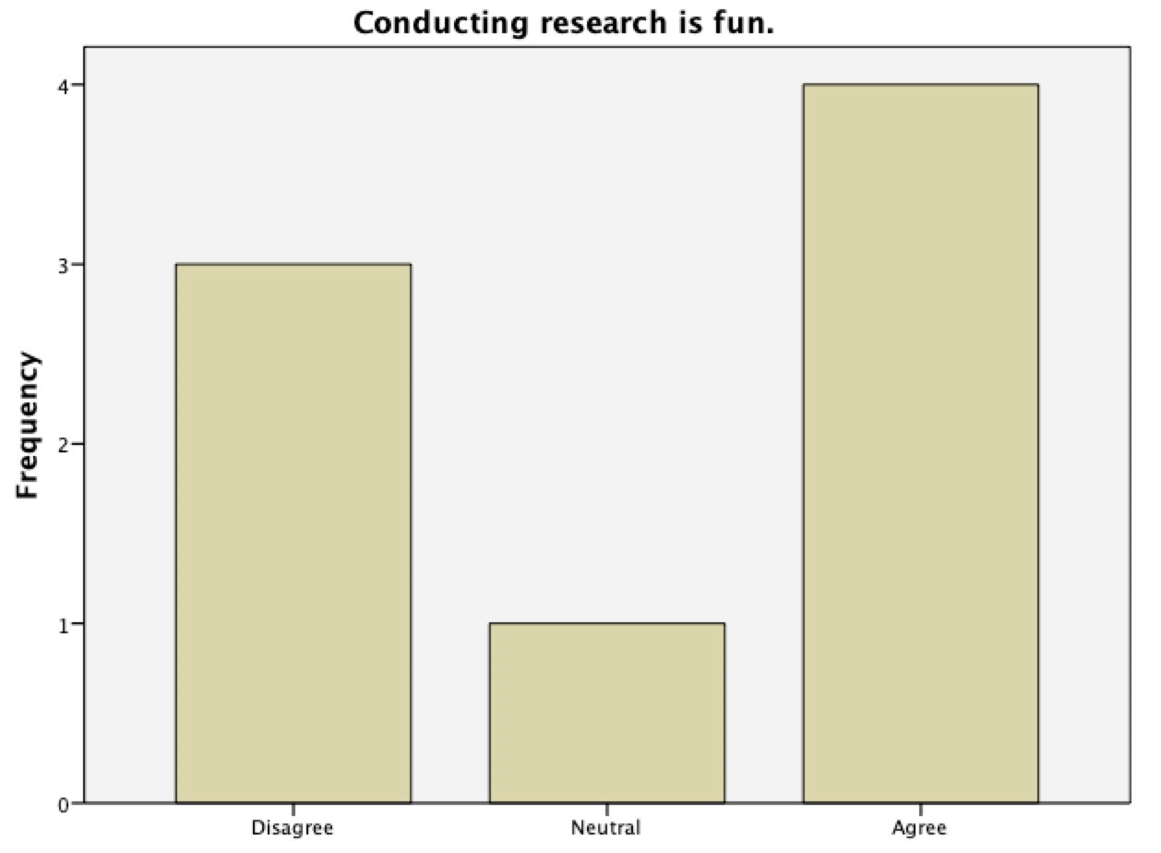

Slide 15
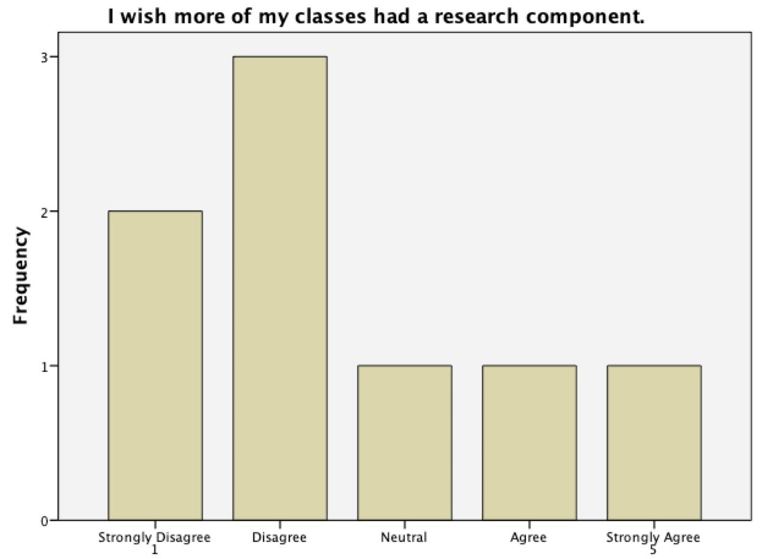

Slide 16
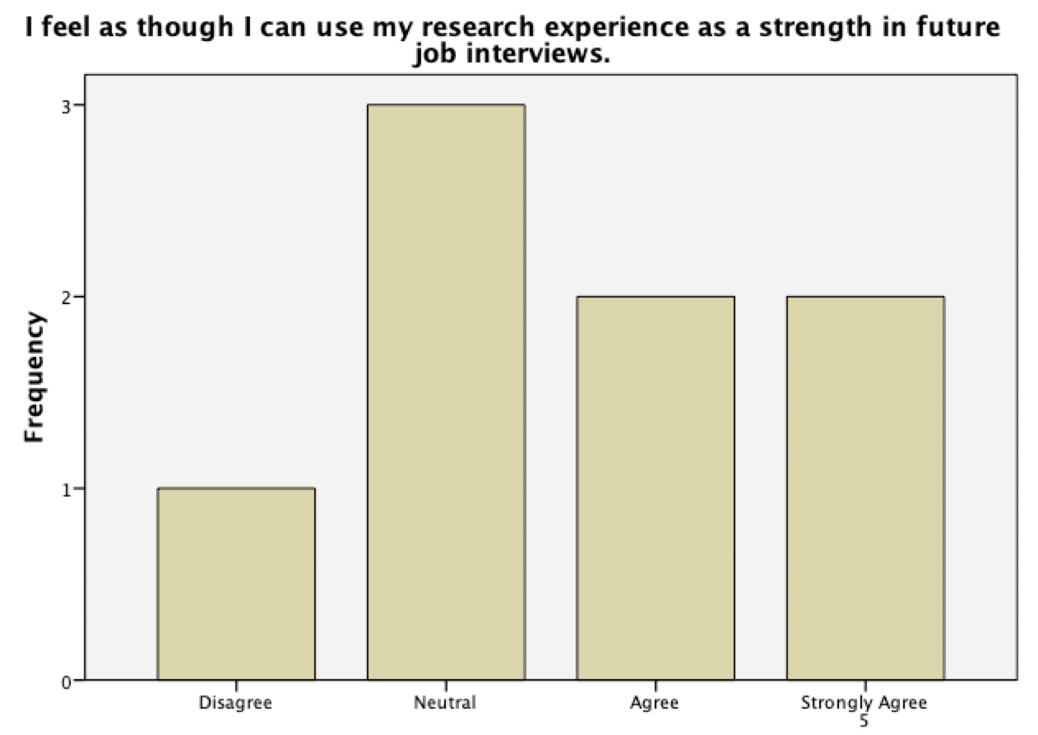

Slide 17
What did you like BEST about the research project?
It was something that I never used before and it pertained to my degree so I found in useful. | Chasing a topic that is exciting to you
Being interested in the topic. | Developing the findings and discussing with my team the interesting aspects of each research question being answered.
I liked the gathering of data through Qualtrics and getting people to participate in the survey we made in class. | That I got to experience researching. I liked learning the process and gaining knowledge in our topic. My favorite part was the survey because I got to read everyone’s answer and come to a conclusion for our hypothesis.

Slide 18
What did you like LEAST about the research project?
Working with unmotivated group members | I wish we would have had more time and more help interpreting our results
Group projects are just not my cup of tea. There are always people that won’t come when your group meets and they don’t do their work, and those people suck. I also didn’t like the group paper. I feel like none of them flowed cause everyone had different writing styles and then nobody cared enough to go back and ‘make it flow better.’ | Having to decrypt all the results and putting numerical data into words.
What I least liked about the project was the writing portion at the very end and the presentation of our findings. | I am unfamiliar with how to use APA format and I am not the best with google scholar so that gave me some trouble.

Slide 19
How could this research project be improved upon?
I think providing a little more time and more help interpreting the results would have helped | More step by step help instead of just uploading things online.
I would have liked to have more time throughout the entirety of our semester to work on the project. | I feel like the research project could have been improved through some more time during class to write portions and a bit more guidance with the actual writing process.
More time spent learning how to use the data | Personally I would prefer to make it a 2 person project. Chances are they both can meet and it’s gonna be a lot easier when it’s just 2 then 4 or 5. Maybe that’s just me, but I would have preferred that.
More explanation, and more time to understand things.

Slide 20
Is there anything else you’d like to add?
I loved this class and I think the research project was a great addition. Dr. Van Raalte was a lot of help through out the process, it was just a matter of having more time | Your class was VERY interesting and exciting. As a non-major I really enjoyed the process and the information!
I appreciate you letting us give feedback. | Although it was challenging and I could see a lot of my classmates getting frustrated, it was an excellent project that developed us inside and outside of the classroom. We learned a lot about research, responsibility, and time management.
Overall though, I would say the research project was an interesting assignment and has definitely given me a better understanding concerning the process of conducting and discussing research using real world resources. | Yes, Prof is amazing, but not everyone is passionate about certain topics etc. and it was a super hard class for 2000 level

Slide 21
Takeaways
More time and explanation needed (lose class material though?)
Selecting their own topics was effective
Group projects are strongly disliked
The survey and results was favored

Slide 22
Thank You
Lisa J. van Raalte
Lisa.vanraalte@shsu.edu
Drlisavanraalte.com
(936) 294-1970

