Slide 1
Fishing
Methods

Slide 2
Objective
Define the different ways to fish
Understand why some fishing is not allowed to be used by recreational fishers
Identify the trends of fishing and the how the purposes changing

Slide 3
Ways to Categorize Fishing
Purpose
Location
Equipment

Slide 4
Main Purpose
Before 19th Century
After 19th Century
Food Resources
Family Bonding
Commercial
Recreational
Sport

Slide 5
Location
Freshwater
Marine
Rivers
Ponds
Lakes
Streams
Deep sea or Offshore
Near shore

Slide 6
Hands Only/Diving
Fresh
Traditional
“Hand Fishing”
Streams
Noodling, Catfish
Tickling
Other than Fish: Oysters, Lobsters and Abalone
http://www.youtube.com/watch?v=paabvv600Hw

Slide 7
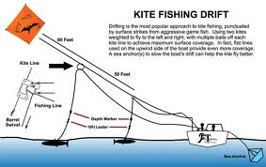
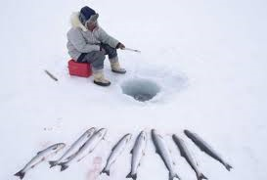
Hand Held Equipment
Fresh and Marine
Most Common
Angling
Kite
Ice
Surfcasting

Slide 8
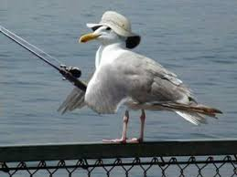
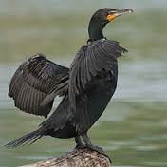
Animals
Marine
Birds
Dogs
Dolphins

Slide 9
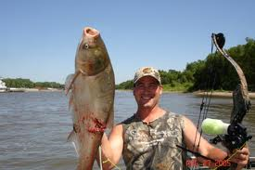
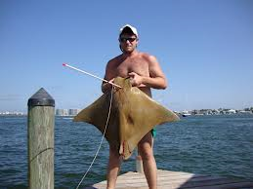
Projectiles
Fresh and Marine
Arrows
Spear Guns
Sticks
http://www.spearfishingtips.com/spearfishing-tips.html

Slide 10
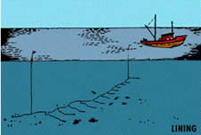
Line
Fresh and Marine
Hooks or Lures
Fishing Line
Most Fresh Water Fish
Trolling is 1 Type

Slide 11
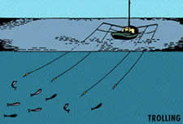
Trolling
Marine
Hooks or Lures
Fishing Line
fast moving surface swimming
Tuna, Marlin and Kingfish

Slide 12
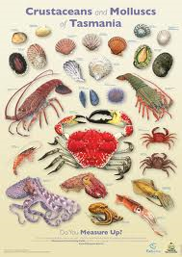
Nets and Traps
Fresh and Marine
Different Types of Netting and Traps
Large Scale Fish
Crustaceans
Crab, Lobster, Eel

Slide 13
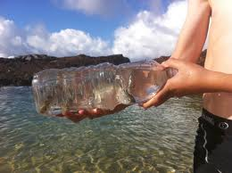
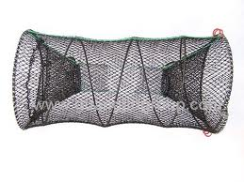
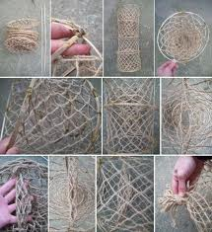
Traps
Fresh or Marine
Bottle, Bag, Bucket

Slide 14
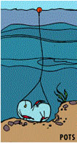
Pots
Marine and Fresh
Baited
Marked
Lobster
Cod
http://www.youtube.com/watch?v=ydicCMJZCp8

Slide 15
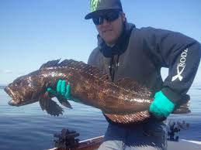
Trawling
Most Important Commercial in New Zealand
One to Two Vessels
Large Net
2-3 Hours at 3 or 4 Knots
Recreational Fishers
Orange Roughy, Hoki, Ling, Hake and Squid

Slide 16
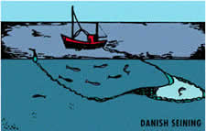
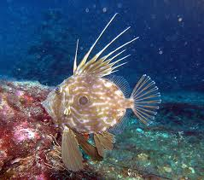
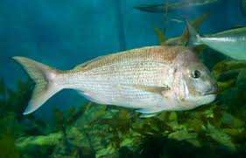
Danish Seining
Marine
Encircle
Herd and Trap
Snapper and John Dory

Slide 17
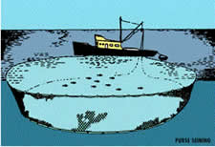
Purse Seining
Surface Dwelling Fish
Planes
Schools
Net is Pursed
Recreational Fishers
Tuna, Mackerels, Kahawai

Slide 18
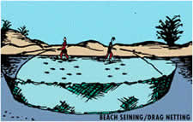
Beach Seining/Drag
Mullet, Flatfish, Snapper, Trevally and Crabs
Most Common with Fresh Water

Slide 19
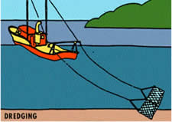
Dredging
Oysters
Heavy Ring Mesh
Vessel tows a Steel-Framed Dredge

Slide 20
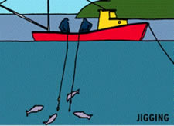
Ligging
Lowering and retrieving lines
Night
Lights
High Quality Squid

Slide 21
Technology
How do they know where the fish are??

Slide 22
Review
Most common in New Zealand?
What type of fishing uses Snorkels?
What is the main different in the more modern fishing?

