Slide 1
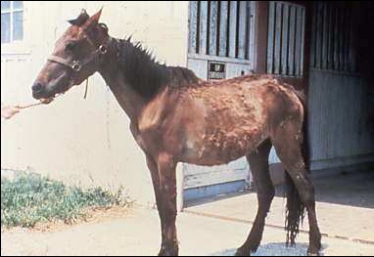
Internal Parasites
Equine Science

Slide 2
Internal Parasites
Why should we be concerned?
Affects:
Reproduction
Growth
Performance
Overall well being
How many internal parasites are known to affect horses?
>150

Slide 3
Internal Parasites
What types of internal parasites are we most concerned with?
Ascarids
Strongyles
Pin Worms
Bots
Threadworms
Tapeworms

Slide 4
Ascarids (Roundworms)
Primarily affects??
Foals and young horses
Adult parasite may reach
5 to 22 inches
Immunity develops by exposure during adolescence
Damage begins during migration

Slide 5
Ascarids (Roundworms)
Damage includes:
Physical damage, inflammation, and scaring of liver and lung tissue
May also cause:
Digestive irritations
Decreased feed absorption
Possibly colic

Slide 6
Ascarids (Roundworms)
Transmission?
Swallow eggs with feed, pasture, or water
Eggs hatch and larvae burrow into S.I.
Travel to liver, heart, and lungs
Migrate via blood supply from lung tissue to air spaces
Coughed up, re-swallowed, return to S.I. and mature

Slide 7
Ascarids (Roundworms)
3 months to complete life cycle
Eggs will start appearing in manure
10-13 wks old
Female worm will lay up to
200,000 eggs/d
Larva develops in ~2 wks
Eggs are very resilient and may remain infective for years in pastures or stalls

Slide 8
Ascarids (Roundworms)
Typically passed from one foal crop to another
Prevention requires
de-worming at least every two months through the first year of life
Some foals will cough and nasal discharge (no response antibiotics)

Slide 9
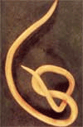
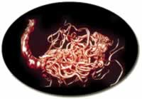
Ascarids (Roundworms)
Signs include un-thriftiness, pot belly, rough hair coat, slow growth, and depression

Slide 11
Strongyles
Most significant and most common
Occur in what ages?
All ages; except neonatal foal
Sexually mature strongyles are found
Within the L.I.
Commonly divided into two groups
Large and Small

Slide 12
Strongyles
Majority of larvae occur on pasture vegetation
Little transmission indoors
Extremely resistant to adverse weather conditions
Survive freezing winters easily; however
Killed by hot, dry summer conditions
Once ingested
Enter the lining of the S.I., cecum ,and L.I.

Slide 13
Large Strongyles
Three significant species:
Strongylus vulgaris (bloodworms)
Larvae burrow into small arteries in the gut wall and migrate to the anterior mesenteric artery
Main blood supply to digestive tract
Migration causes disruption of blood flow by formation of blood clots in the artery

Slide 14
Large Strongyles
Larvae remain in anterior mesenteric artery
~120 days while they grow and develop
Start a return migration
Down the arteries to the L.I.
Upon maturation
Females may lay several thousand eggs/d
Passed into manure
Life cycle takes
~6 to 7 mo.

Slide 15
Large Strongyles

Slide 16
Small Strongyles
Strongylus endentatus
Strongylus equinus
Similar life cycles but not as dangerous
Migrate within the liver, causing damage, and then return to the L.I.
8 to 11 month life cycle

Slide 17
Small Strongyles
De-wormers have
Reduced the significance of these parasites
Migrate beyond the lining of the small intestine
Tissue damage is somewhat less severe
May cause diarrhea & increased chances of colic

Slide 19
Pinworms
Not very harmful
Relatively simple life cycle
Adults found primarily in
Colon and rectum
Lay eggs around anus
Contaminate pastures, water, bedding, etc.

Slide 20
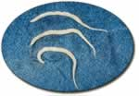
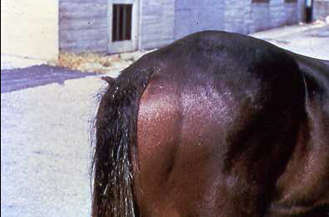
Pinworms
After ingested
Develop into maturity in the colon and rectum without a migratory state
Damage is minor
Produce severe irritation around the tail
Causes rubbing

Slide 21
Stomach Bots
Larvae of the Bot Fly
Adult fly resembles a honey bee
Females lay eggs on the hairs of horses, especially legs
Friction and moisture is necessary for hatching

Slide 22
Stomach Bots
Horse licks area where bots are attached
Larvae attach to tongue
Burrow into the tissue of the mouth
Those attached to neck, mane, and face
May migrate to mouth

Slide 23
Stomach Bots
After ~ three weeks
Second stage larvae emerges that is swallowed
Attaches to the lining of the stomach
Spend ~ 9 months attached to stomach lining
Then pass out in manure
Pupate into adult flies

Slide 24
Stomach Bots
Life cycle depends on
The larvae over-wintering in the stomach
Adult flies are active from
Late spring to the killing frost
Treatment for bots should be scheduled from
Mid to late summer
Again after a killing frost

Slide 25
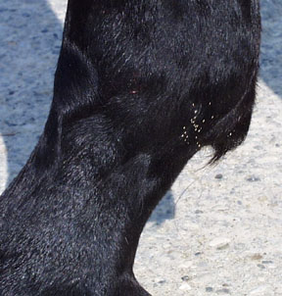
Bot Eggs

Slide 26
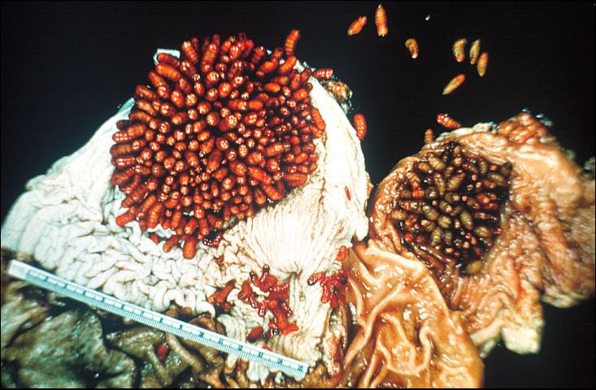
Bot Larvae

Slide 27
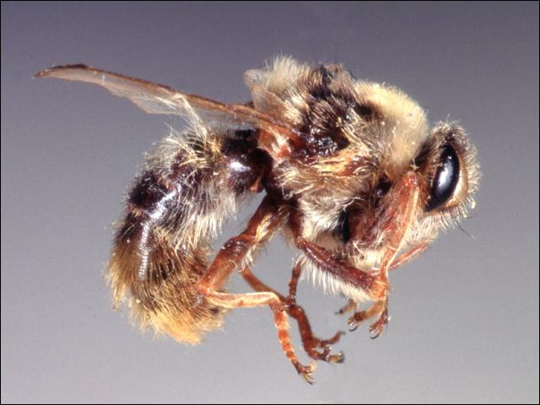
Bot Fly

Slide 28
Strongyloides (Threadworms)
Mainly infects young foals 4-47 d old
Foals become infected by
Ingesting larvae in the dam’s milk
Larvae migrate through the lungs and S.I.
Causing injury while passing

Slide 29
Strongyloides (Threadworms)
Life cycle can be completed in
< two weeks
Creates potential for severe infections in short time intervals
Foals will quickly reject the infection
by 60 – 90 d of age

Slide 30
Strongyloides (Threadworms)
Main problem is
Diarrhea, which may not respond to treatment
May become extremely dehydrated
May accompany “foal heat” diarrhea

Slide 31
Tapeworms
Occurs in all ages of horses
An intermediate host (ingestion of mite)
Once ingested
Takes about two to four months for tapeworm to mature
Mature worms first occur in weanlings and yearlings

Slide 32
Tapeworms
Large number can cause ulceration in L.I. cecum, and colon
May also cause intestinal blockage
Pyrantel pamoate is effective in removing by
Doubling normal dosage
What is the most common drug for removal
Praziquantel

Slide 33
Prevention and Control of Internal Parasites
No way to eliminate
Factors affecting internal parasite loads include:
Season of year
Humidity
Rainfall
Age of Horse
Concentration of Horses on Land

Slide 34
Prevention and Control of Internal Parasites
Key to successful control program is
Interruption of the life cycle
What is primary means through which Parasites spread?
Manure
Manure contaminates
Feed and water supply, pastures, paddocks, and stalls

Slide 35
Prevention and Control of Internal Parasites
Sanitation plays an important role in
Parasite reduction
Proper manure disposal will
Help prevent contamination
Manure should be
Composted before spreading on pastures currently being grazed

Slide 36
Prevention and Control of Internal Parasites
If manure is not composted
Should be spread on un-grazed pasture
Good pasture management can
Dramatically reduce internal parasites
Should prevent overcrowding

Slide 37
Prevention and Control of Internal Parasites
Mowing and harrowing helps
Break up manure
Exposes larvae to existing climatic conditions
Should be cautious of mowing and harrowing
On occupied pastures
Grazing cattle after horses may be beneficial
Parasites specific to horses do not affect cows

Slide 38
Prevention and Control of Internal Parasites
Separate and feed by
Class, stage of production, and/or age group
Yearlings should be managed differently than brood mares. Why?
They are affected by different types of parasites
Should also be on a different De-worming schedule

Slide 39
Prevention and Control of Internal Parasites
Try not to feed on the ground
Provide hay mangers and feed bunks
Make sure mangers and bunks are cleaned regularly
Make sure water supply is regularly cleaned and free of fecal material

Slide 40
Prevention and Control of Internal Parasites
Many different commercial products are available for parasite control
Differ in their ability to remove internal parasites
Important to be familiar with
Anthelmintics and for which parasites are affected
De-wormers alone will not
Be effective in parasite control if management is poor

Slide 41
Prevention and Control of Internal Parasites
What are the most common physical forms of anthelmintics?
Paste
Stomach tube
Continuous Method
Consume small daily doses
Continuous control except for bots

Slide 42
Prevention and Control of Internal Parasites
No schedule fits all horses
Basic guidelines:
Most veterinarians feel that horses should be de-wormed at least four times/year
This would include:
Strongyles, Ascarids, and Pinworms
Botacide in early spring and late fall
Foals every 30 to 60 d for first year

Slide 43
Prevention and Control of Internal Parasites
Rotation of de-wormers is also important
Parasites may become resistant to particular classes
Parasite control can help reduce colic and increase performance

