Slide 1
History of Wildlife Management
By Heather Milam
©1999
Edited by Ullrich

Slide 2
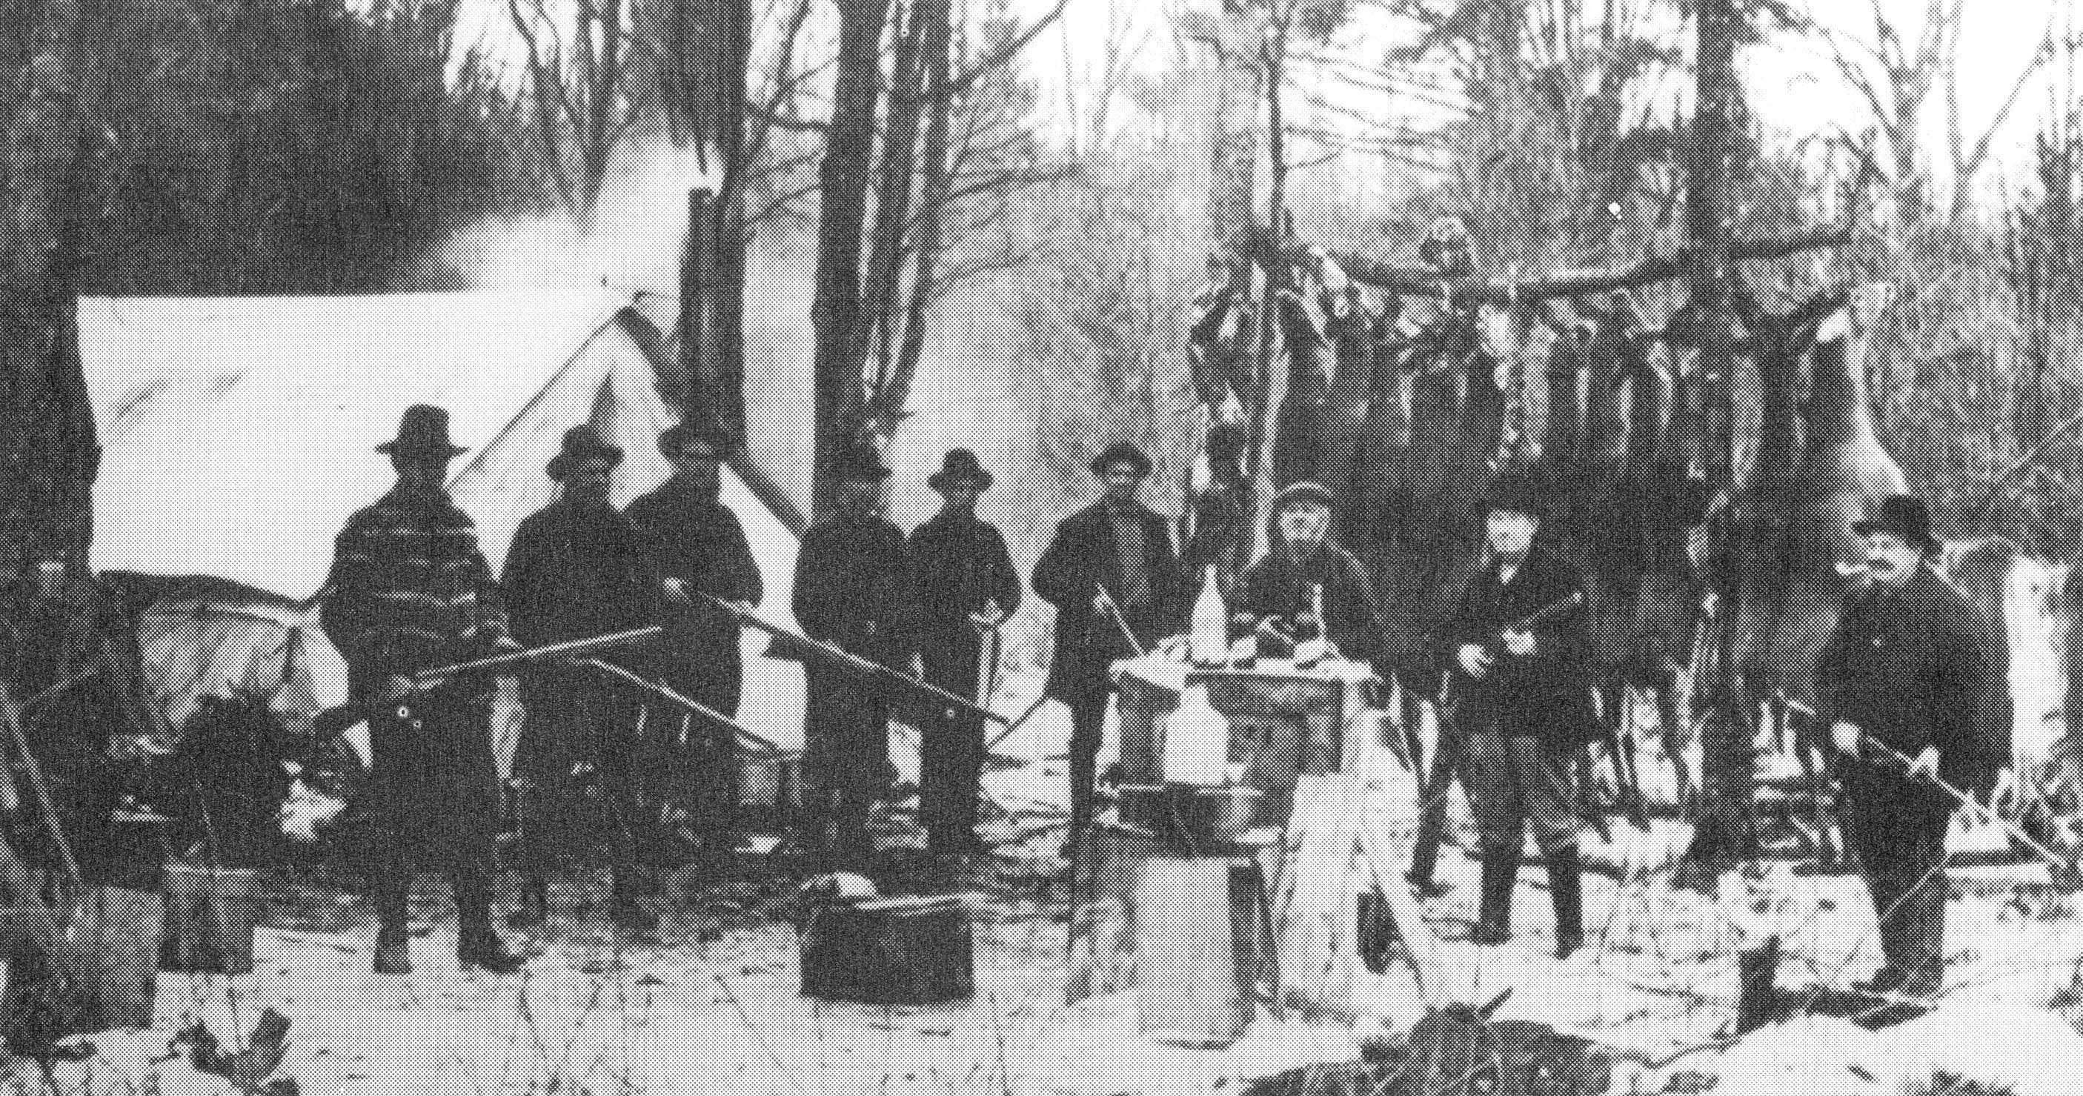
WILDLIFE MANAGEMENT…. What is it?

Slide 3
Wildlife Management...
In wildlife management there are various controls used to maintain the quality and quantity of animals.
The change or improvement needed determines the control used.

Slide 4
Wildlife Controls
Restrictions on hunting
Predator control
Reservation of Game lands (parks, forests, and refuges)
Artificial Replenishment
Environmental controls (control of food water and disease)

Slide 5
B.C. and Historic
Game management dates back to the beginning of human history.
Tribes that restricted hunting were more likely to survive and prosper over those who had no restrictions.

Slide 6
Late 13th Century
The first clear record on a system of game management concerning conservation was found in the Mongol Empire.
Marco Polo described the game laws of Kublai Khan.
People were prohibited from killing hares, deer, large birds, and other animals between the months of March and October. To enable the animal populations to increase and multiply.

Slide 7
Late 13th century contd..
In Europe, from 1200-1800 management was established mostly to benefit the upper classes.
In 1536, Henry VIII established protection of all waterfowl during May-August.
During the 1600’s James I extended landowners protection of trespass to all hunting, for game protection. (poaching)

Slide 8
History
Until about 1905 the main concern of the public was to preserve hunting, rather than improve the wildlife population.
People believed that restrictions on hunting would make the species last longer.
People didn’t realize that management could aid in the production and maintenance of the animal supply.

Slide 9
Agencies Associated with Conservation and Management of Wildlife
Federal Agencies
Bureau of Land Management
Department of Agriculture (USDA)
The Environmental Protection Agency (EPA)
U.S. Fish and Wildlife Service
U.S. Forest Service
National Park Service
Natural Resource Conservation Service (NRCS)

Slide 10
Agencies Associated with Conservation and Management of Wildlife
State Agencies:
Texas Dept of Agriculture (TDA)
Environmental Protection Division (EPD)
Texas Forestry Service
Texas AgriLife

Slide 11
Agencies Associated with Conservation and Management of Wildlife
Private Conservation Groups
Quail Coalition / Quail Unlimited
National Wild Turkey Federation
Ducks Unlimited
National Wild Turkey Federation
The Nature Conservancy
National Rifle Association
Quality Deer Management Association
National Wildlife Federation
Sierra Club

Slide 12
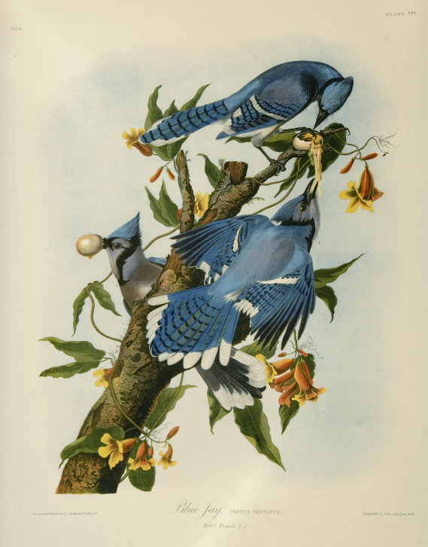
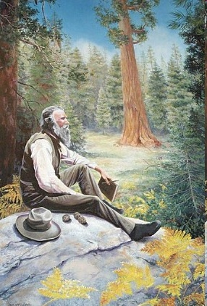
Past Leaders of Wildlife Conservation
John James Audubon
Studied birds of North America
Famed naturalist
American Audubon Society named for him
John Muir
Explorer, naturalist, and writer
Influential in establishment of Yosemite and Sequoia National Parks

Slide 13
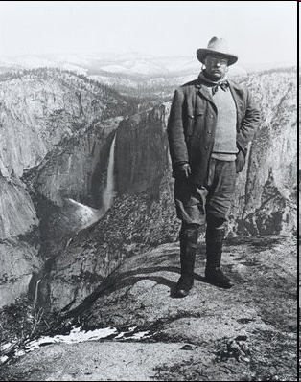
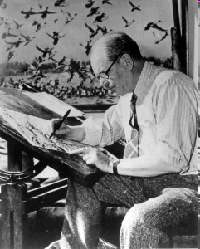
Past Leaders of Wildlife Conservation
President Theodore Roosevelt
Considered father of Conservation Movement in United States
Established 18 national monuments and 51 bird reservations
Jay Norwood “Ding” Darling
Writer and cartoonist
Designed first migratory bird hunting stamp
President National Wildlife Federation

Slide 14
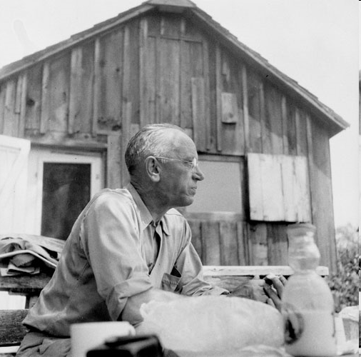
Past Leaders of Wildlife Conservation
Gifford Pinchot
Promoted forest stewardship
Head of U.S. Forest Service
Aldo Leopold
Contributions to wildlife ecology
Wrote: Game Management

Slide 15
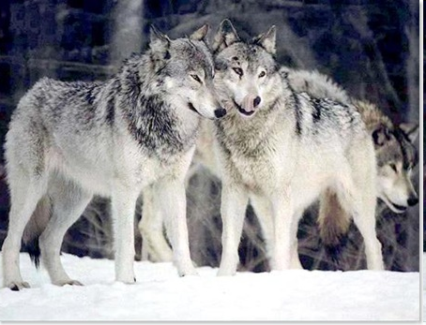
Types of Legislation to Protect Wildlife
Habitat
Game
Fish
Wildlife commerce
Threatened and Endangered species
Animal Damage

Slide 16
Policies and Legislation for Conservation of Wildlife Resources in the United States
1872: Land set aside for Yellowstone National Park
1900: Lacey Act (Game and Wild Bird Preservation Act)—prohibited transportation of killed game across state lines
1903: Pelican Island Refuge Established
1913: Weeks-McClean Act—protected migratory and song birds
1918: Federal Migratory Bird Treaty Act—initiated federal involvement in wildlife management

Slide 17
Continued…
1934: Duck Stamp Act—raised monies for wetland habitats
1937: The Federal Aid in Wildlife Conservation Act (Pittman-Robertson Act)—initiated sales tax on hunting supplies to fund wildlife management programs
1940: The Bald Eagle Protection Act—protected the Bald Eagle
1940: Fish and Wildlife Service formed
1950: The federal Aid in Fish Restoration Act—taxed fishing tackle to fund research

Slide 18
Continued…
1964: Land and Water Conservation Act—created funds to purchase scenic and recreational land
1964: The Wilderness Act—established a wilderness preservation program
1966: Endangered Species Act—protect endangered species
1971: The Wild-Free Roaming Horse & Burro Act—protected horses and burros on publicly owned lands
1972: Marine Mammal Protection Act—limited killing dolphins

Slide 19
Continued…
1973: Endangered Species Conservation Act—Comprehensive plan to protect threatened and endangered species
1985: Conservation Reserve Program—establish wildlife habitat on farms near crops

Slide 20
Federal Legislation
1900: Lacey Act: regulates shipment of illegally harvested animals
1929: Migratory Bird Conservation Act: First attempt to protect migratory birds
1934: Migratory Bird Hunting Stamp Act: Revenue generated to fund habitat
1937: Pittman-Robertson Act: taxed all hunting equipment and ammunition
1966: Endangered Species Act: Protected endangered and threatened wildlife species

Slide 21
Era’s of Wildlife Management
There are five main eras of wildlife management that have contributed to modern management.
Historians group these eras according to their attitudes, conditions, and management strategies.

Slide 22
Era’s Contd..
The Era Of Abundance (1600-1849)
The Era Of Overexploitation (1850-1899)
The Era Of Protection (1900-1929)
The Era Of Game Management (1930-1965)
The Era of Environmental Management (1966-present)

Slide 23
Era Of Abundance (1600-1849)
Early American settlers had no reason to worry, for they had an enormous quantity of wildlife around them. Their only purpose for management was predator control.
The earliest record of wildlife mgt.. occurred in the Mass. Bay Colony in 1630, paying one penny for wolf killed, aiding in predator control.
In 1646 a hunting season was established on deer. 1708 first bird season.

Slide 24
Era of Abundance [cont.]
In 1779 the Act of the Preservation of Deer passed in Vermont. This act protected bucks, does, and fawns January -June.
In 1848 Rhode Island passes laws against hunting migratory game birds in spring.

Slide 25
Era Of Exploitation (1850-1899)
Destruction of buffalo occurred during this era.
In 1850, millions of buffalo roamed the land. By the close of the century the buffalo was nearly extinct.
At one time there were so many buffalo that Buffalo Bill Cody would shoot 200 head per day, in one month he shot 4280.
Between 1871-1872 8.5 million Buffalo were shot.

Slide 26
Era of Exploitation [cont.]
The purpose of conservation in this era was to control the harvest of game species.
In 1852 the first state game laws and salaried game wardens in Maine.
12 years later New York implemented the first state hunting license requirements.
1872 Yellowstone became the nation’s first national park.
Iowa became the first to establish limits on game birds
By 1880, all states had game laws.

Slide 27
Era Of Protection (190-1929)
1900, Lacy Act helped limit market hunting by making interstate transport of illegally killed game a federal offense, and regulating importation of exotic wildlife.
1913, Weeks-McLean Act, developed federal control over migratory birds and ended spring waterfowl hunting.
1915, first funds for predator control.
State game and fish departments developed.

Slide 28
Teddy Roosevelt
Major contributor to wildlife management.
Believed that wise use of resources would continue the existence of wildlife.
Personal philosophy of conservation
Outdoor resources as important systems
Conservation as public responsibility
Private resource ownership as a public trust
science used for resource management
1903- Pelican Island
148 million acres of land set aside for national forrest, national parks doubled.

Slide 29
Era Of Game Management (1930-1965)
Increase in public funding and effective conservation administration.
Duck Stamp Act, 1934, Proceeds secure wetlands for breeding, migration stopover,and wintering of waterfowl.

Slide 30
Who was Aldo Leopold?
In the 1930’s he saw that wildlife was disappearing. He began asking questions about how to manage animals. Wrote “Game Management” which became the first step toward wildlife management.

Slide 31
Era Of Game Management [cont]
During this era numerous game laws and regulations were passed including the Pittman-Robertson Act which taxed hunting equipment and ammo.

Slide 32
Era Of Environmental Management (1966-present)
1966, Endangered Species Act (several amendments)
1969, National Environmental Policy Act
1970, Environmental Protection Agency
1980, Nongame Wildlife Act
Endangered Species List includes: 133 mammals, 124 birds, 25 fish.

Slide 33
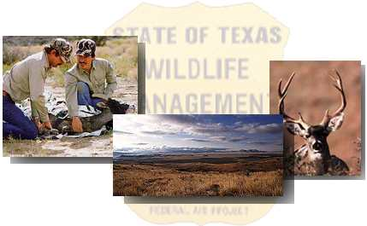
Wildlife Management Areas of Texas - An Overview -
By Monika Trevino
Materials from www.txpw.org
Edited by Ullrich

Slide 34
Overview………..
What a Wildlife Management Area is.
Primary goals of WMAs.
The 11 Natural Regions of Texas are divided into 7 Regions that contain 50 Wildlife Management Areas {WMA’s}

Slide 35
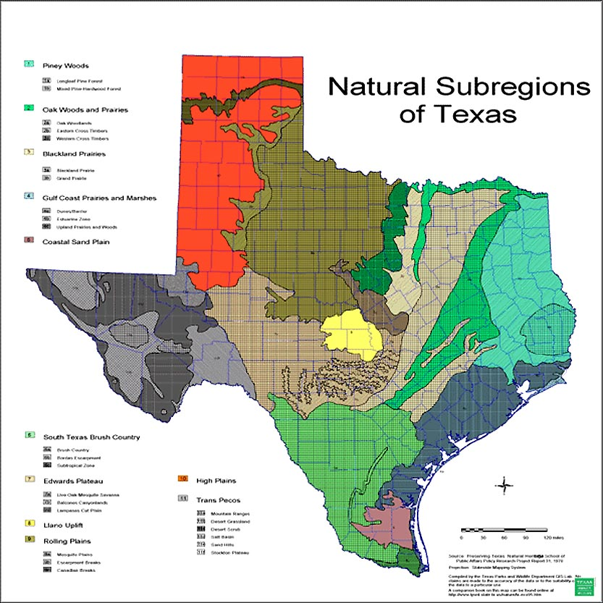

Slide 36
What are Wildlife Mgmt Areas?
Approximately three quarter of a million acres make up the 50 WMAs in Texas.
The high plains of the Panhandle to the tropical thorn forest of the Lower Rio Grande Valley - from the vistas of the Trans-Pecos to the lush green mystery of the Pineywoods
WMAs represent the spectacular diversity of Texas wildlife habitats.

Slide 37
The Wildlife Division of TPWD :
Conserves all of the state's wildlife resources along sound biological lines for the public's common benefit.
This includes:
wildlife research,
species inventory and
monitoring of population dynamics,
regulation of game seasons and
bag limits,

Slide 38
The Wildlife Division {cont.}
conservation of non-game species,
urban wildlife issues and information,
habitat inventories and monitoring,
land acquisition of diverse habitats to benefit wildlife and
the operations, maintenance and enhancement of 50 wildlife management areas.

Slide 39
The Wildlife Division {cont.}
Staff provides expertise and guidance on wildlife resources, wildlife restoration techniques and technical guidance;
provides opportunities for public hunting and appreciative uses of wildlife;
provides general information, technical brochures and educational opportunities to the public.

Slide 40
What are WMAs?
Wildlife Management Areas are special sites that provide opportunities for:
research on wildlife populations
habitats
public hunting
and an assortment of other outdoor recreational activities.

Slide 41
Primary goals of WMAs: (Cont.)
To develop and manage wildlife habitats and populations of indigenous wildlife species.
To provide a site where research of wildlife populations and habitat can be conducted under controlled conditions.
To provide areas to demonstrate habitat development and wildlife management practices to landowners and other interested groups.

Slide 42
Primary goals of WMAs: (Cont.)
4. To provide natural environments for use by educational groups, naturalists, and other professional biological investigators.
5. To protect populations of endangered, threatened, or migratory wildlife and protected plant species and related habitats.
6. To provide public hunting and appreciative use of wildlife in a manner compatible with the resource.

Slide 43
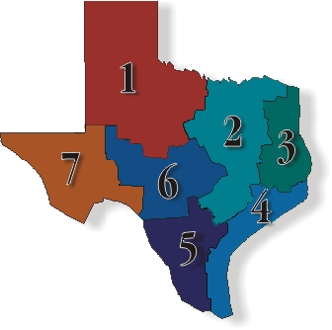
The Seven Regions
High & Rolling Plains
Post Oak Savannah & Blackland Prairies
Pineywoods
Gulf Prairies & Marshes
South Texas Plains
Edwards Plateau
Trans-Pecos Mountains & Basins

Slide 44
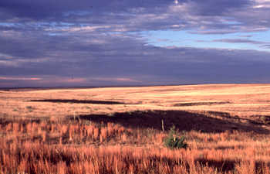
Region 1- The Panhandle Plains
Encompasses the High Plains of the Panhandle and the adjoining Rolling Plains of northwest Texas.

Slide 45
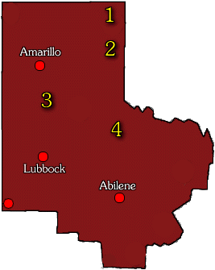
The Panhandle Plains
1. W. A. "Pat" Murphy WMA
2. Gene Howe WMA
3. Playa Lakes WMA
Armstrong Unit
Dimmitt Unit
Taylor Lakes Unit
4. Matador WMA

Slide 46
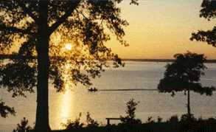
Region 2- Prairies and Lakes
Blackland prairies and oak "cross timbers" is a transition zone between the pineywoods of east Texas and the western plains.
Oak savannah, where patches of oak woodland are interspersed with grassland.

Slide 47
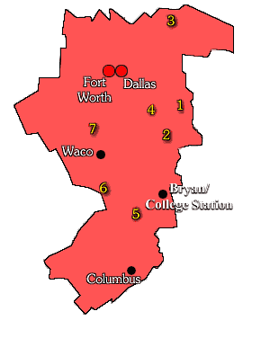
Prairies and Lakes
1. Gus Engeling WMA
2. Keechi Creek WMA
3. Caddo National Grassland & WMA
4. Richland Creek WMA
5. Sommerville WMA
6. Granger WMA
7. Aquilla WMA

Slide 48
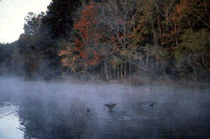
Region 3- The Piney Woods
Pine and pine-hardwood forests with scattered areas of cropland, planted pastures, and native pastures.

Slide 49
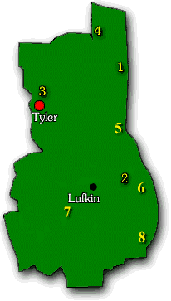
The Piney Woods
1. Caddo Lake SP / WMA
2. Bannister WMA
3. Old Sabine Bottom WMA
4. White Oak Creek WMA
5. North Toledo Bend WMA
6. Moore Plantation WMA
7. Alabama Creek WMA
8. Lower Neches WMA

Slide 50
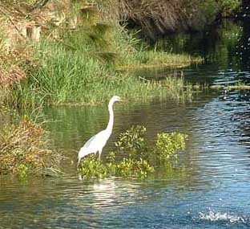
Region 4- The Gulf Coast
Nearly level slowly drained plain, dissected by streams and rivers
Includes barrier islands along the coast, salt grass marshes surrounding bays and estuaries, remnant tallgrass prairies, oak parklands and oak mottes and tall woodlands in the river bottomlands

Slide 51
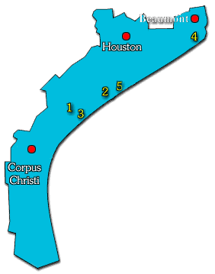
The Gulf Coast
1. Guadalupe Delta WMA
2. Mad Island WMA
3. Matagorda Island SP & WMA
4. J.D. Murphree WMA
5. Peach Point WMA

Slide 52
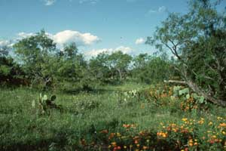
Region 5- South Texas Plains
Plains of thorny shrubs and trees and scattered patches of palms and subtropical woodlands in the Rio Grande Valley.
The primary vegetation consists of thorny brush such as mesquite, acacia, and prickly pear mixed with areas of grassland

Slide 53
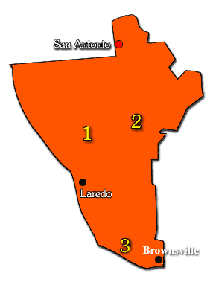
South Texas Plains
1. Chaparral WMA
2. James E. Daughtrey WMA
3. Las Palomas WMA
4. Lower Rio Grande Valley Unit
5. Ocotillo

Slide 54
Region 6- Texas Hill Country
Known as the Texas Hill Country. It is a land of many springs, stony hills, and steep canyons. The region is home to a whole host of rare plants and animals found nowhere else on earth. Today, the Edwards Plateau is characterized by grasslands and savannahs were more common in pre-settlement times than they are today.

Slide 55
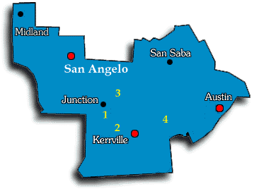
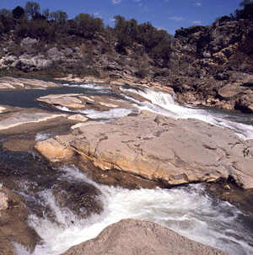
Texas Hill Country
1. Kerr WMA
2. Walter Buck WMA
3. Mason Mountain WMA
4. Old Tunnel WMA

Slide 56
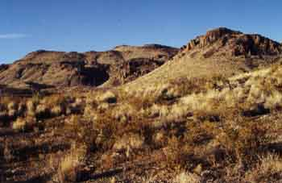
Region 7- Big Bend Country
Most complex of all the regions. It occupies the extreme western part of the state eastward generally to the Pecos River.
Diverse habitats and vegetation, from the desert valleys and plateaus to wooded mountain slopes.

Slide 57
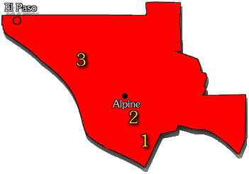
Big Bend Country
1. Black Gap WMA
2. Elephant Mountain WMA
3. Sierra Diablo WMA
Elevations range from 2,500 feet to more than 8,749 feet at Guadalupe Peak. Mountain ranges vary greatly in the environments they offer for plant and animal life. Some are characterized by volcanic rocks, others by limestone.

Slide 58
FACTS TO THINK ABOUT
One in three people in the world don’t have enough to eat.
12 million people die of starvation each year.
By the year 2030; The world’s population will be nearly 10 BILLION.
SO WHAT DOES THAT MEAN FOR THE ENVIRONMENT?

Slide 59
THE END

