Slide 1
Equine Nutrition
Energy

Slide 2
Energy
First Law of Thermodynamics?
Energy can be neither created nor destroyed
How is energy expressed in U.S.?
Calories
Energy content of food
For Horses:
Kilocalories or Megacalories
May also be expressed in Joules
One megacalories is = 4.184 megajoules (MJ)

Slide 3
Gross Energy
What does this represent?
The amount of heat produced from the total combustion of that feed
As measured in a bomb calorimeter
Will chemical composition affect a feeds gross energy?
Lipids higher than CHO’s & Proteins
Starch similar to cellulose
High mineral content, lower GE value

Slide 4
Apparent Digestible Energy
How do you calculate?
By subtracting GE in feces from GE consumed
Why apparent?
Endogenous material
What two factors affect amount of DE in a feed?
GE content of feed
Digestibility of energy containing components

Slide 5
Apparent Digestible Energy
What is the most accurate method of estimating DE in a feed?
Feeding Trial
Other species have also been used as estimates
Can DE content be different?
Individual variation
Exercise
Diet Form

Slide 6
Apparent Digestible Energy
One feed component may affect digestibility of another
Example:
Addition of concentrate with straw may affect digestibility of straw
Adding Fat has been seen to reduce fiber digestibility

Slide 7
Metabolizable Energy
Calculated?
(Urinary loss + Gas loss) – DE
Urinary and Gas loss are
Smaller than fecal loss in horses
Efficiency of DE conversion to ME is influenced by
Composition of diet
Gaseous losses are higher when feeds are digested where?
L.I.

Slide 8
Net Energy
Calculated?
ME – Heat
Also referred to as recovered energy
Energy stored in tissues
Lactation Energy
Conceptus Energy
Hair Energy

Slide 9
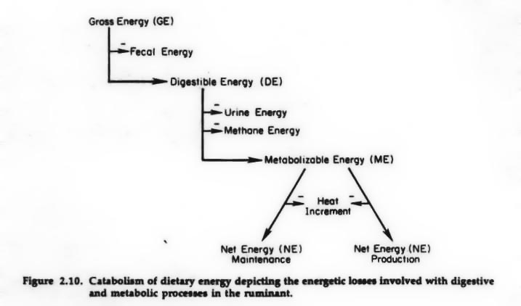
Energy Flow Diagram

Slide 10
Energy Sources
What is the major source of chemical energy in cells?
Adenosine Triphosphate (ATP)
Generated from what?
Catabolism of CHO’s, Fats, and Proteins
What is the primary form of CHO used for ATP production?
Glucose

Slide 11
Energy Sources
Where does glucose come from?
Circulation
Stores (Glycogen)
What is the most abundant energy source in the body?
Fat
Obtained through stores or circulation
VFA Production
May be metabolized to fatty acids or glucose

