Slide 1
Equine Nutrition
The Athlete

Slide 2
The Equine Athlete
Horses are raised to be athletes
Racing, endurance, roping, etc.
Basic driving force behind all of theses various types of work is:
Conversion of stored chemical energy into mechanical energy for muscular movement

Slide 3
The Equine Athlete
A number of physiological systems work to
Provide fuels to the muscle and to remove waste that are produced from metabolism
All of these systems function together to
Produce efficient movement of the horse’s limbs and body

Slide 4
The Equine Athlete
These physiological systems can be divided into several categories:
Cardiovascular system
Respiratory system
Muscular system
Biomechanics and conformation
Hematology
Nutrition

Slide 5
The Equine Athlete
Each of these systems can be viewed as links in a chain
If any link is weak, performance suffers
The study of exercise physiology entails
Methodically evaluating each physiological system to assess its role in limiting performance

Slide 6
Fueling Exercise
Work capacity depends on the rate at which energy is supplied to and used by muscles for contraction
What is used to produce muscular activity
ATP
Most direct way to form ATP is by cleaving creatine phosphate
Muscle contains small amounts of ATP & CP
Supplies are exhausted rapidly upon exercise

Slide 7
Fueling Exercise
Other pathways to re-synthesize ATP’s include:
Glycolysis
Breaks down glucose or glycogen into lactic acid
Anaerobic reaction – outside mitochondria
Net ATP = 8
Krebs Cycle aka Citric Acid Cycle
Breakdown of CHO’s, Fats, and Proteins, into energy (ATP) with the involvement of Oxygen
Aerobic reaction – inside mitochondria
Net ATP = 38

Slide 8
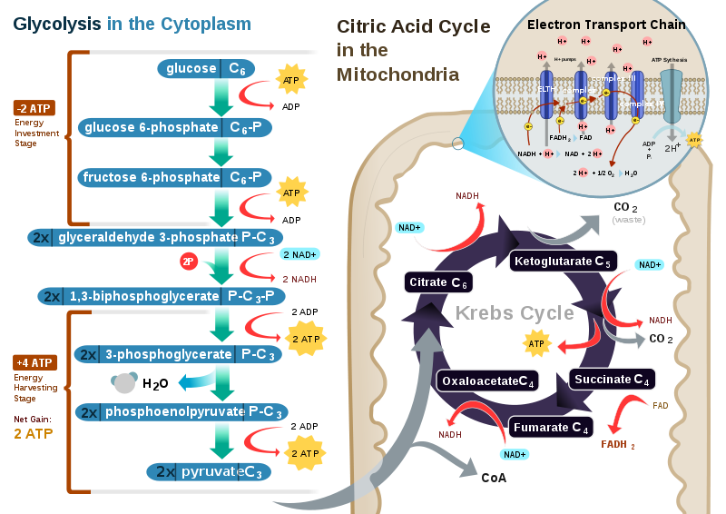

Slide 9
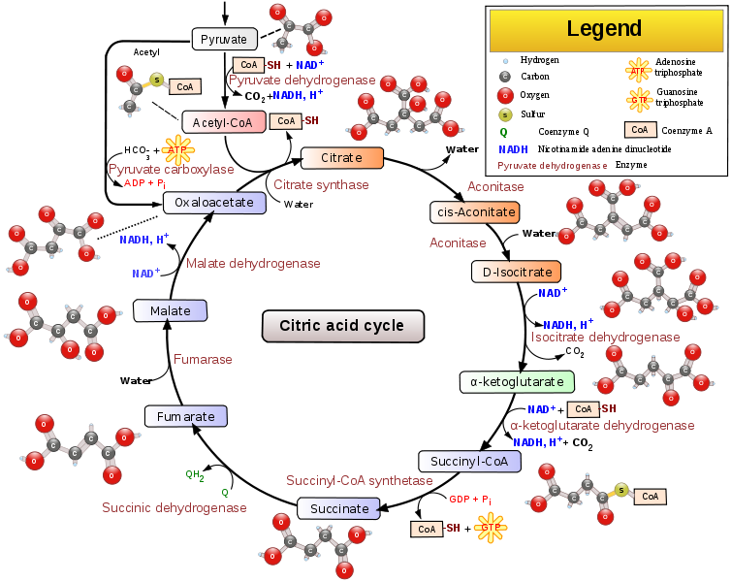

Slide 10
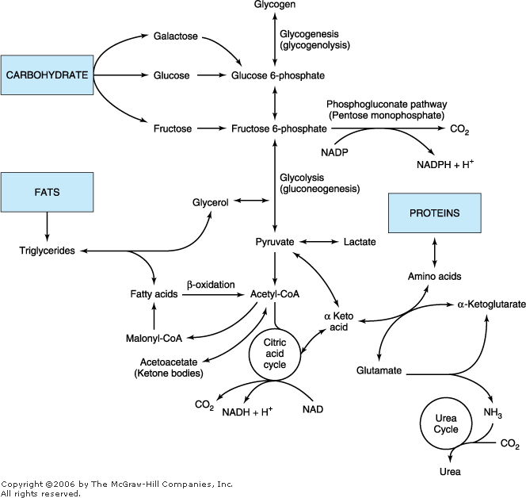

Slide 11
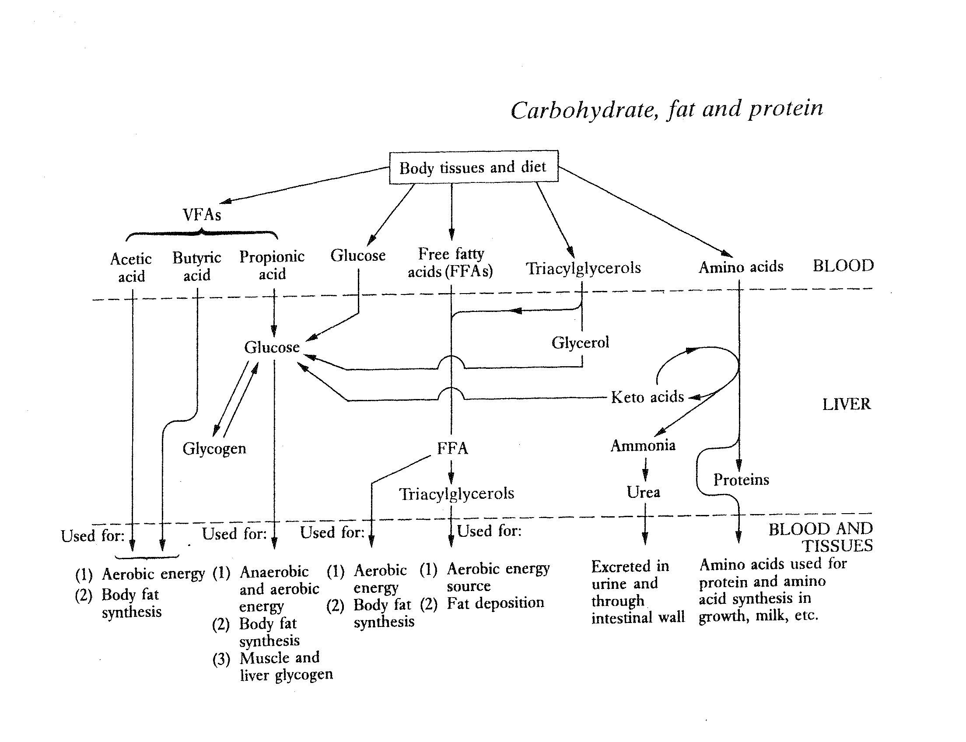

Slide 12
Muscle Fiber Types
Three Basic Types:
Type I
Type IIA
Type IIB
These fiber types have different contractile and metabolic characteristics

Slide 13
Muscle Fiber Types
Type I Fibers are
Slow-contracting
Type IIA and IIB are
Fast contracting
Type I and IIA have
High oxidative capacity thus utilize fuels aerobically

Slide 14
Muscle Fiber Types
Type IIB have
Low aerobic capacity
Depending more on anaerobic glycolysis for energy generation
All are very high in glycogen
Only Type I and IIA have triglyceride storage
The % of each fiber type that a particular breed has in its muscle depends on
Type of performance that the breed is selected for

Slide 15
Muscle Fiber Types
Heavy hunters have many?
Type I
TB’s & QH few Type I and many
Faster contracting IIA and IIB
TB’s had highest?
IIA
TB’s also had higher Type I than
Sprinters or middle distance horses

Slide 16
Substrate Utilization
The amount of ATP used by a muscle depends directly on?
How fast it is contracting
Muscles contract slow while walking:
Type I fibers used
Aerobic; fat burned from stores
As speed increases:
Type I fibers are unable to produce enough energy
Type IIA fibers recruited; aerobic; glycogen & fat burned

Slide 17
Substrate Utilization
As speed increases:
Fat becomes too slow for production of energy
Glycogen can be metabolized twice as fast
As speed reaches gallop:
Type IIB fibers are recruited; aerobic and anaerobic
What is the fastest metabolic pathway to generate ATP?
Anaerobic glycolysis
Depended on heavily during racing

Slide 18
Substrate Utilization
Anaerobic glycolysis results in:
Lactic acid build up and fatigue soon develops as pH drops in muscle
Endurance horse typically travels at speeds maintaining aerobic exercise:
Fatigue from glycogen depletion
Racehorses depend more on:
Anaerobic exercise
Fatigue more from lactic acid accumulation

Slide 19
Respiratory System
The amount of air which the horse can inspire is a product of its
Respiratory rate (RR) times tidal volume (air = 21% O)
RR during the gallop is linked to
Stride frequency, so a breath is taken with every step
RR can reach in excess of
150 breaths/min
Tidal volume as high as 12 liters/breath
Horse may expire over 2.5 times/sec

Slide 20
Conformation & Biomechanics
A horse with faulty conformation may perform poorly for two reasons:
Unsound
Poor Movers
Expend extra energy when working

Slide 21
Cardiovascular System
Cardiac Output (CO):
The measure of how much blood the heart can pump per minute
Product of heart rate times stroke volume
Heart rate in the resting horse varies from:
25 to 45 beats/min; Avg 32 to 35
Maximal heart rates of:
220 to 250 beats/min
Stroke volume ~0.8-1.2 L/beat; max = ?
250 L/min = 55 g drum/min

Slide 22
Nutrition
Supplying nutrients to the working muscle to produce energy is
Certainly an important factor affecting performance
How feeding affects the supply and utilization of energy by the muscle is
Still not completely resolved
There is no doubt that feeding does affect performance
But it remains to be determined what are the best sources of energy

