Slide 1
Adipose Tissue

Slide 2
objectives
Know the four locations fat is deposited
Explain adipogenesis
Explain lipogenesis
Compare and contrast the different factors affecting lipid metabolism

Slide 3
Anatomical Location of Adipose
Fat depots – locations where fat is deposited
  Visceral
  Subcutaneous
  Intermuscular
  Intramuscular

Slide 4
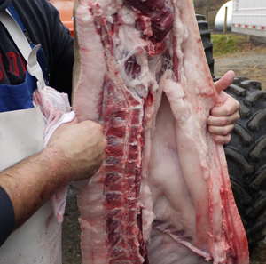
Visceral Fat
Located within the body cavity
  Surrounds locations that require protection and insulation
One of the first depots to develop

Slide 5
Visceral Fat
Mesenteric Fat
  Located around the intestines
Caul Fat
  Thin sheet of adipose tissue contained in a large fold of connective tissue over the stomach and adjacent organs
Perirenal Fat
  Protective fat around the kidneys
  Also called kidney fat

Slide 6
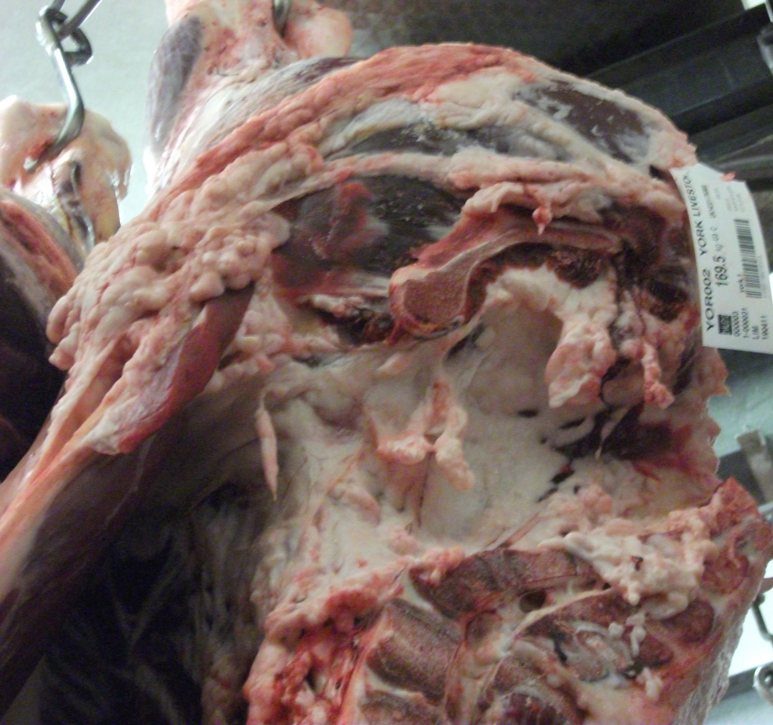
Visceral Fat
Leaf Fat
  Located between the lining of the thoracic cavity and the ribs in mammalian meat animals

Slide 7
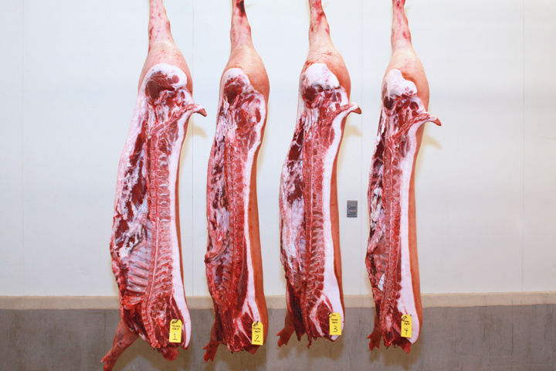
Subcutaneous fat
Located just under the skin or hide
Also referred to as back fat
Largest depot of fat in pork carcasses

Slide 8
Subcutaneous fat
Outer Layer- First to develop
  Acts as insulation for the animal
Middle Layer- Second to develop
  Normally thickest postnatally
  Most metabolically active
Inner Layer- Last layer to develop
  Small and thin
  Can be difficult to detect in lean animals

Slide 9
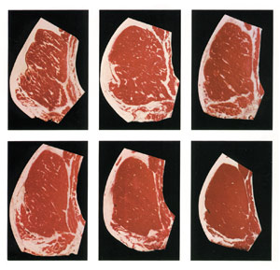
Intermuscular Fat
Located around and in between individual muscles or groups of muscles
Also called “seam fat”
Associated with the epimysium of muscles
Development of subcutaneous and intermuscular depots may be interchangeable

Slide 10
Intramuscular fat
Last fat depot to develop
Also called marbling
Associated with the perimysium that surrounds muscle fiber bundles
Related to the eating quality of meat

Slide 11
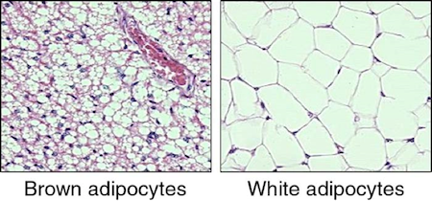
Brown Fat
Exists at birth and contains more/larger mitochondria than white fat
Important for generation of heat in the neonate

Slide 12
Adipogenesis
Increased vascularization of the connective tissue during early stages
Lobules (groups of adipoblasts) form and are enclosed by a collagenous sheath

Slide 13
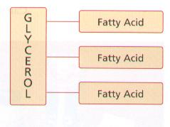
Adipocyte lipids
Adipocytes can store fatty acids, but not triglycerides
The glycerol must be removed to free the fatty acids for storage
Three fatty acids must be rejoined to a glycerol once inside the adipocyte.

Slide 14
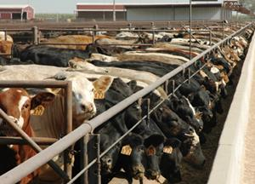
Adipose tissue metabolism
Rate of fat deposition is a function of:
  Absorption of FAs from the blood
  FA synthesis and triglyceride formation
  Lipolysis

Slide 15
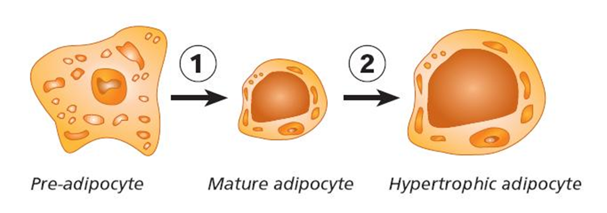
Adipogenesis
Once preadipocytes begin to mature they will collect lipid droplets
  Multilocular
  Unilocular

Slide 16
Adipocyte Hyperplasia
Much adipocyte hyperplasia occurs prenatally
However, additional cells can be recruited postnatally
Recruitment has binomial distribution

Slide 17
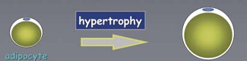
Adipocyte Hypertrophy
Adipoblasts are < 20 µm in diameter
Mature adipocytes ~ 120 µm in diameter
Lipid droplet can make up >95% of the cytoplasmic volume.
  Nucleus is forced toward the outer membrane

Slide 18
Lipogenesis
Adipose tissue is the major site of lipogenesis in cattle, sheep, and pigs
The liver is the major site of lipogenesis in avian species

Slide 19
Factors affecting adipose composition and lipid metabolism
Age
Location
Species
Genetic selection
Sex
Hormones
Nutrition
Environment

Slide 20
Cellularity and Age
The amount of lipid increases, as a percentage of the tissue weight, in older animals
As we enter the fattening stage of the growth curve we slow growth of other tissues, leaving more energy to be stored as fats.

Slide 21
Anatomical location
Fat depots develop at different times
  Some are larger than others based on which developed first
Intramuscular adipocytes may account for 50% of the total NUMBER of adipocytes, but may represent only 10% of the total LIPID.

Slide 22
Anatomical location

Slide 23
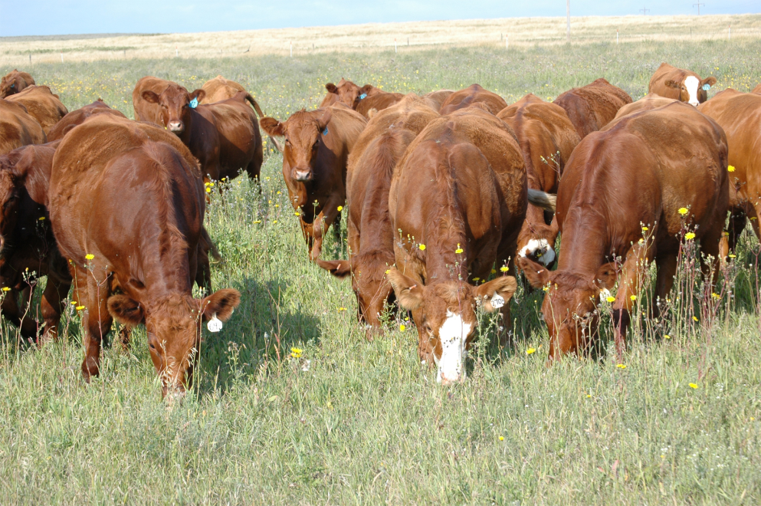
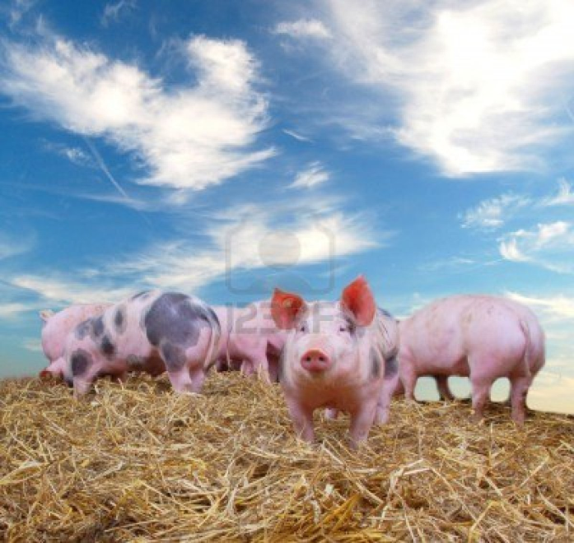
Species
Monogastric vs. Ruminants
Microbes cause hydrogenation of fatty acids that enter the rumen
  Converts unsaturated fatty acids to saturated fatty acids.

Slide 24
Genetics
In the 1950’s and 60’s genetic lines of pigs may have had 5 cm of back fat at market weight
Now pigs may have a few mm at market weight

Slide 25
sex
Testosterone inhibits lipid deposition.
Increased fatness seen in females is associated with a greater SIZE of adipocytes rather than a greater number.
  Due to estrogenic hormones

Slide 26

hormones
In addition to sex hormones, Leptin plays a major role in nutrient partitioning
Leptin is associated with feed intake and appetite, and are seen in higher levels in obese animals.

Slide 27
Nutrition
High fat diets depress FA synthesis while low fat diets increase de novo synthesis rates.
The presence of high amount of marbling generally indicates the animal was fed on a high plane of nutrition.
Diets with amino acid deficiencies often result in increased lipogenesis due to the excess energy

Slide 28
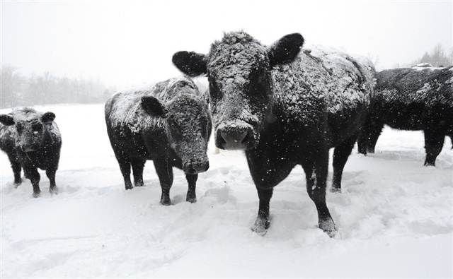
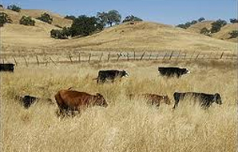
Environmental Temperature
Animals exposed to low temperature will mobilize adipose tissue to support heat production.
At high temperatures feed intake is depressed so as to inhibit heat producing processes.

Slide 29
Objectives
Know the four locations fat is deposited
Explain adipogenesis
Explain lipogenesis
Compare and contrast the different factors affecting lipid metabolism

