Slide 1
Planning and Visioning
A Team Approach to Integrating Strategic Planning, Budgeting, and External Parameters to Frame the University Vision

Slide 2
Major Strategic Components
Planning , Programming, and Assessment
Budgeting and Fiscal Operations
External Parameters
Enrollment Management
VISION

Slide 3
Strategic Planning Process Flow
External Factors
Competitive Environment
(CC, Private, Public, For-Profit)
President’s Circle and other university advisory boards
Competitive Environment
(CC, Private, Public, For-Profit)
Legislative Initiatives
(Federal and State)
Texas State University S
Legislative Initiatives
(Federal and State)
THECB and TSUS Offices
Texas Higher Education Coordinating Board
SHSU Strategic Planning
Strategic Enrollment Planning
Physical Marketing, Student Plan Recruitment Plan Academic Plan Budget Plan Retention Plan Service Plan
Clear Goals
Strategies
Detailed Action Plans
Objectives, Timetables, Responsibility, Budgets, Evaluation for Continuous Improvement

Slide 4
The THECB has heightened its focus on four areas where Texas is well below its 2015 Target
CLOSING THE GAPS GOALS
Closing the Gaps Areas Well
Below Target
Close the Gaps in Participation
Participation of Hispanic Students and African American Male Students
Success of Hispanic and African American Students
Close the Gaps in Success
Accelerated Plan Focus Areas
STEM Degrees
Close the Gaps in Excellence
Teachers Certificates and Effectiveness
Close the Gaps in Research
Nursing Awards
Research Funding
While nursing awards and research funding are also below CTG targets, these areas already have legislative support and momentum.
THECB – Aug 2012
Notes:
In 2010, we identified key areas where progress lagged.
We have focused on these areas with a variety of initiatives and investments (where possible) to accelerate progress.

Slide 5
Outcomes-Based Funding for Universities Metrics for Measuring Student Success
Critical Workforce Needs (Double Weight)
Degrees awarded in fields identified as critical workforce needs.
Total Undergraduate Degrees
Total Bachelor’s Degrees awarded at the institution
Institutional Mission
Bachelor’s Degrees awarded per 100 full time student equivalents (FTSE)
Persistence
Points awarded for students who complete their 30th, 60th, or 90th hour at the institution
At-Risk Student
Degrees awarded to students who meet federal criteria for being at high risk of dropping out.
Time-to-Degree
Bachelor’s Degrees awarded times the institution’s six-year graduation rate
Cost-to-Degree
Bachelor’s Degrees awarded adjusted for instructional costs
THECB – Aug 2012

Slide 6
THECB Key Strategies and Initiatives
SHSU Strategic Enrollment Management Planning Goals
Expanding Access to Higher Education
Restructuring Financial Aid
Low-cost degrees
Institutionalizing LEAN culture of continuous improvement
Strengthening Community Colleges
(Including improving transfer and aligning outcomes with workforce needs)
Sustaining collaboration with P-12
College Readiness
Professional Development for Teachers
Goal 1: Increase the size, diversity, quality, and success of the Total Undergraduate Student Body
Goal 2: Increase the size, diversity, quality, and success of the total Graduate Student Body
Goal 3: Provide excellent student services and programs to enhance retention for all classifications and ethnic groups (Student Services Plan)
Goal 4: Collaborate and coordinate with academic departments and faculty to produce and implement the Academic Program plan
Goal 5: Enhance and provide timely marketing and recruiting initiatives
Notes:
We are working on a number of key initiatives that are highlighted in this slide and I will briefly discuss.
FIRST, we must continue to expand access to higher education.
One of the main obstacles to access is cost and we must have a comprehensive strategy to address this issue.
In 2010, the Coordinating Board adopted a series of recommendations and strategies to improve cost-efficiency at our public institutions.
The goal was to identify ways to bend the cost curve in higher education without sacrificing quality.
Many of these initiatives are currently being implemented by institutions around the state and the Governor recently requested the Coordinating Board to survey institutions as to their progress.
Higher education, like all other facets of government and private industry, must help control costs.
In addition to controlling costs, the Coordinating Board has been looking at ways to stretch limited financial aid dollars further.
While the state has significantly increased financial aid appropriations, demand is far outpacing resources.
The old system of financial aid that maximizes dollars to a few and provides little incentive for students to complete on time and with as few credits as possible is no longer feasible.
Finally, we are working aggressively with institutions across the state to realize the challenge by the Governor to provide pathways for a $10k degree.
Not all degrees and not all institutions can meet this challenge, but we must find innovative approaches to provide a less expensive pathway to postsecondary education, particularly for our non-traditional student population.

Slide 7
THECB Key Strategies and Initiatives
SHSU Strategic Enrollment Management Planning Goals
Goal 4: Collaborate and coordinate with academic departments and faculty to produce and implement the Academic Program plan
Goal 5: Enhance and provide timely marketing and recruiting initiatives
Goal 6: Provide quality facilities and support services
Goal 7: Connect the SEM plan to the financial plan of the institution (Finance/Budget Plan)
Improving higher education outcomes
Reinventing Developmental Education/ABE
Outcomes-based Funding for Institutions
Notes:
We are working on a number of key initiatives that are highlighted in this slide and I will briefly discuss.
FIRST, we must continue to expand access to higher education.
One of the main obstacles to access is cost and we must have a comprehensive strategy to address this issue.
In 2010, the Coordinating Board adopted a series of recommendations and strategies to improve cost-efficiency at our public institutions.
The goal was to identify ways to bend the cost curve in higher education without sacrificing quality.
Many of these initiatives are currently being implemented by institutions around the state and the Governor recently requested the Coordinating Board to survey institutions as to their progress.
Higher education, like all other facets of government and private industry, must help control costs.
In addition to controlling costs, the Coordinating Board has been looking at ways to stretch limited financial aid dollars further.
While the state has significantly increased financial aid appropriations, demand is far outpacing resources.
The old system of financial aid that maximizes dollars to a few and provides little incentive for students to complete on time and with as few credits as possible is no longer feasible.
Finally, we are working aggressively with institutions across the state to realize the challenge by the Governor to provide pathways for a $10k degree.
Not all degrees and not all institutions can meet this challenge, but we must find innovative approaches to provide a less expensive pathway to postsecondary education, particularly for our non-traditional student population.

Slide 8
Recruitment and Retention Committee Initiatives
SEM Goals
Initiative 1: International Student Recruitment Plan
Identify target populations
Develop Marketing Plan
Modify admission processes
Initiative 2: Student Success Formula
Create new PREP formula
Develop predictive model for enrollment projections
Initiative 3: Transfer Initiative Council
Identify all transfer enrollment and retention efforts on campus
Coordinate efforts and develop a Transfer student plan
Initiative 4: Retention Plan
Identify and document all retention efforts on campus
Connect efforts to Career Services and success data tracking
Goal 1: Increase the size, diversity, quality, and success of the Total Undergraduate Student Body
Goal 2: Increase the size, diversity, quality, and success of the total Graduate Student Body
Goal 5: Enhance and provide timely marketing and recruiting initiatives

Slide 9
SEM Goals
Inter-divisional Initiatives
Competitive Marketing Team
Optimization of web searches and navigation
Consistency in online information and services
Undergraduate Program Marketing
Develop formal plans and materials for 12 programs
Provide maintenance funds annually
Graduate Hobson’s/Recruiting
Converting graduate prospect database to integrated Hobson’s database
Enhance targeted graduate marketing
Office of Institutional Effectiveness
Institutional resources data collection and reporting
Legislative tracking
Administrative assessment
Office of Academic Planning and Assessment
Coordination of Academic planning and assessment
Student COGNOS data reporting
Space Utilization Analysis
Identify spaces deemed under-utilized by THECB measures
Optimize THECB score
Efficiency Task Force
Identify operational inefficiencies from staff perspective
Incorporate efficiency efforts into divisional and institutional initiatives
Campus Master Plan
Goal 3: Provide excellent student services and programs to enhance retention for all classifications and ethnic groups (Student Services Plan)
Goal 4: Collaborate and coordinate with academic departments and faculty to produce and implement the Academic Program plan
Goal 6: Provide quality facilities and support services
Goal 7: Connect the SEM plan to the financial plan of the institution (Finance/Budget Plan)

Slide 10
Institutional Strategic Planning Process Communicate and Develop Inter-divisional Strengths
Division Goals
External
Academic Plan
Retention Plan
Budget Plan
Marketing/Recruiting Plan
Student Services Plan
Advancement Plan
Technology Plan
Institutional Goals
Department Goals
SEM
Institutional Initiatives
Recruitment and Retention Committee
Inter-divisional Initiatives

Slide 11
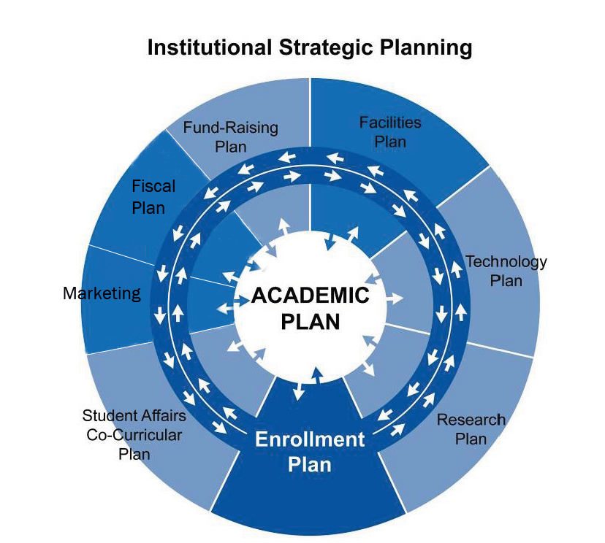
Institutional Strategic Planning Philosophy Every Facet of the Mission is Critical

Slide 12
Pulling Together with Purpose Maintaining a High Performance Team Concept
Balance in Purpose
Focus on accomplishing tasks
Maintain healthy work relationships and awareness of greater purpose
Understand the Obstacles
Changing demographics
Decreasing budgets
Changing business models
Increasing workloads
Communicate
Engage colleagues
Collaborate with colleagues
Develop action plans
Assess and improve
Note: “Pulling Together with Purpose” Business Officer September 2011

Slide 13
Pulling Together with Purpose Being an Effective Team Member
Engender Trust Among Colleagues
Integrity
Authenticity
Compassion
Respect Your Team Members
Recognition of task accomplishments
Emphasize importance of professional relationships
Commit to the Mission
Purpose is bigger than yourself
Leave room for disagreement
Manage Conflict
Do not personalize work conflicts
The conflict does not matter, it’s how it is handled
Note: “Pulling Together with Purpose” Business Officer September 2011

Slide 14
Pulling Together with Purpose Being an Effective Team Member
Focus on Results
Individual successes
Team successes
Assessment and Accountability
Self evaluation as a team member
Improving the total outcome
We win together, we lose together
Note: “Pulling Together with Purpose” Business Officer September 2011

Slide 15
Pulling Together with Purpose Being an Effective Team Member
Ability is what we are capable of doing
Motivation determines what you do
Attitude determines how well you do it
Individual Task Oriented
Team Mission Oriented
Note: Lou Holtz, Former college football coach and ESPN commentator

Slide 16
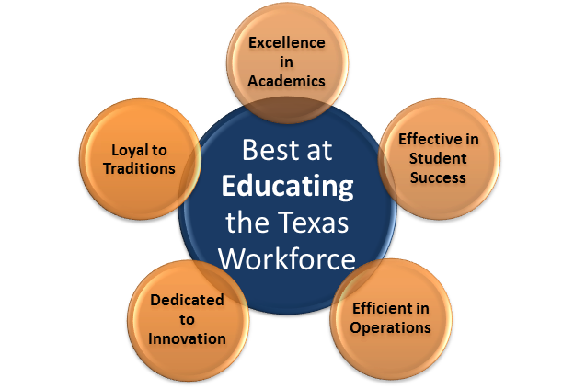
University Vision and Goals
Foster a lifelong learning environment in support of a diverse faculty and staff who are excellent scholars, educators, and professionals.
Promote a stimulating learning environment through the integration of academic settings, campus culture and service.
Increase and develop university resources and infrastructures that support the intellectual transformation of students.
Enhance marketing outreach and visibility to include academic and scholarly activities through consistent and integrated messaging while optimizing communication channels.
Promote efficient data driven decision making through the integration of centralized data analysis, review and dissemination.
Cultivate a continually sensitive and proactive response to the ever-changing needs of our constituents.

