Slide 1
Texas Rural Internship Program June 2013
Ednisha peel
Giddings, TeXas

Slide 2
About Myself
Marlin, Texas (population of 6,628)
Graduated from Rosebud-Lott in 2010
Went to Lon Morris College in Jacksonville, Texas where I earned a associated degree in Psychology
Senior at SHSU
Double major in Psychology and Communication Studies with a minor in Sociology
Crisis Counseling

Slide 3
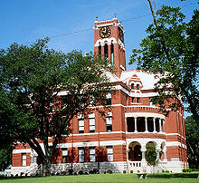
Giddings Texas: “Experience Hometown Hospitality”
Giddings is located at the intersection of Highway 290 and Highway 77
Founded in 1871
Giles Giddings
Lee County was established in 1874
The Lee County Courthouse in Giddings, built in 1899

Slide 4
The community and the people
4,897 (as of 2011)
Well-Known (Texas Weekly)
Organized
Weekly Activities & Meetings
Busy
Great Restaurants
Very Friendly
Welcoming
Family Oriented
Knows Everyone
Caring

Slide 5
Overall Review
What I expected going into the internship
What I gained from the internship
Youth Internship
Food Pantry
Lee County Youth Center
Lions Club & Rotary Club
Will I do it again
How do I view myself as a person since the internship
Mrs. Denice Harlan, Kelita Alberts and the Noack’s

Slide 6
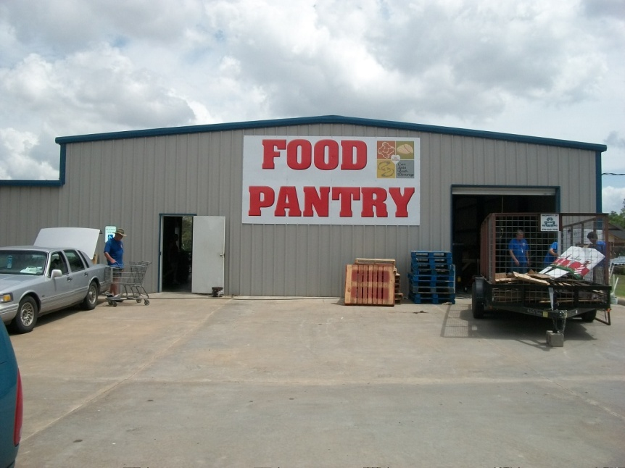
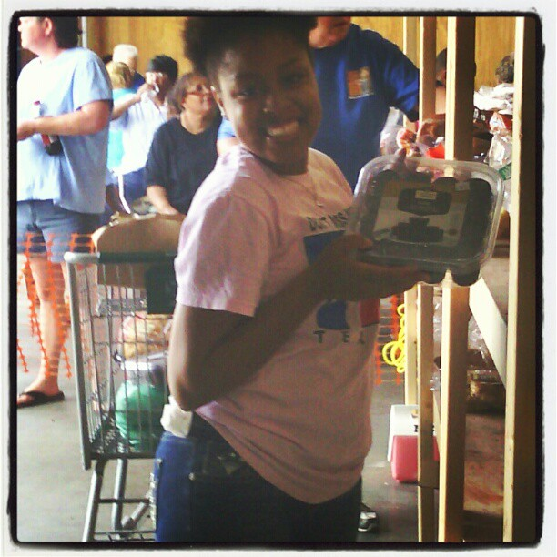
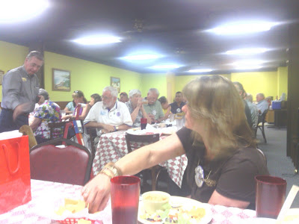
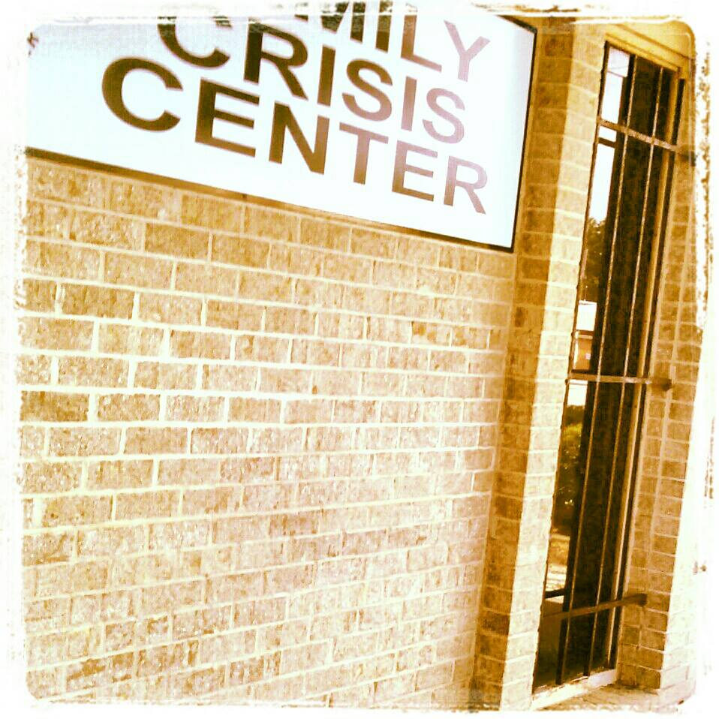
Putting together bags for the round top institute festival “youth internship”

Slide 7
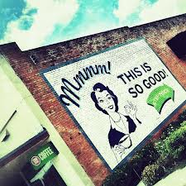
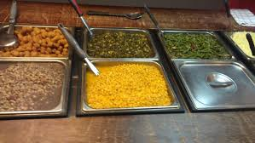

Slide 8
Rural Texas Tourism Center

Slide 9
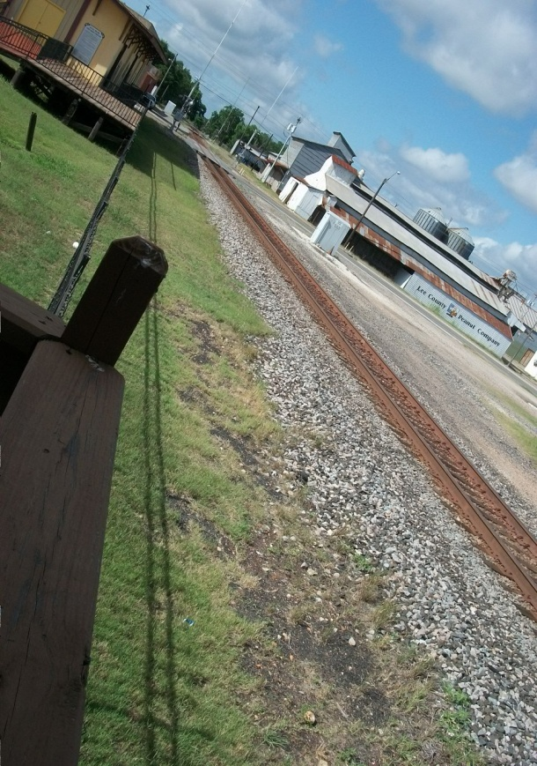
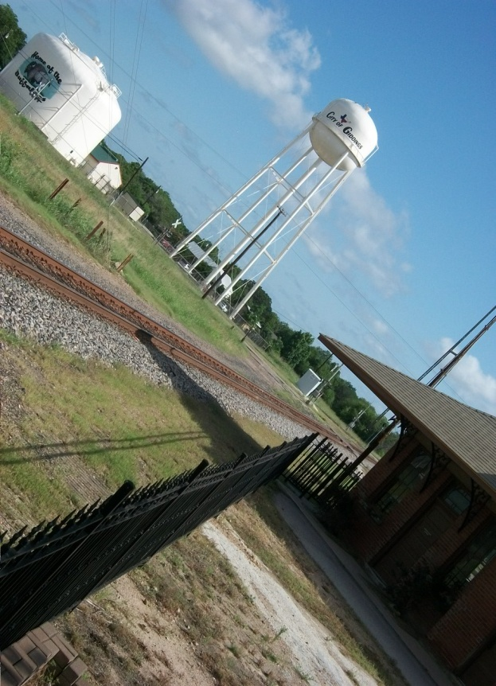

Slide 10
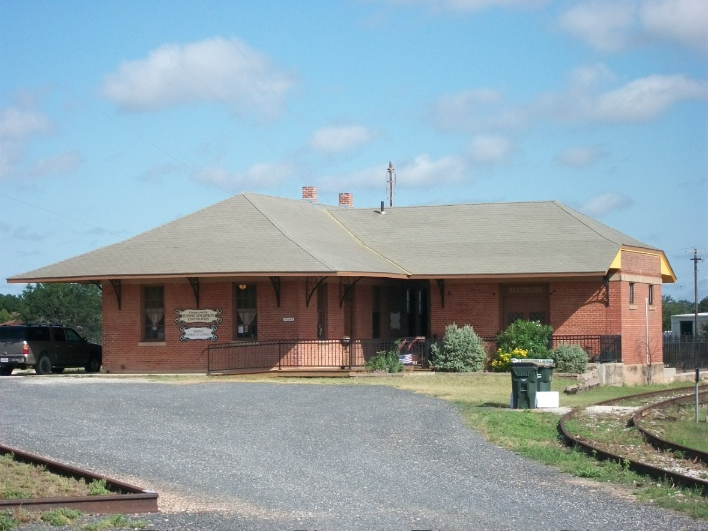
Economic Development Corporation and Chamber of Commerce

Slide 11
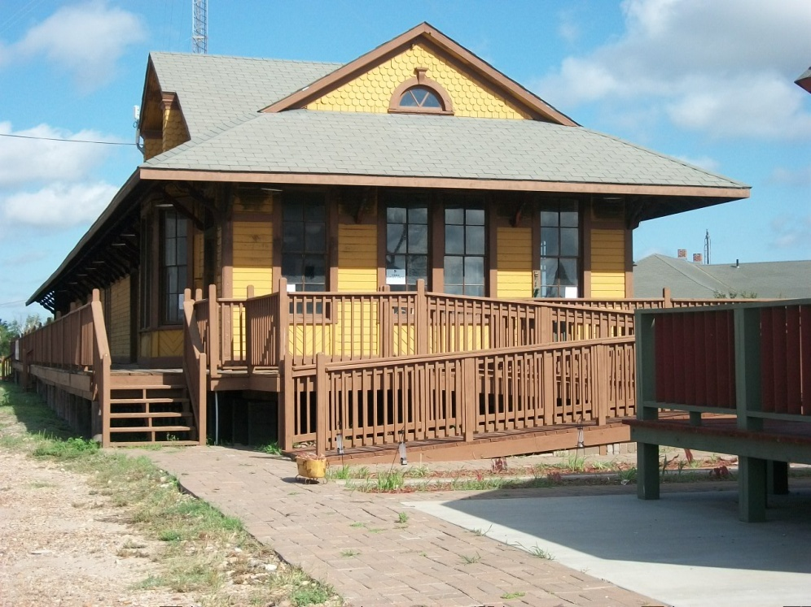
1900's Antique Carousel & Union Station Transportation Museum

Slide 12
Theater 'One Act'

Slide 13
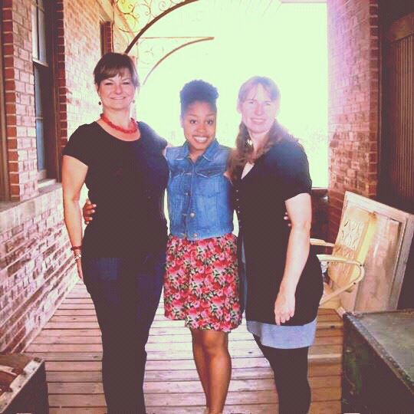
Thank You!!!

