Slide 1
Sick Animals
Jess Curbo

Slide 2
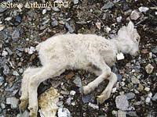
What’s Wrong?

Slide 3
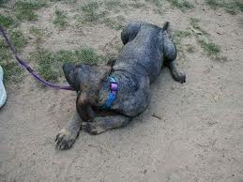
What’s Wrong?

Slide 4
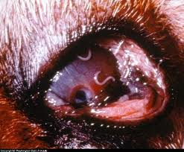
What’s Wrong?

Slide 5
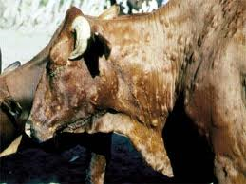
What’s Wrong?

Slide 6
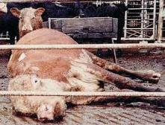
What’s Wrong?

Slide 7
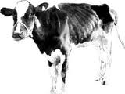
What’s Wrong?

Slide 8
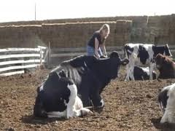

Slide 9
